Slide 1
Maintenance
Iverson

Slide 2
CONTENT
01
02
03
Fuse
IGBT
Soft Start Resistor

Slide 3
Fuse Testing
Iverson

Slide 4
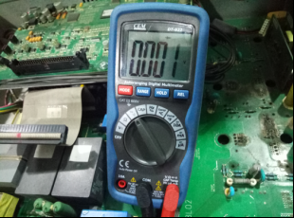
_{S} Fuse Testing-AHF
Equipment: electricity Multimeter
Setting: Resistor Band
Good: the resistor value is close to 0
Fault: the resistor value is close to infinity
Iverson

Slide 5
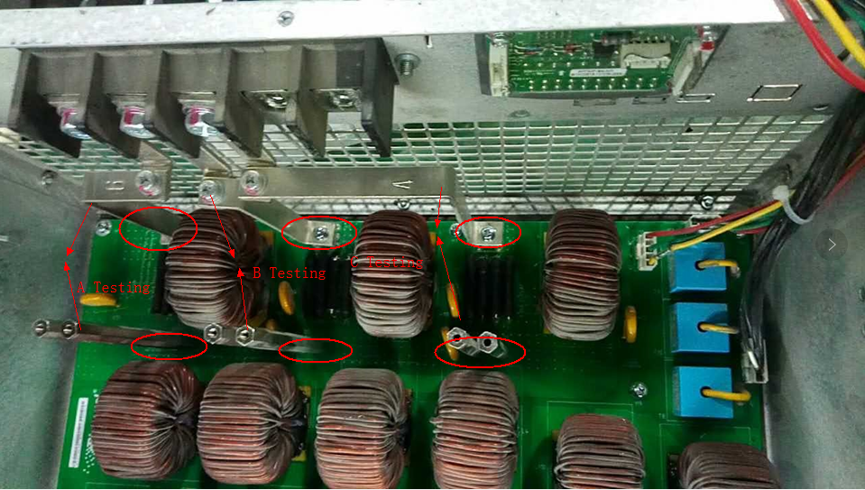
_{S} Fuse Testing-AHF
Iverson
Notes:
铜柱：copper cylinder
铜排：basbur

Slide 6
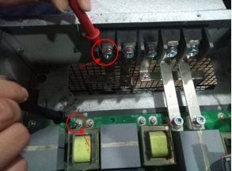
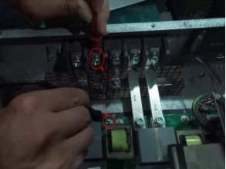
_{S} Fuse Testing-AHF
Iverson

Slide 7
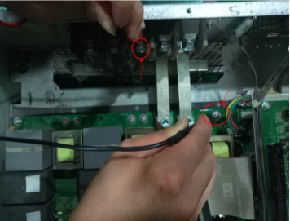
_{S} Fuse Testing-AHF
Iverson

Slide 8
_{S} Fuse Testing-AHF
Equipment: electricity Multimeter
Setting: Resistor Band
Good: the resistor value is close to 0
Fault: the resistor value is close to infinity
Iverson

Slide 9
IGBT Testing
Iverson

Slide 10
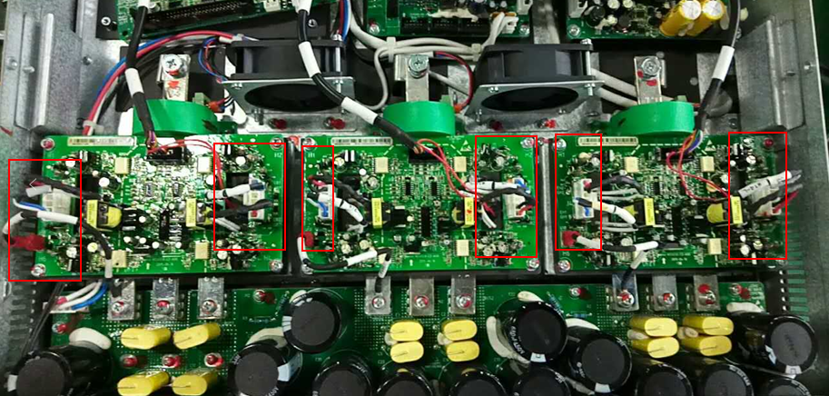
_{S} IGBT Testing-Three Types
Socket Type IGBT
Iverson

Slide 11
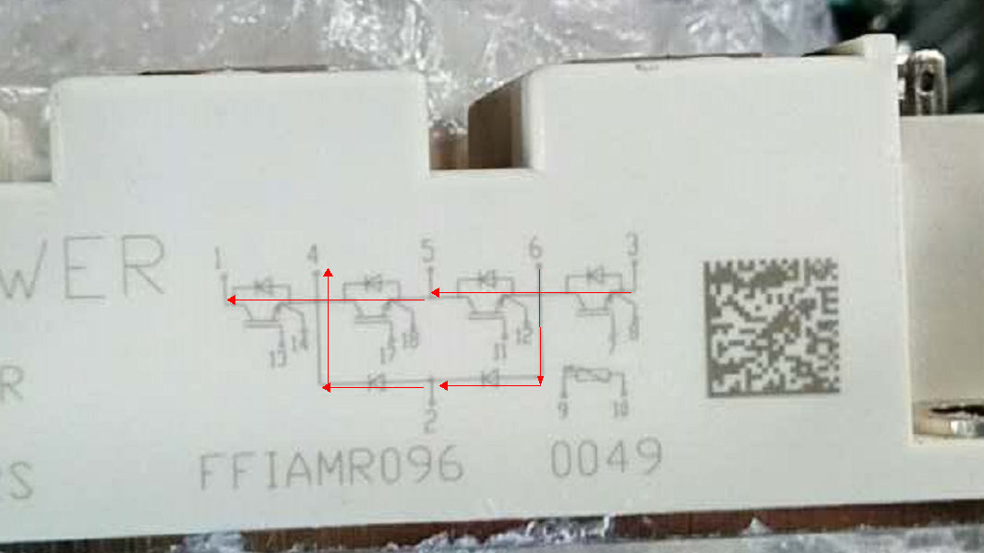
_{S} IGBT Testing-Three Types
Socket Type IGBT
IGBT Testing point is for diode
Four Testing point
From 3 to 5 ;
From 5 to 1;
Useful : Both Two diode means voltage is about 0.66V
From 6 to 2 ;
From 2 to 4 ;
Useful : Both Only one diode, means voltage is about 0.33V
Iverson

Slide 12
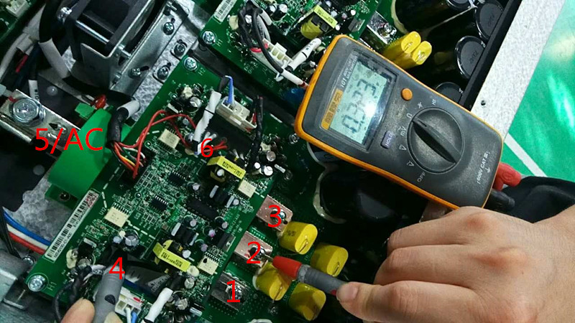
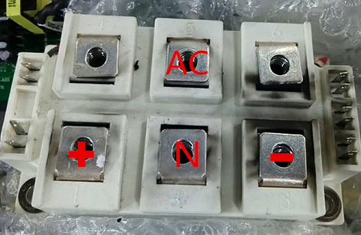
_{S} IGBT Testing-Three Types
Socket Type IGBT
Iverson

Slide 13
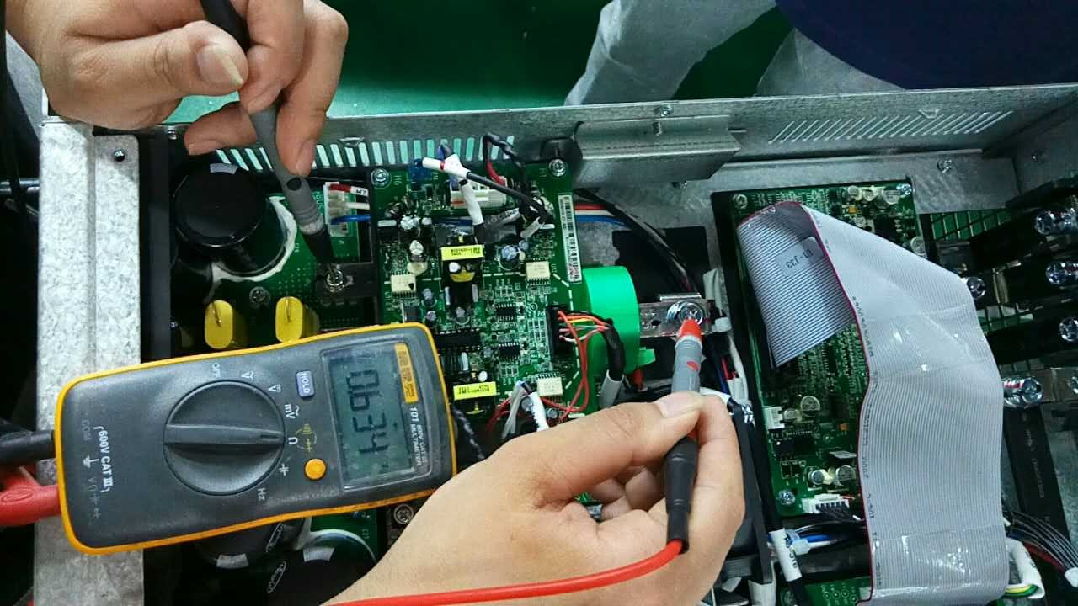
_{S} IGBT Testing-Three Types-Socket Type IGBT
Testing point (From 5 to 1)-0.66V
Iverson

Slide 14
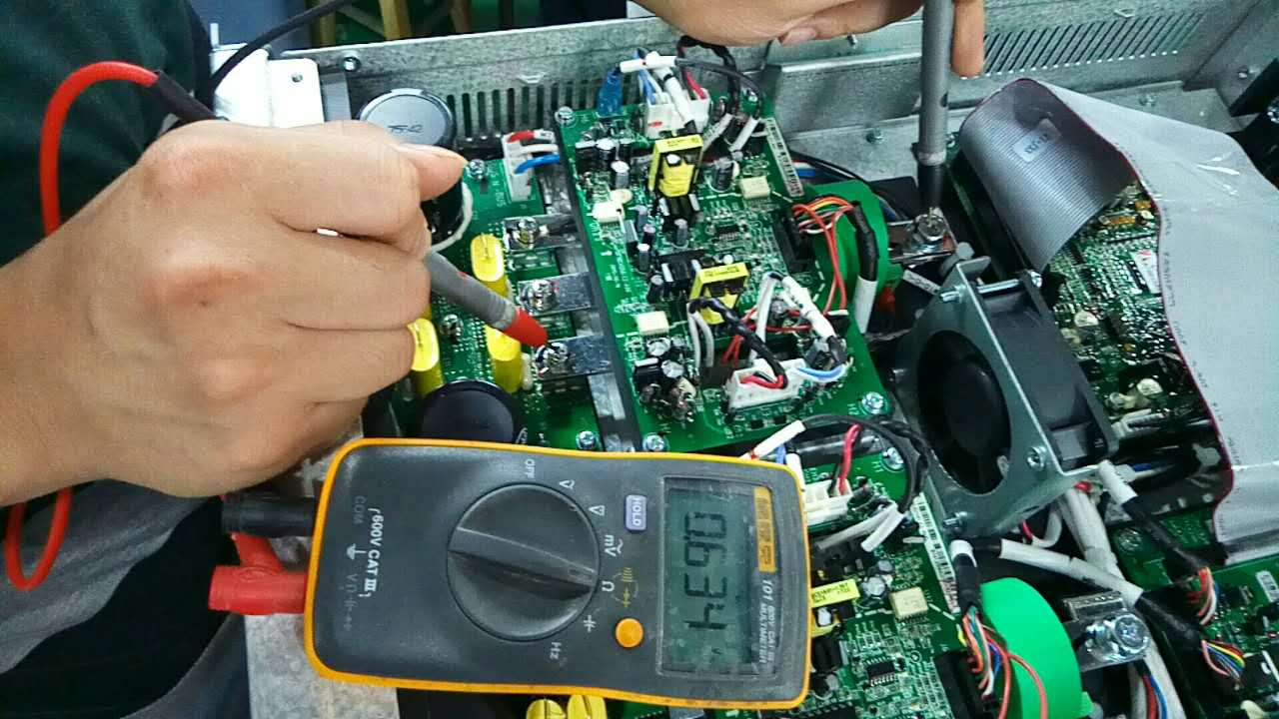
_{S} IGBT Testing-Three Types-Socket Type IGBT
Testing point (From 3 to 5)-0.66V
Iverson

Slide 15
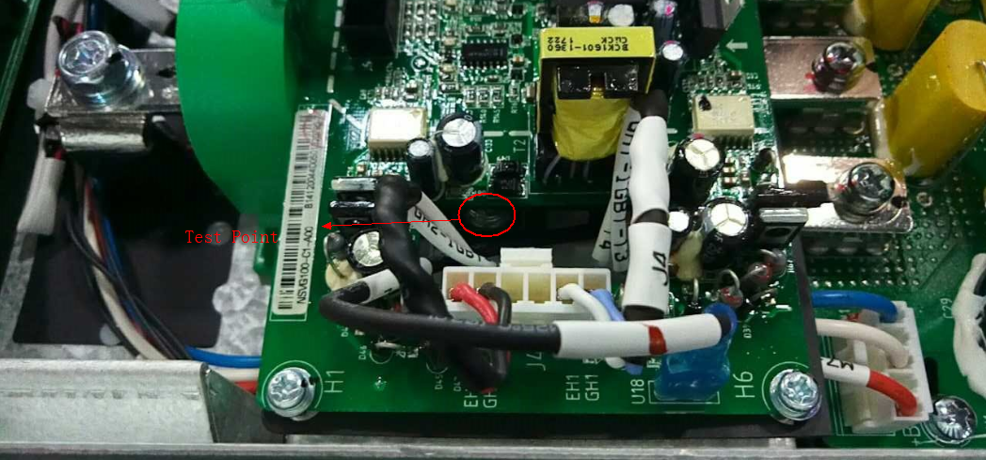
_{S} IGBT Testing-Two Types-Socket Type IGBT
4 and 6 Testing Point
Iverson

Slide 16
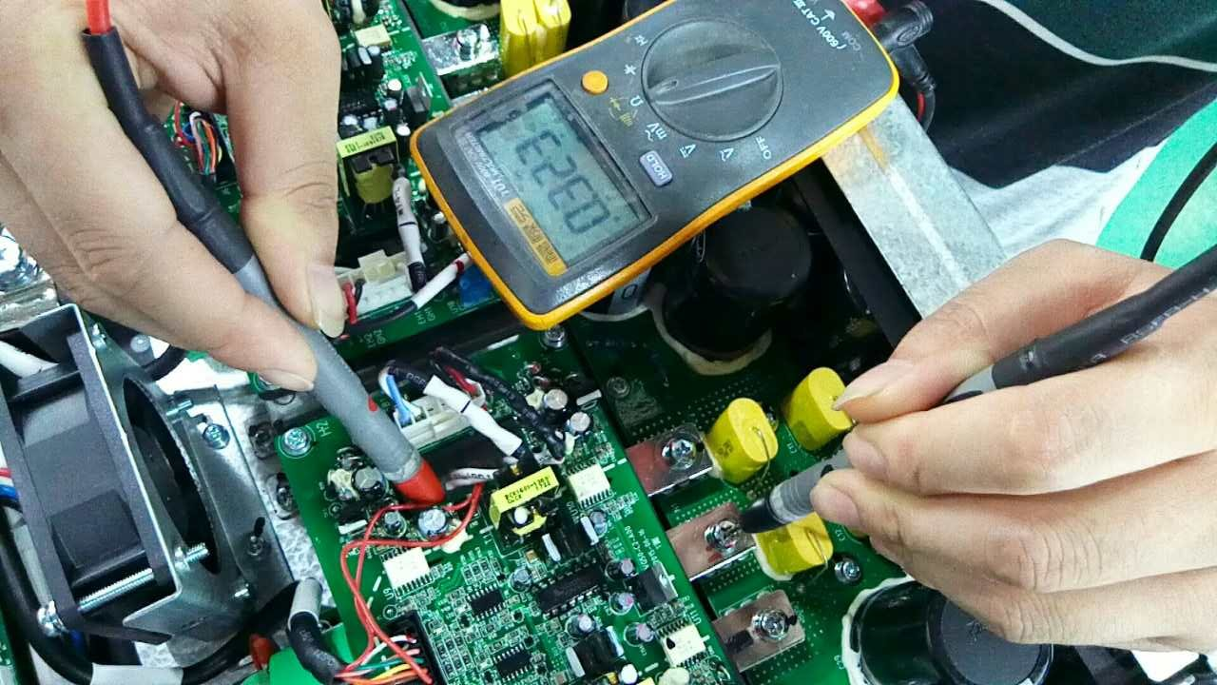
_{S} IGBT Testing-Three Types-Socket Type IGBT
Testing point (From 6 to 2)-0.33V
Iverson

Slide 17
_{S} IGBT Testing-Three Types-Socket Type IGBT
Testing point (From 4 to 2)-0.33V
Iverson

Slide 18
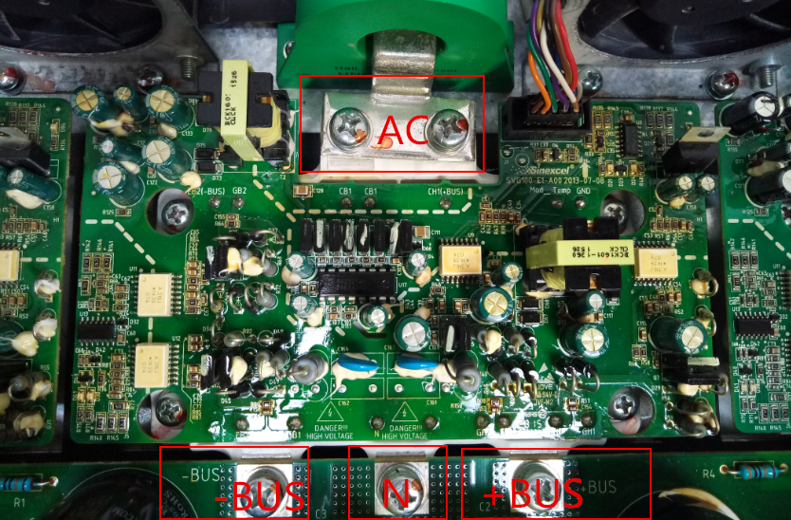
_{S} IGBT Testing-Three Types-For Plug One
Iverson

Slide 19
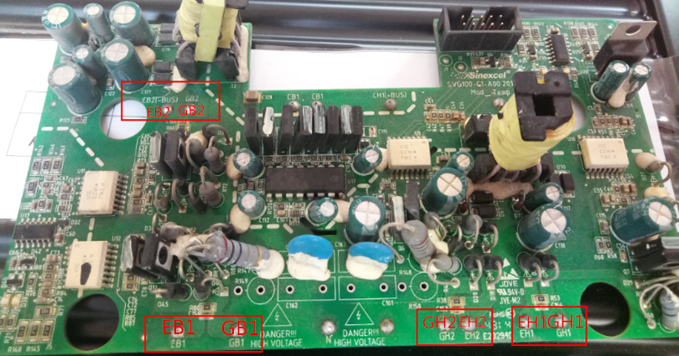
_{S} IGBT Testing-Three Types-For Plug One
Iverson

Slide 20
_{S} IGBT Testing-Three Types-For Plug One
Testing Point: “EH1” – “+BUS”
“N” – “EH1”
“(AC)EH2”—EH1
“-BUS” –”EB1”
“EB1” – “N”
“EB1” –”AC”
Iverson

Slide 21
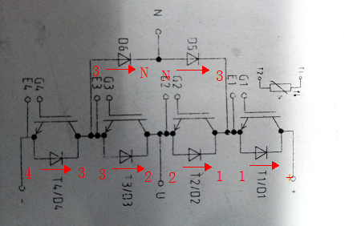
_{S} IGBT Testing-Three Types
Integrate Type IGBT
6 Testing Points
“–” to “ 3 “ - 0.33V
“ 3 ” to “ 2 ” - 0.33V
“ 2 “ to “ 1” - 0.33V
“ 1 “ to “ - ” - 0.33V
“ 3 ” to “ N ” - 0.33V
“ N ” to “ 1 ” - 0.33V
- /
Iverson

Slide 22
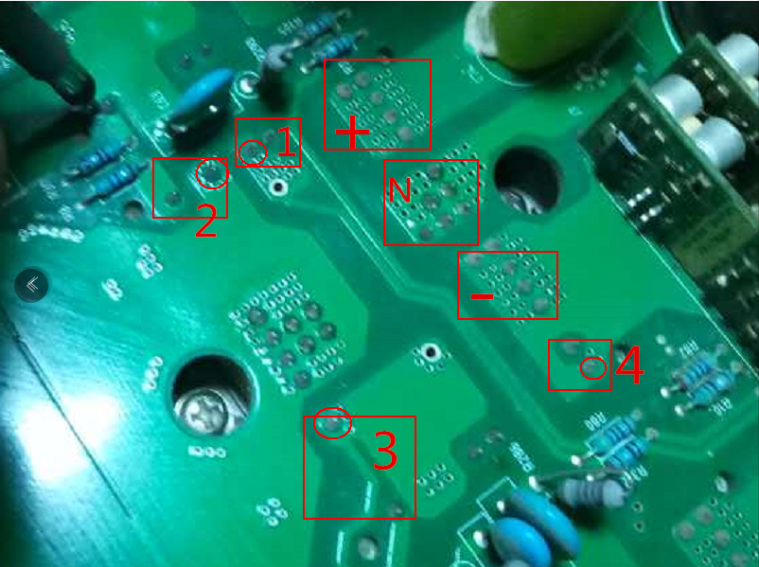
_{S} IGBT Testing-Three Types-integrate Type IGBT
Integrate Type IGBT
Iverson

Slide 23
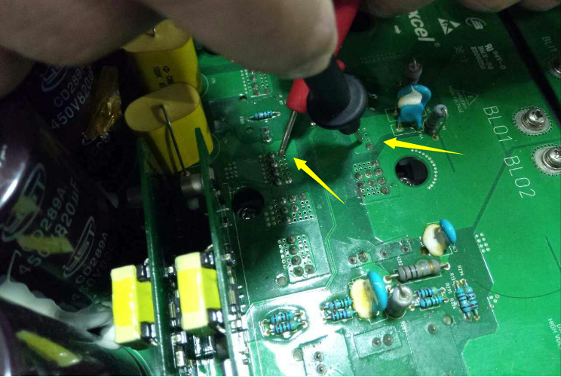
_{S} IGBT Testing-Three Types-integrate Type IGBT
Testing point (From — to 3)-0.33V
Iverson

Slide 24
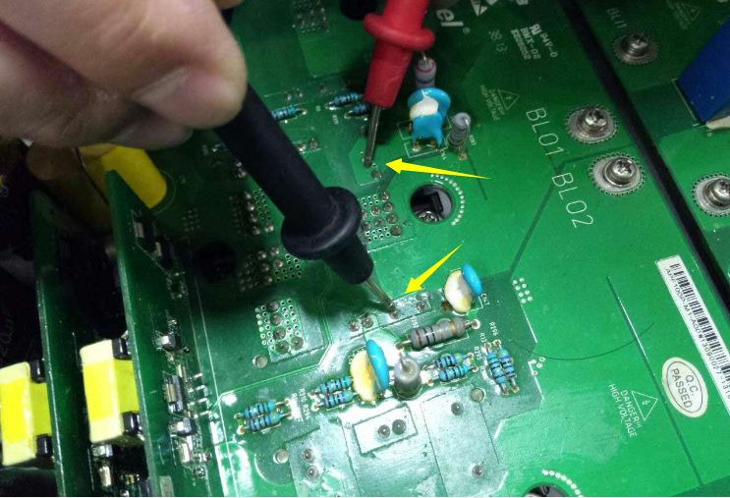
_{S} IGBT Testing-Three Types-integrate Type IGBT
Testing point (From 3 to 2)-0.33V
Iverson

Slide 25
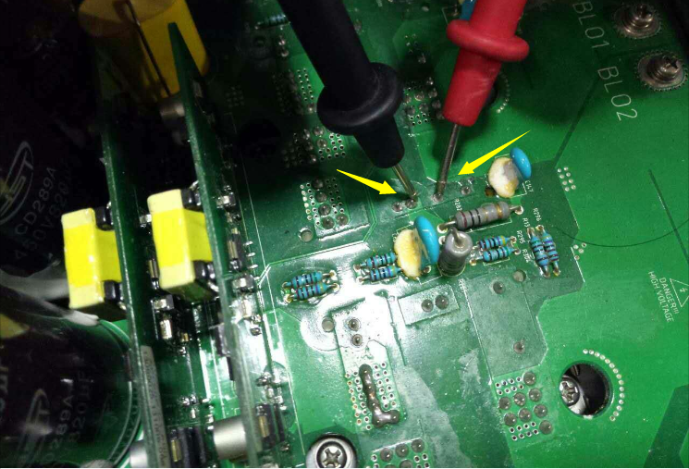
_{S} IGBT Testing-Three Types-integrate Type IGBT
Testing point (From 2 to 1)-0.33V
Iverson

Slide 26
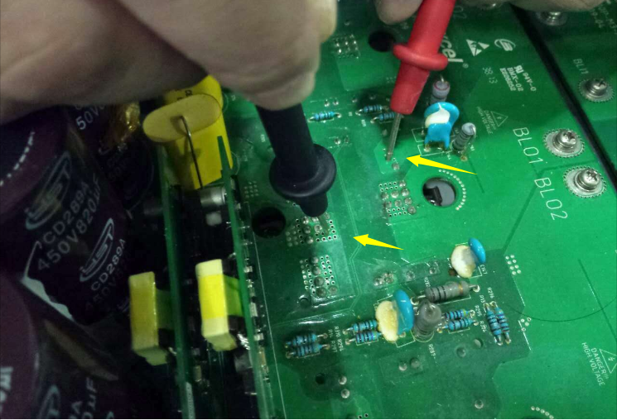
_{S} IGBT Testing-Three Types-integrate Type IGBT
Testing point (From 3 to N )-0.33V
Iverson

Slide 27
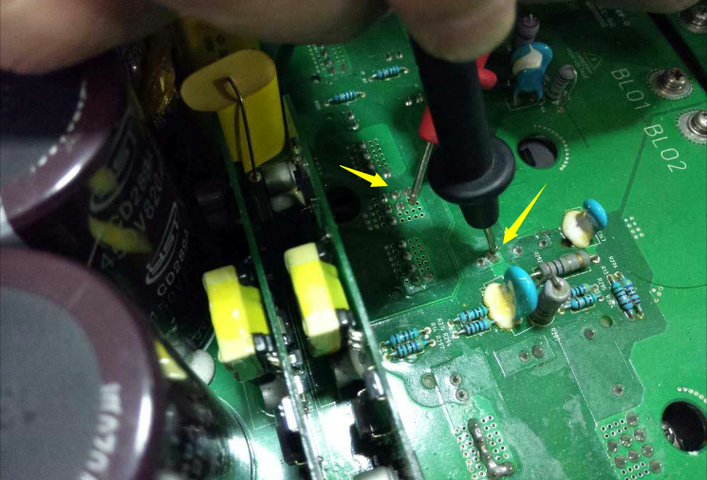
_{S} IGBT Testing-Three Types-integrate Type IGBT
Testing point (From N to 1)-0.33V
Iverson

Slide 28
Soft Start Resistor
Iverson

Slide 29
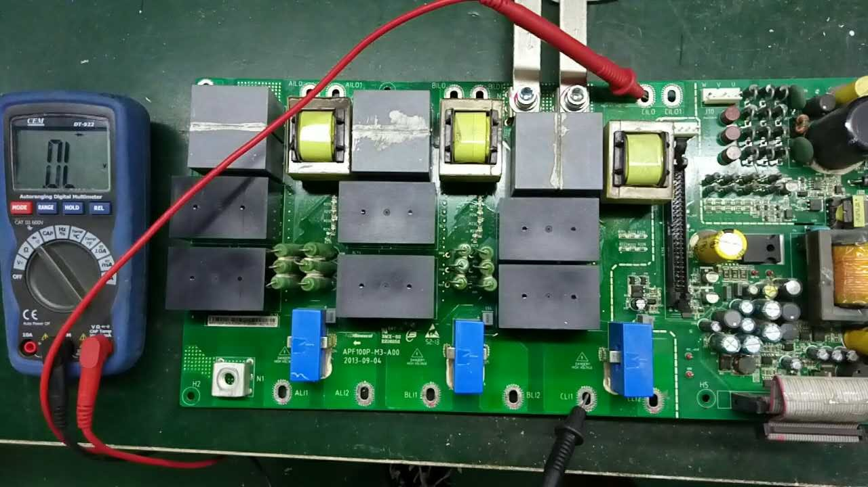
_{S} Soft Start Resistor Testing-AHF-Function normally
Iverson

Slide 30
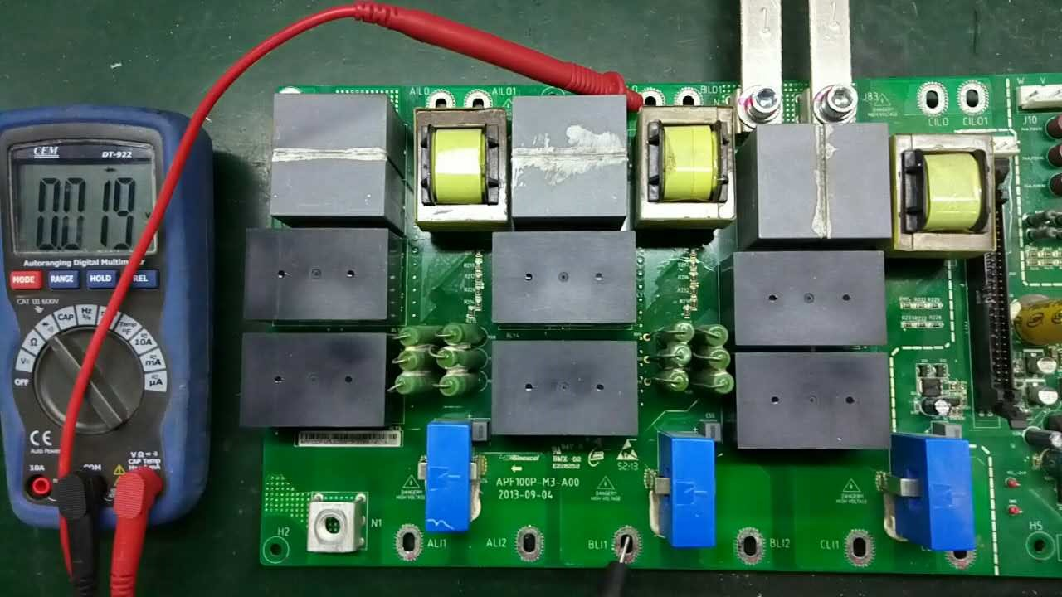
_{S} Soft Start Resistor Testing-AHF-Function normally
Iverson

Slide 31
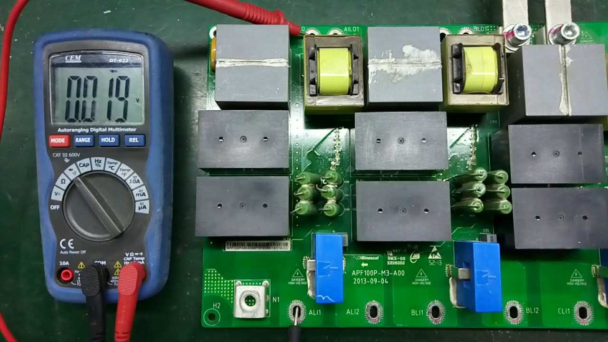
_{S} Soft Start Resistor Testing-AHF-Function normally
Iverson

Slide 32
_{S} Soft Start Resistor Testing-AHF-Notice
Notice
1、Only two phase have soft start resistor
2、With the soft start resistor, and if the multimeter shows infinity, means soft start resistor broken.
3、because the relay is parallel with the soft start resistor, and if the multimeter shows 0L, and it means the relay fault.
(Normal condition: Relay is off)
Iverson

