Slide 1
WIFI Monitoring System
Sinexcel Electric
Shenzhen·China

Slide 2
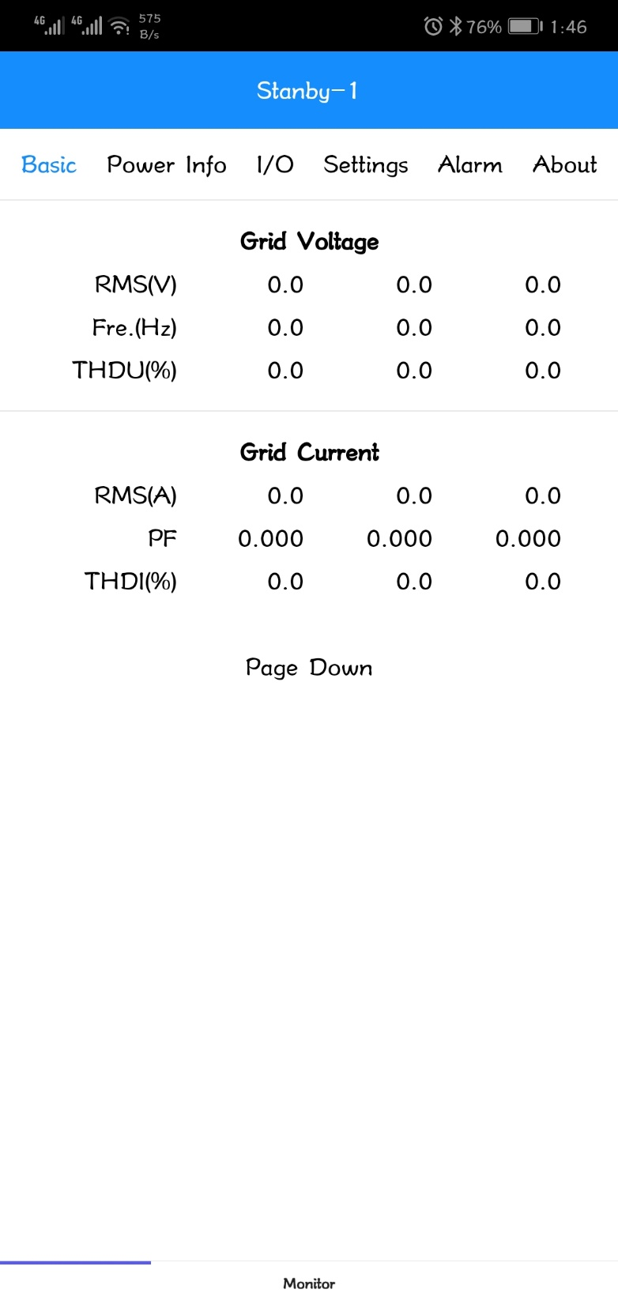
WiFi display - Basic
WiFi Interface
When use the WiFi module to control the AHF/SVG/ASVG, customers only need to link the WiFi generated by WiFi module. Then after that customers can use this to control the module, view many kind of data and change the parameters of AHF/SVG/ASVG.

Slide 3
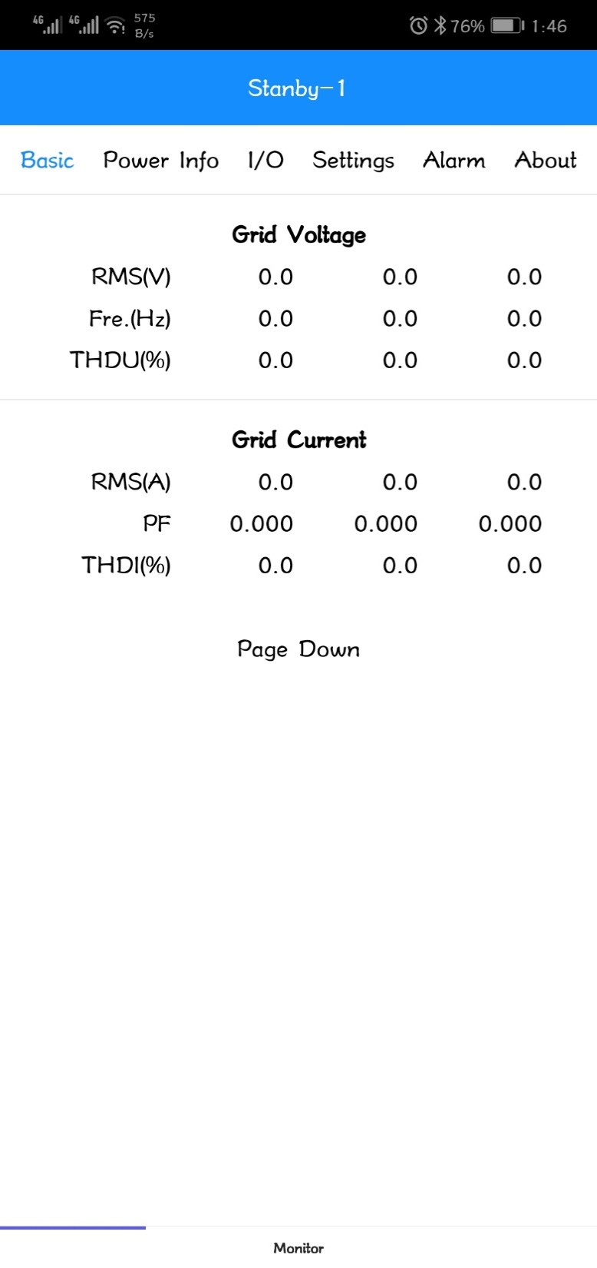
WiFi display - Basic
WiFi Interface
On the interface, it include 6 options:
Basic
Power Info
I/O
Settings
Alarm
About

Slide 4
WiFi display - Basic
Basic
On the basic interface, it shows the information of grid side, load side and compensation current.
Grid Voltage/ Current: Before compensation
Load Current: After compensation
RMS: Effective value of current
Fre.: Frequency
PF: power factor
THDi: total harmonic distortion
Load rate: Ratio of Comp power to rated power

Slide 5
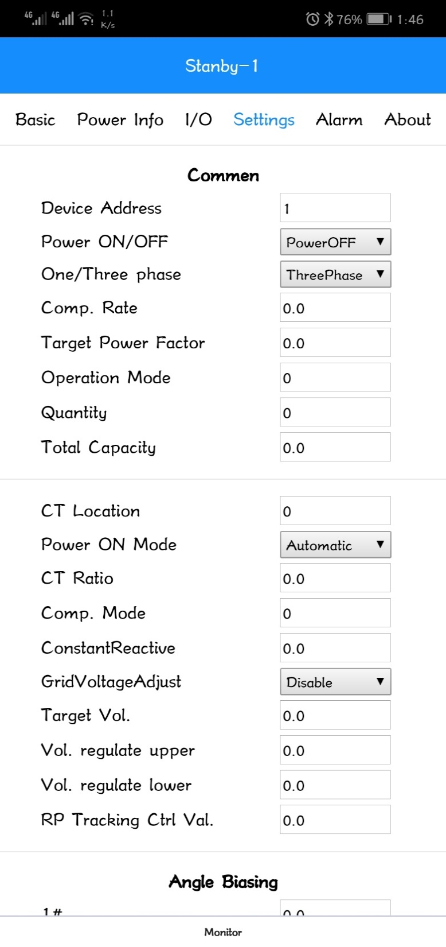
WiFi display – Setting
Setting Interface
On the setting interface, users can change the parameters on this to change the working state of the product.
It mainly include:
Commen setting
Angle Biasing setting
Harmonic setting
Power Saving Function

Slide 6
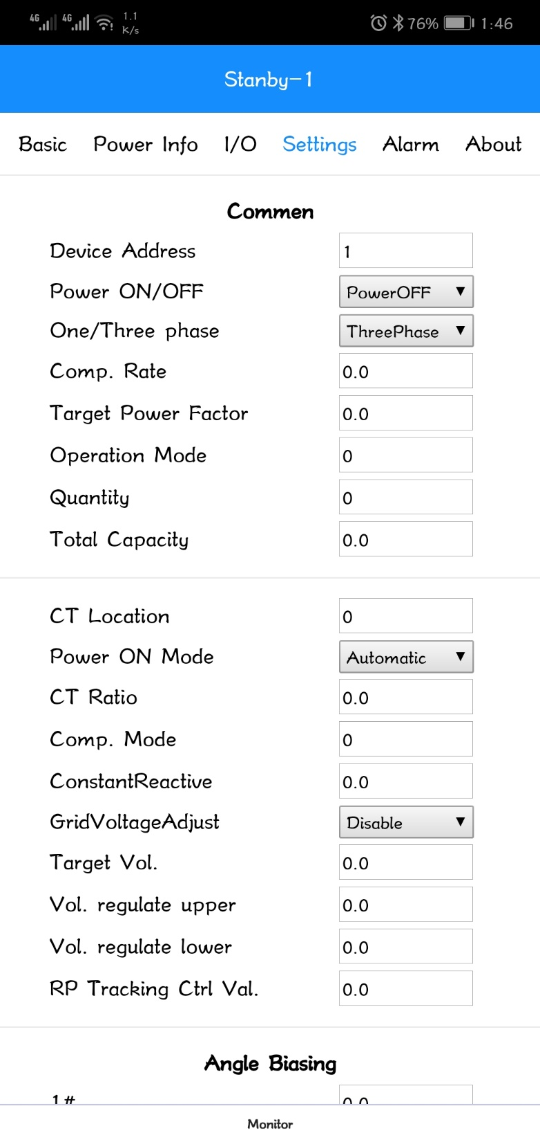
WiFi display – Setting
Setting Interface-Commen
Device Address:
Set the device address to connect the software to the device, normally set it 1.
Power ON/OFF：
Used to control the device on and off.
One/Three phase：
Choose the correspond phase, if the device is single phase product, choose one, otherwise choose three phase.
Target Power Factor：
When use reactive power compensation, it can work, set the target value of PF.

Slide 7
WiFi display – Setting
Setting Interface-Commen
Operation Mode:
This function is important, cause no matter AHF, SVG, ASVG or SPC, we use the same interface, so we need to choose the correspond product and correspond function by filling some parameters in this blank.

Slide 8
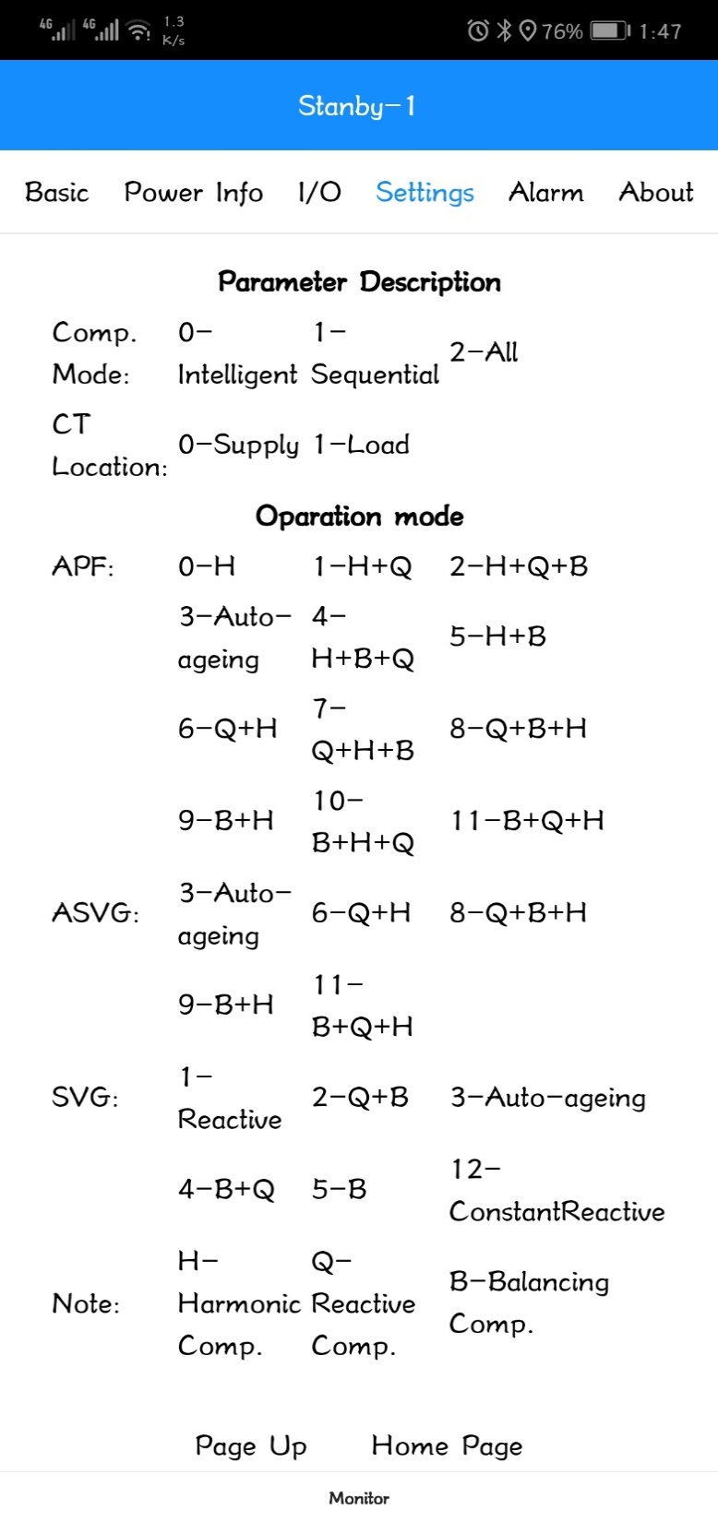
WiFi display – Setting
Setting Interface-Commen
Operation Mode:
Different products and functions need different code.
H: harmonic compensation
Q: reactive power compensation
B: Phase unbalanced compensation
H+Q: harmonic compensation firstly, then go to reactive power compensation.
Q+B+H: reactive power compensation first, then go to the phase unbalanced compensation, compensate the harmonic as last.

Slide 9
WiFi display – Setting
Setting Interface-Commen
Quantity:
Input the quantity of modules controlled by the WiFi
Total Capacity:
Set individual compensation points total and machine capacity, that is, combining each single module system rated capacity.
CT location:
For SVG single module, it supplys both gird side and load side.
For others, it only can support the load side.
Noted: Detailed please refer last page.

Slide 10
WiFi display – Setting
Setting Interface-Commen
Power On Model
In automatic mode , after the system is power on, the products will automatically start working. In the manual mode, it needs to be started by artificial execution in the monitoring interface.
CT ratio:
The setting value need to correspond to the actual changes of external CT. The setting range: 150~30000. (500 means 500:5 .)
Noted: The secondary side only can be 5.

Slide 11
WiFi display – Setting
Setting Interface-Commen
Comp. Rate:
Set the compensation ratio of compensation current measured by the product itself. The setting range is 0~1, 1 on behalf of 100%.
Constant Reactive:
When the operation mode selection constant reactive, is used to set the value of constant reactive power output, you can select the output inductive or capacitive power by setting the positive and negative values. (user have to ask manufacturer engineer first before set it )

Slide 12
WiFi display – Setting
Setting Interface-Commen
Grid Vol. Adjust:
Default setting is Disable. Set the voltage target value. The machine will compensate the voltage if system voltage over the range of target voltage.
Target Vol:
When the value exceeding the target voltage setting range, the product will go to adjust the voltage from other operation mode

Slide 13
WiFi display – Setting
Setting Interface-Commen
Vol. regulate upper:
If the voltage over upper limite of target voltage , the product will go to reduce voltage from other operation mode
Vol. regulate lower :
If the voltage over lower limite of target voltage , the product will go to improve voltage from other operation mode (this voltage stable function only for especial model product)
Noted: These two function only can work when the Grid Vol. Adjust is enable.

Slide 14
WiFi display – Setting
Setting Interface-Commen
RP Tracking Ctrl Val:
Cause AHF itself will C current to compensate the reactive power generated by itself. This function is to adjust the current. Each unit is 1kvar. Plus is inductive and minus is capacitive.
Noticed: Please contact Sinexcel engineer before changing this parameter.

Slide 15
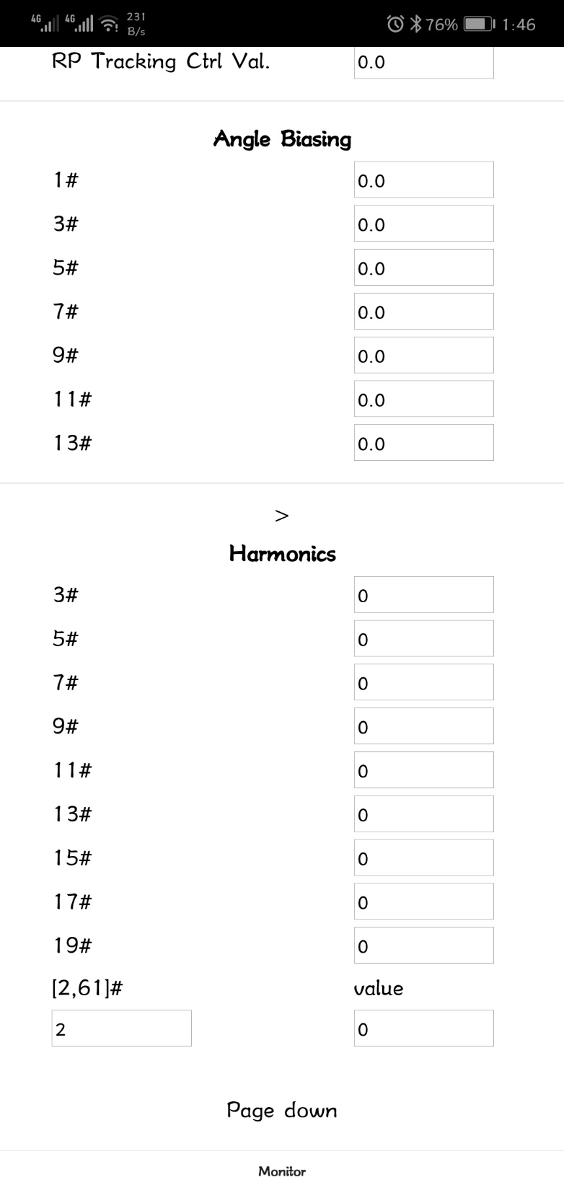
WiFi display - Settings
Setting Interface-Angle Biasing
Default setting is 0.
3 to 13 times harmonic phase angle offset and harmonic compensation rate. When some phase difference happened due to the transformer or some thing,
adjust this parameters can approve the compensation performance.

Slide 16
WiFi display - Settings
Setting Interface-Harmonic
Harmonic compensation rate of each order which is from 2nd order to 50th order.
And each order can be changed from 0%~110%.
The last bank can select which order you want to change, and next blank is where you need to input the correspond rate.

Slide 17
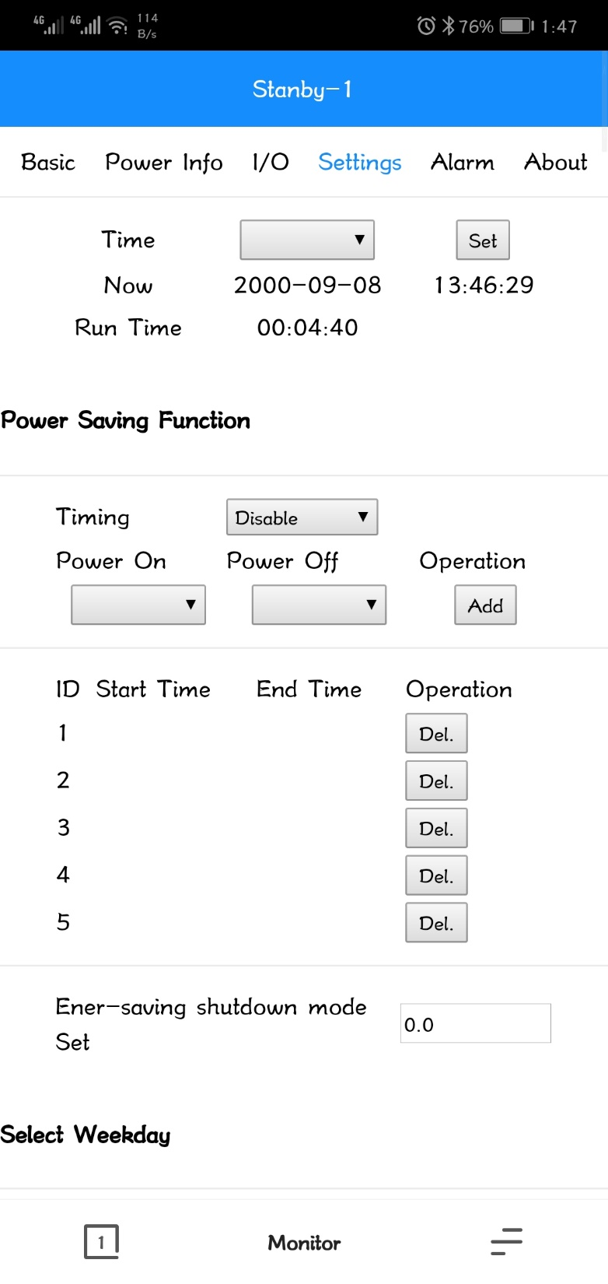
WiFi display - Settings
Setting Interface-Time
Set the time of the product.
Setting Interface-Power Saving Function
Using this function, we can set the AHF to work at some time and sometimes not working.

Slide 18
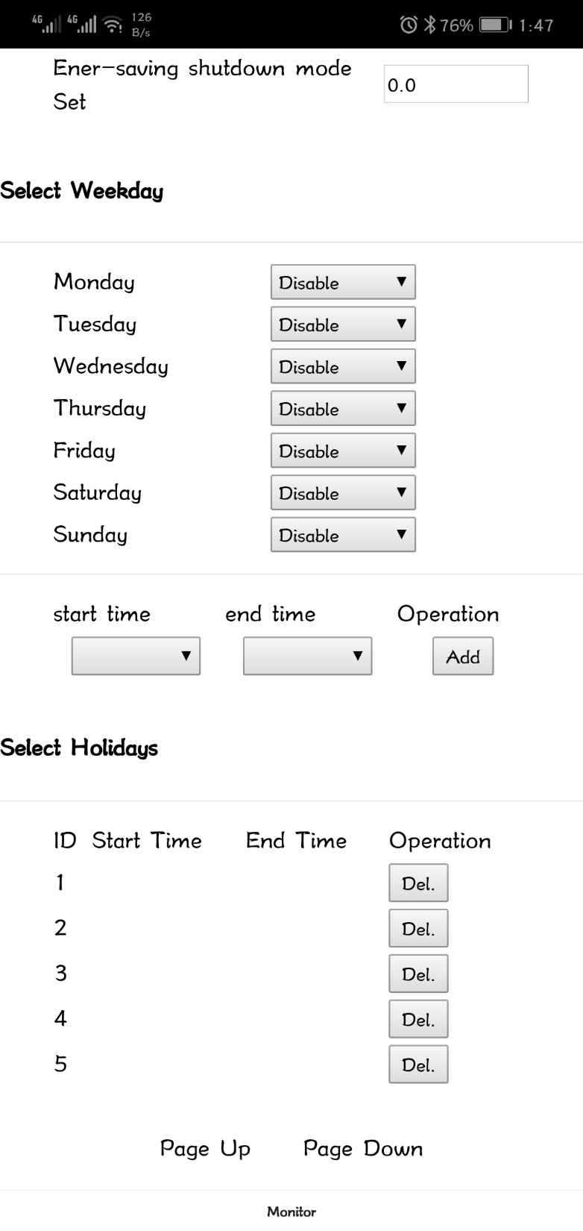
WiFi display - Settings
Setting Interface-Power Saving Function
Using this function, we can set the AHF to work at some time and sometimes not working.
Also, We can choose the time by week or by holiday.

Slide 19
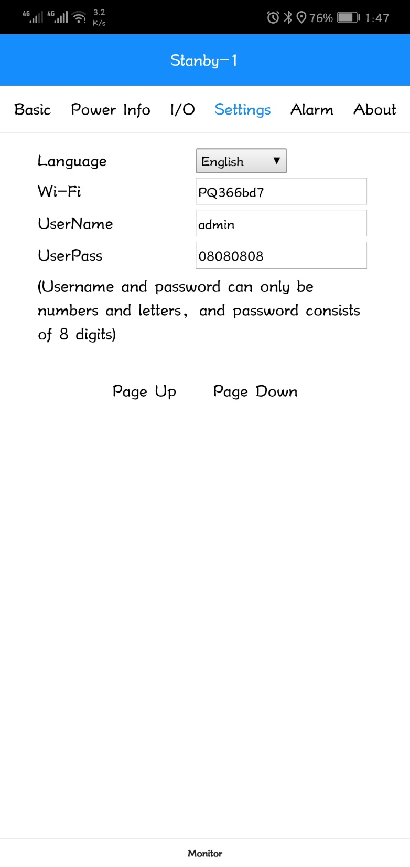
WiFi display - Settings
Setting Interface
Language:
choose the language which customer prefer.
Wi-Fi:
Set the WiFi name
UserName
UserPass

Slide 20
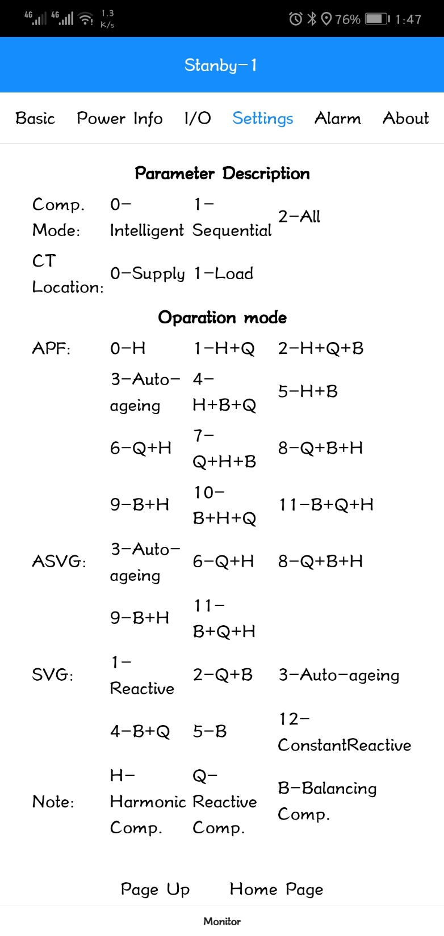
WiFi display - Settings
Setting Interface-Guidence

Slide 21
WiFi display - Alarm
Alarm Interface
From this interface, you can see all the alarm record happened in the past.

Slide 22
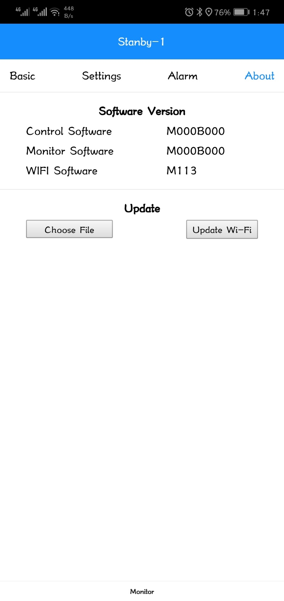
WiFi display - About
About Interface
Software Version
Update
Download the date though WiFi.

Slide 23
THANKS

