Slide 1
Inverter Based Harmonic Compensation-AHF

Slide 2

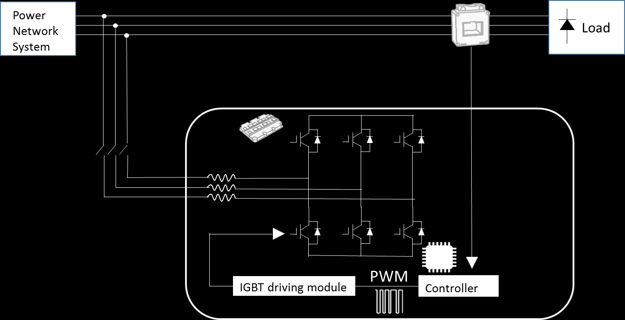






Full Controlled Technology
Flexible Alternative Current Transmission
Load
Power Electronic
Tech Combination
Micro-Programming
Micro-Electronics
Communication
DSP
Control
IGBT Driver

Slide 3



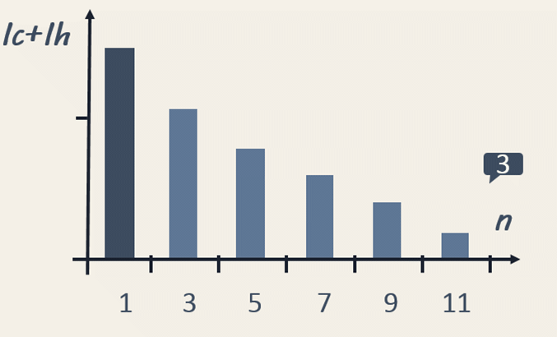
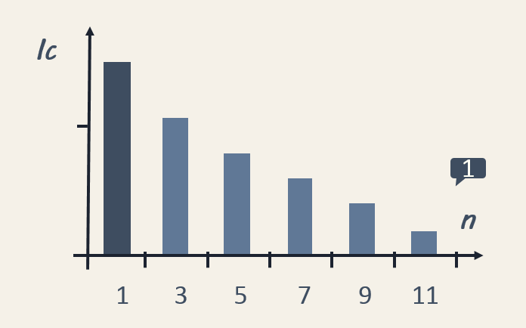
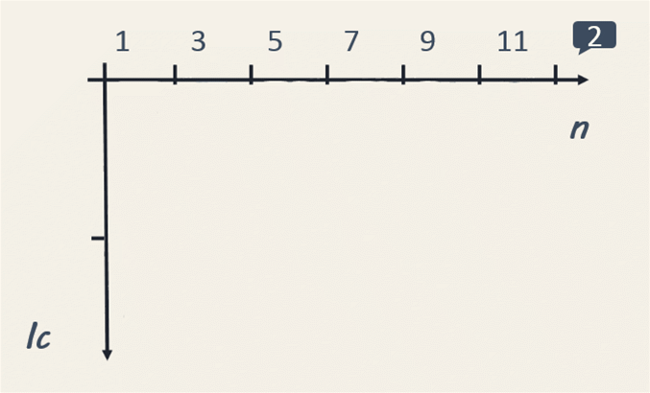


Benefit Of Inverter Based PQ
Load
Ih
PWM
DSP
IGBT Driver
Fast and programmable to high accuracy
Extremely excellent performance consistent to meet PQ standard
High reliability by free maintenance

Slide 4



1. The grid side AC through the rectifier part and be changed into DC bus capacitance voltage, this voltage will be stabled in a small range by DC bus capacitor
2. DSP control the port and length of IGBT on and off time to generate a voltage at inverter part.
3. The different voltage between grid side and converter part add on the inverter inductor and generate a compensation current.
4. Ripple current be removed on the LCL filter circuit
AHF
Innovative Inverter Based PQ
Extremely Fast
calculation and reaction in ms
High Accuracy
Programmable and customized AC

Slide 5
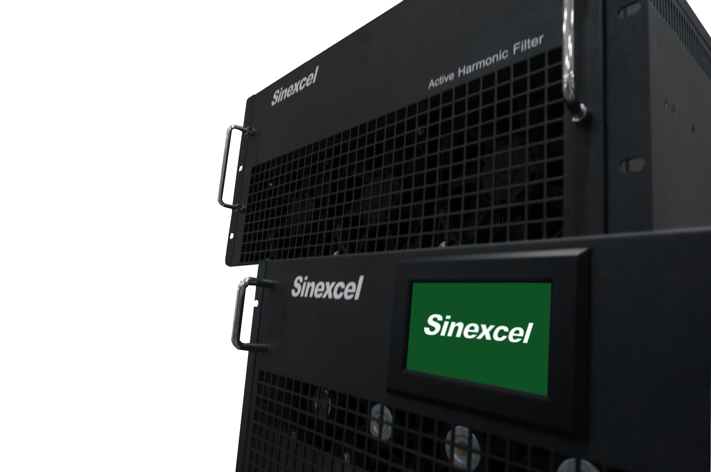
2nd-50th harmonic compensation
Compensate dynamic change harmonic

Slide 6
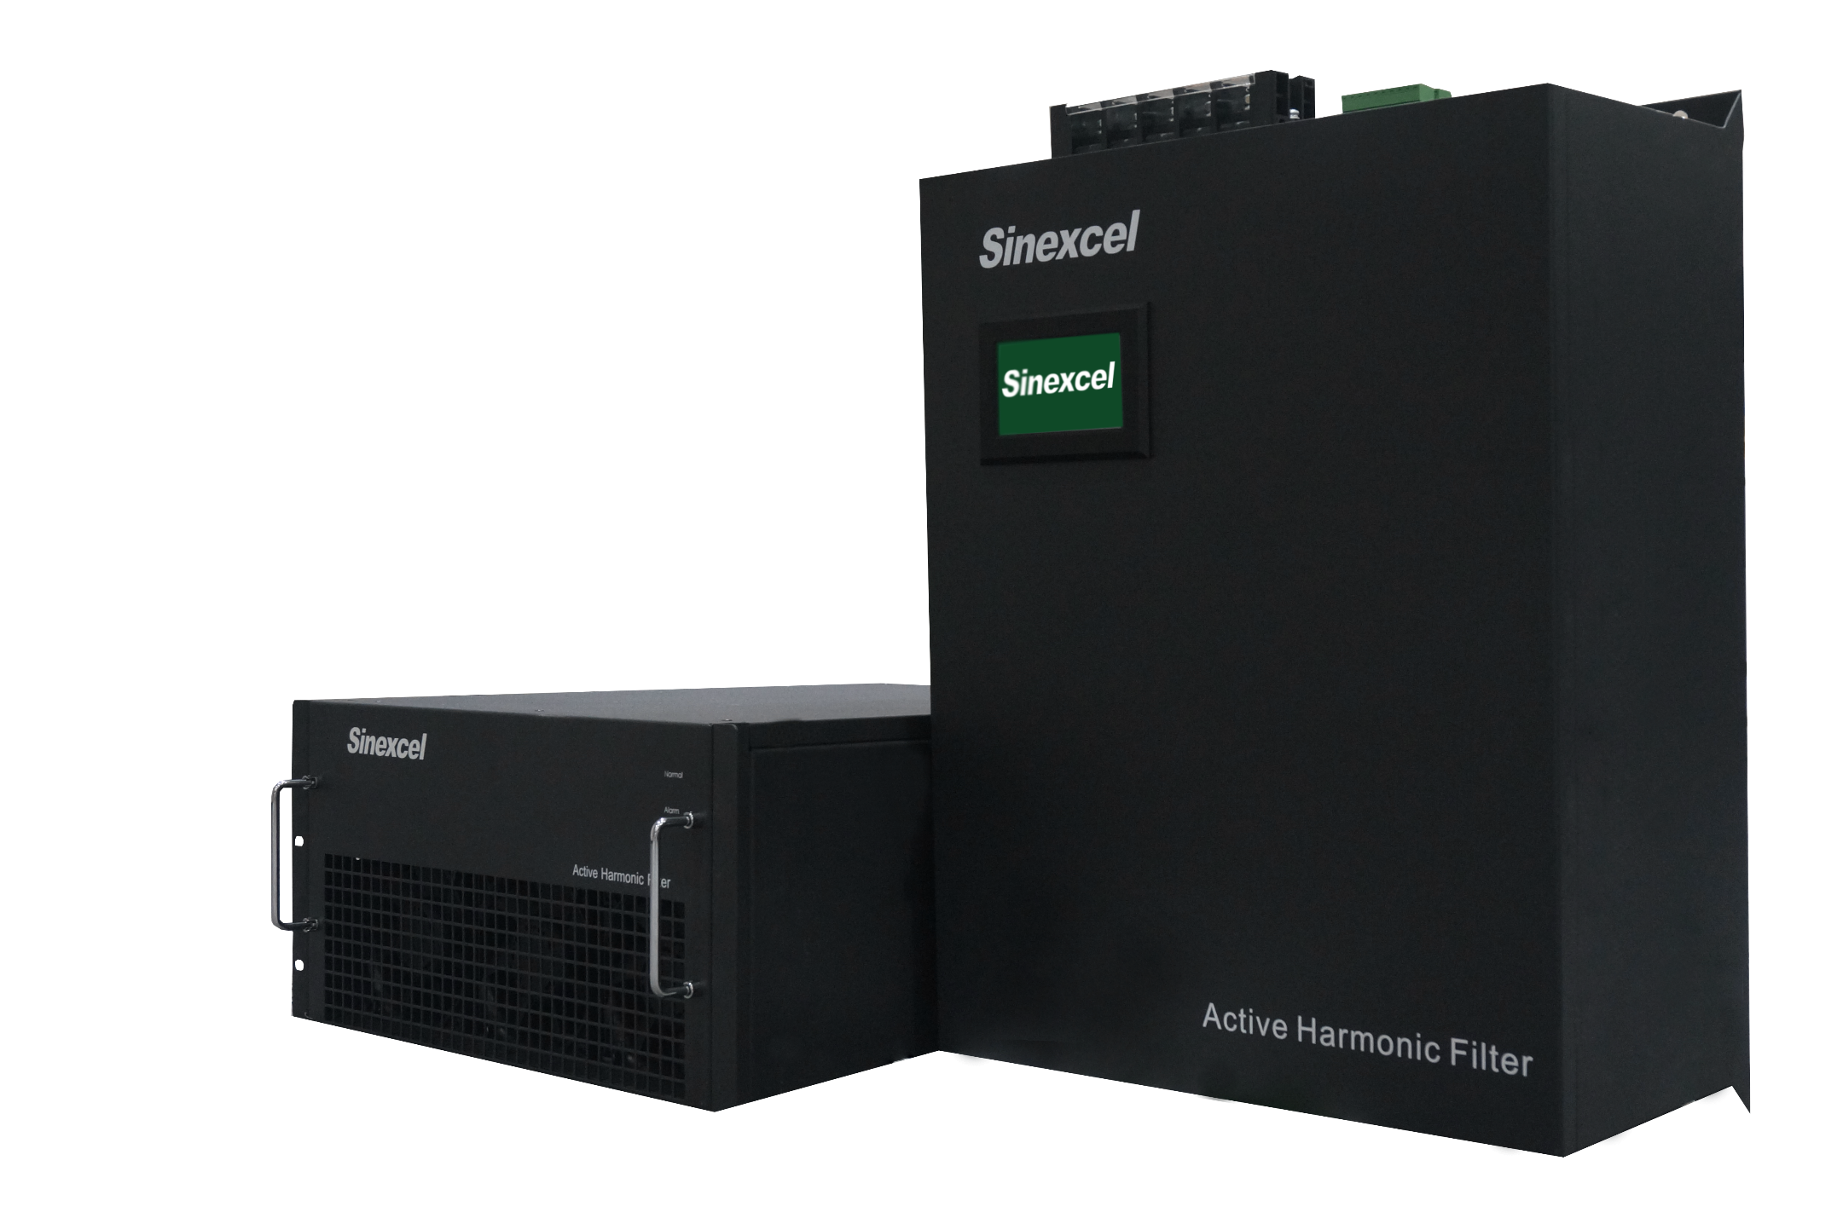

Slide 7
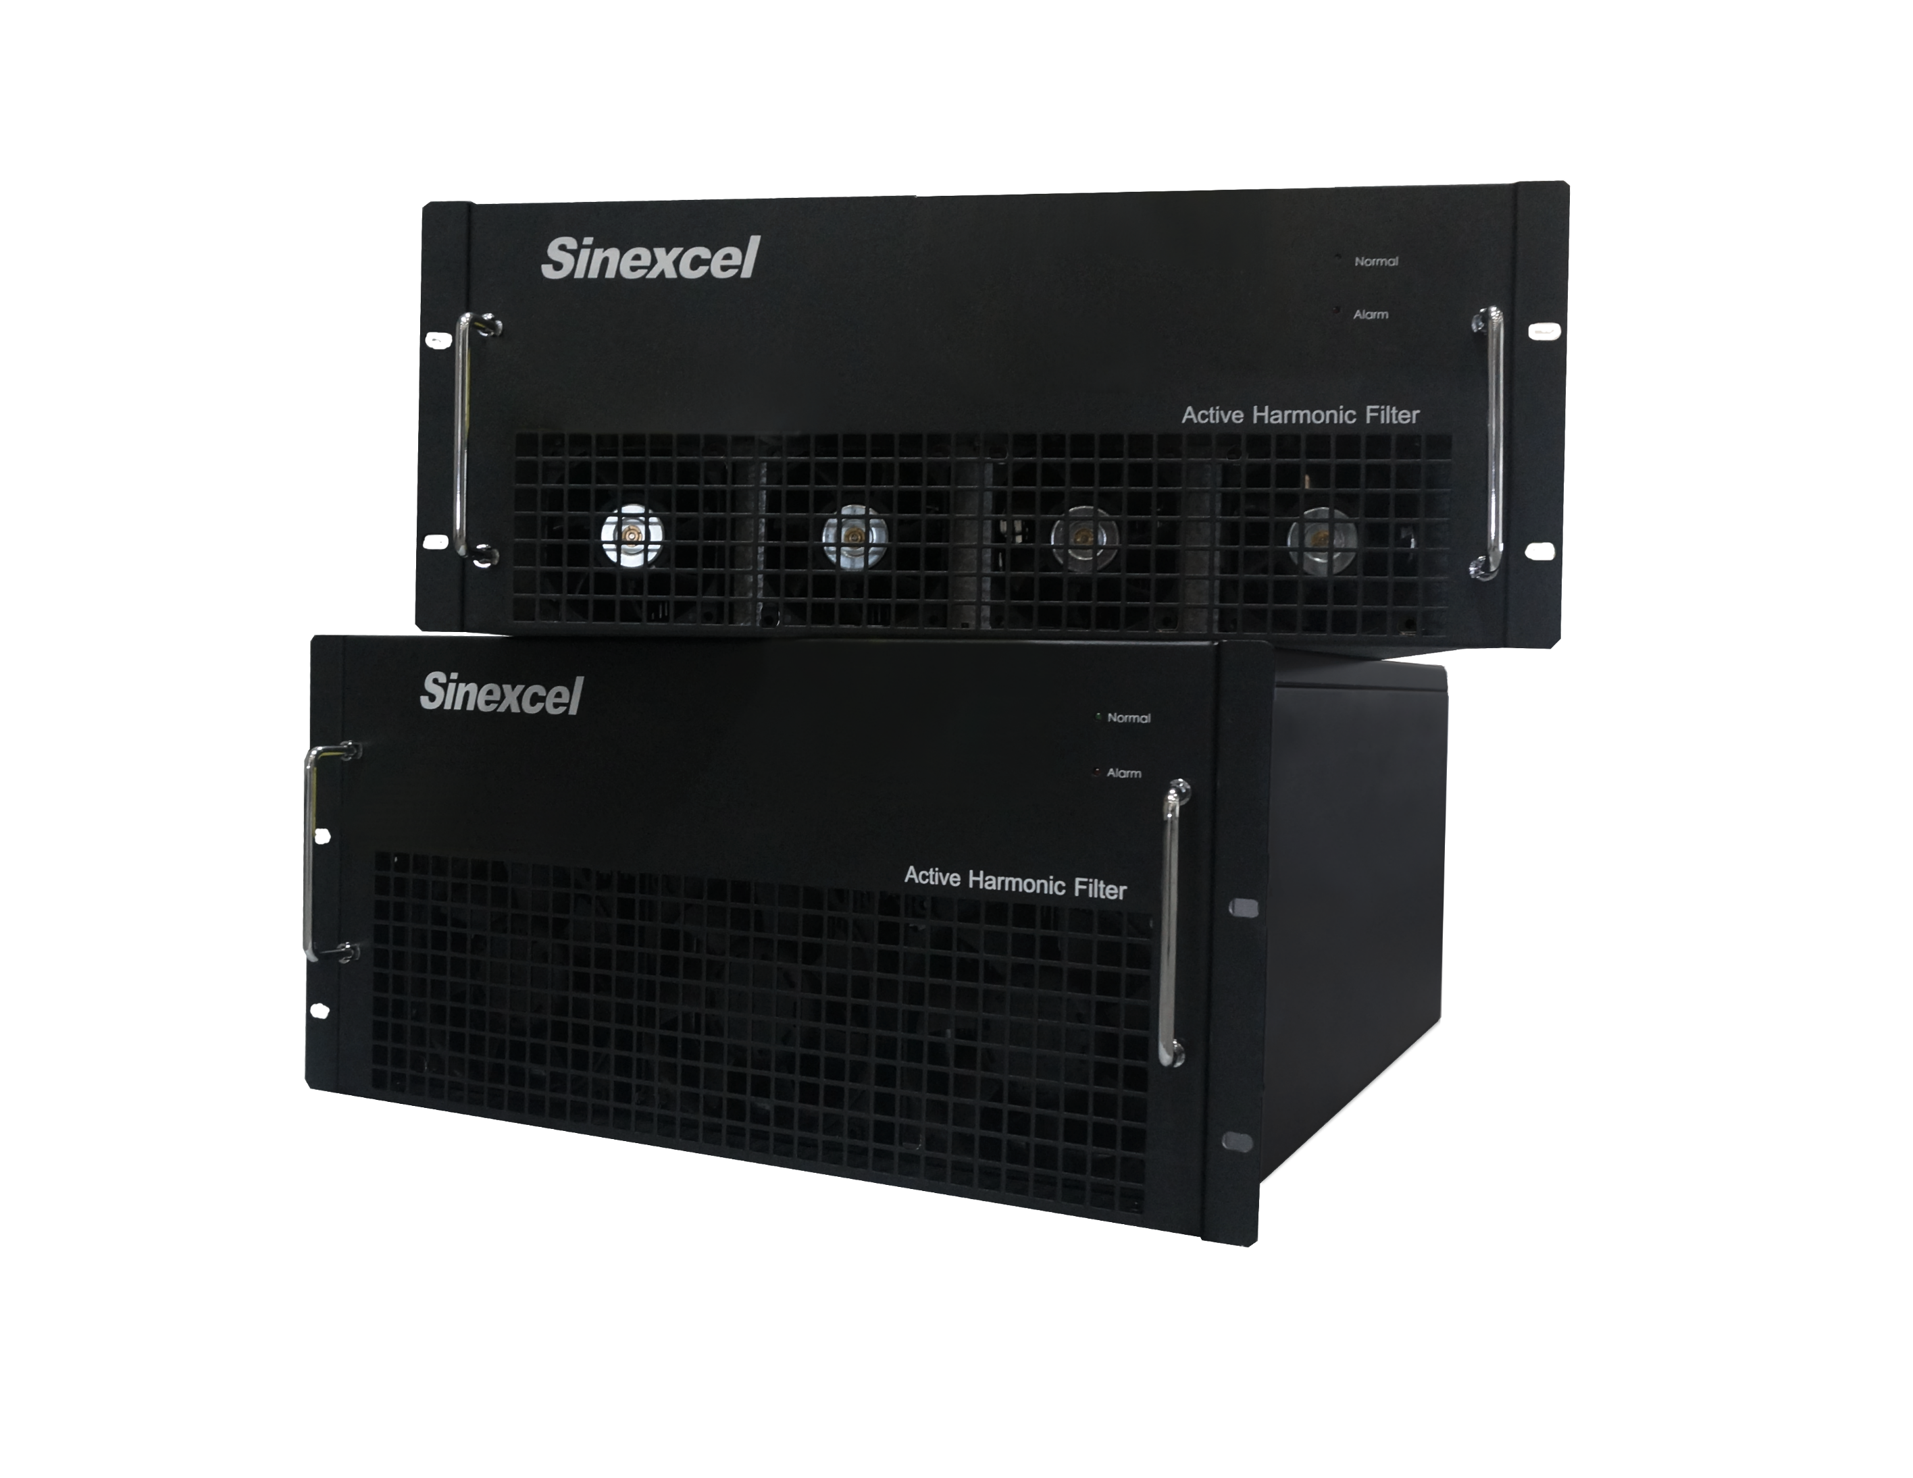

Slide 8
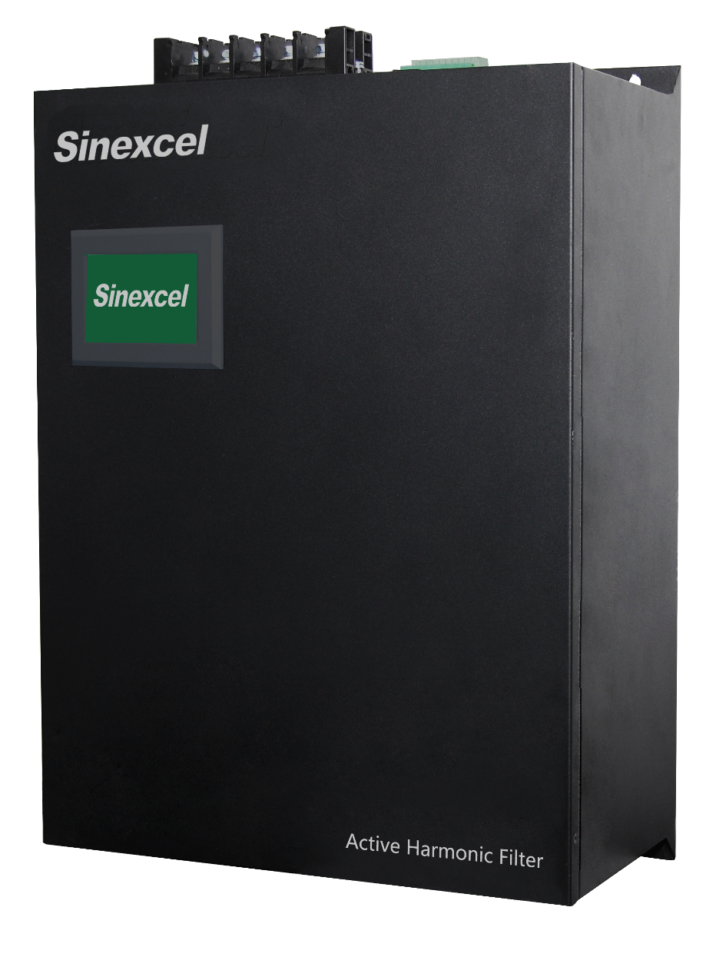
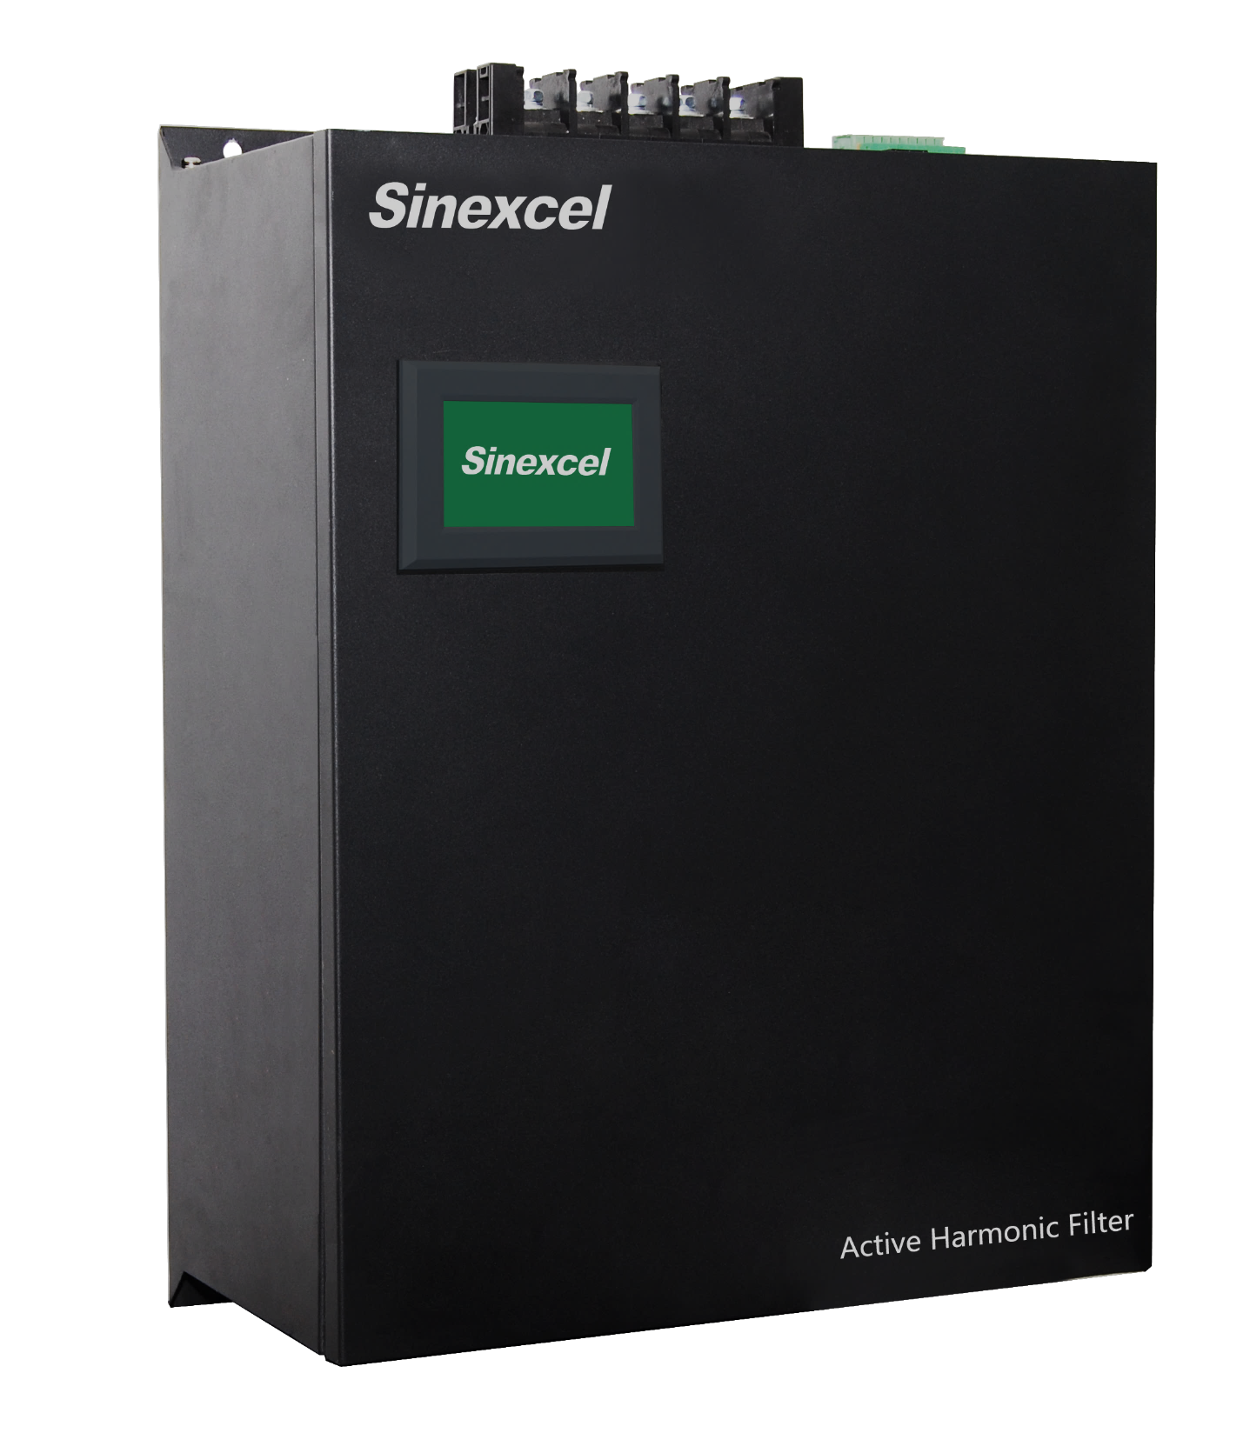

Slide 9
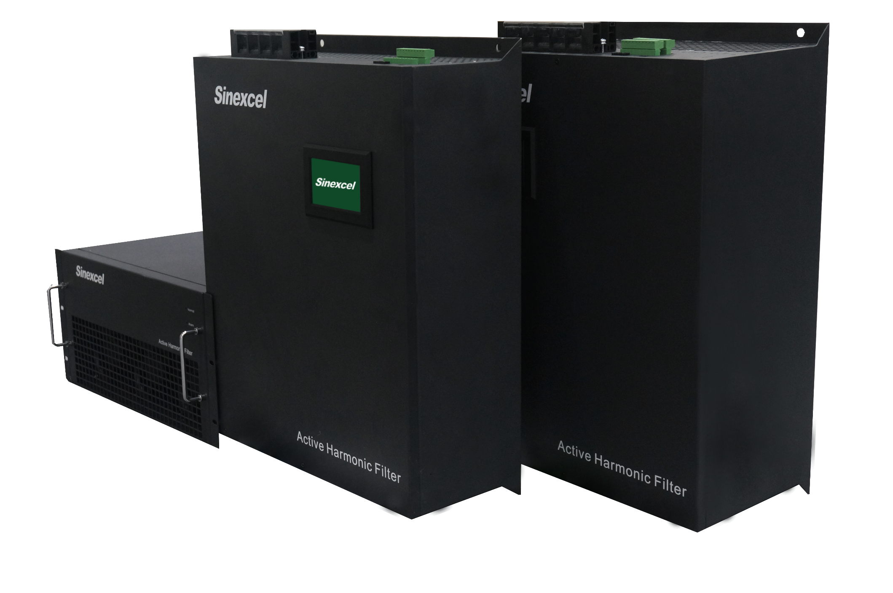

Slide 10
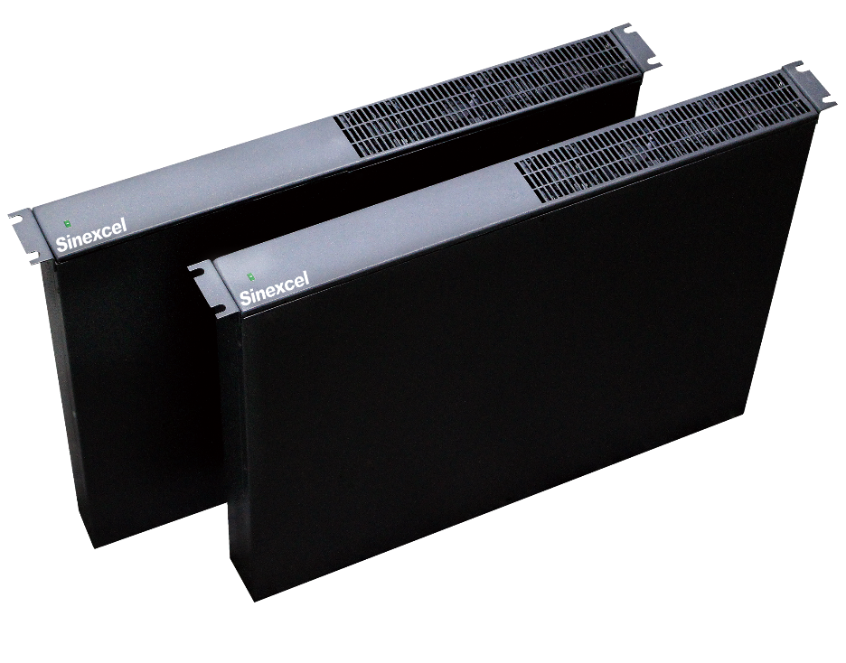

Slide 11
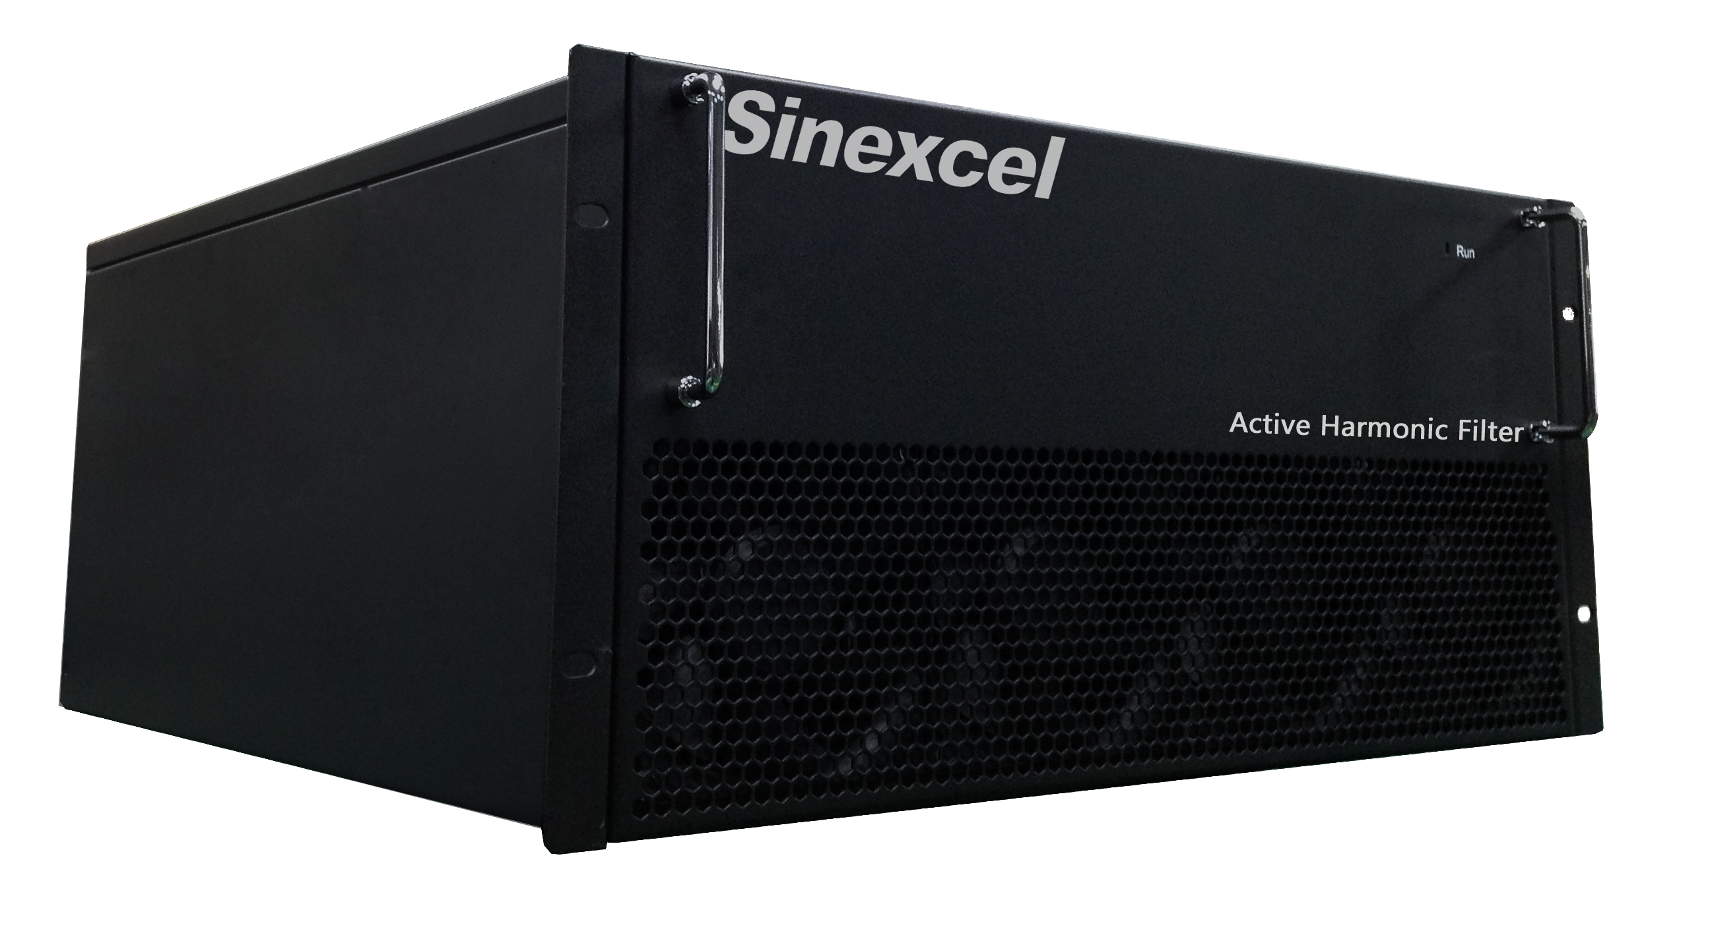
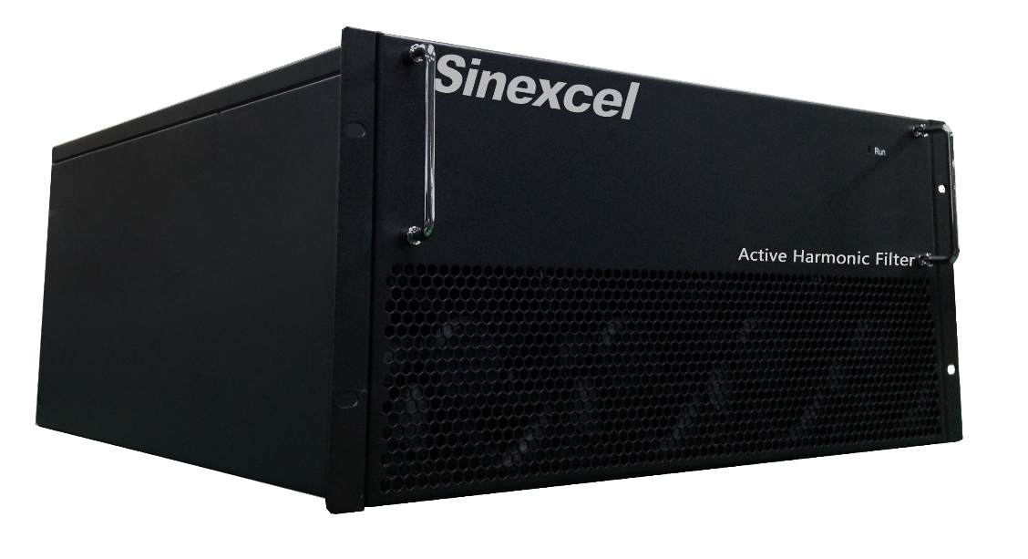

Unique
Flexible-Capacity
25A/35A/50/60A/75A/100A/150A/300A wall/rack
Free combination of capacity

Slide 12
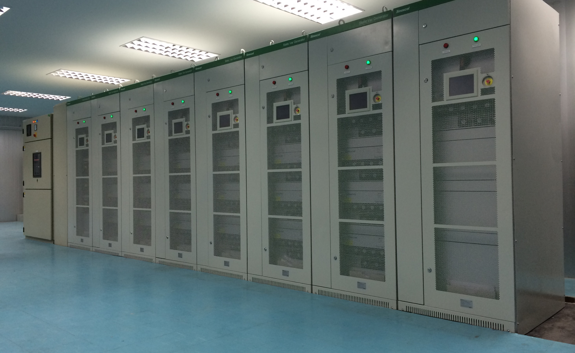
Flexible Engineering-Sinexcel Flexible cabinet
AHF 400A
SVG 2500Kvar

Slide 13
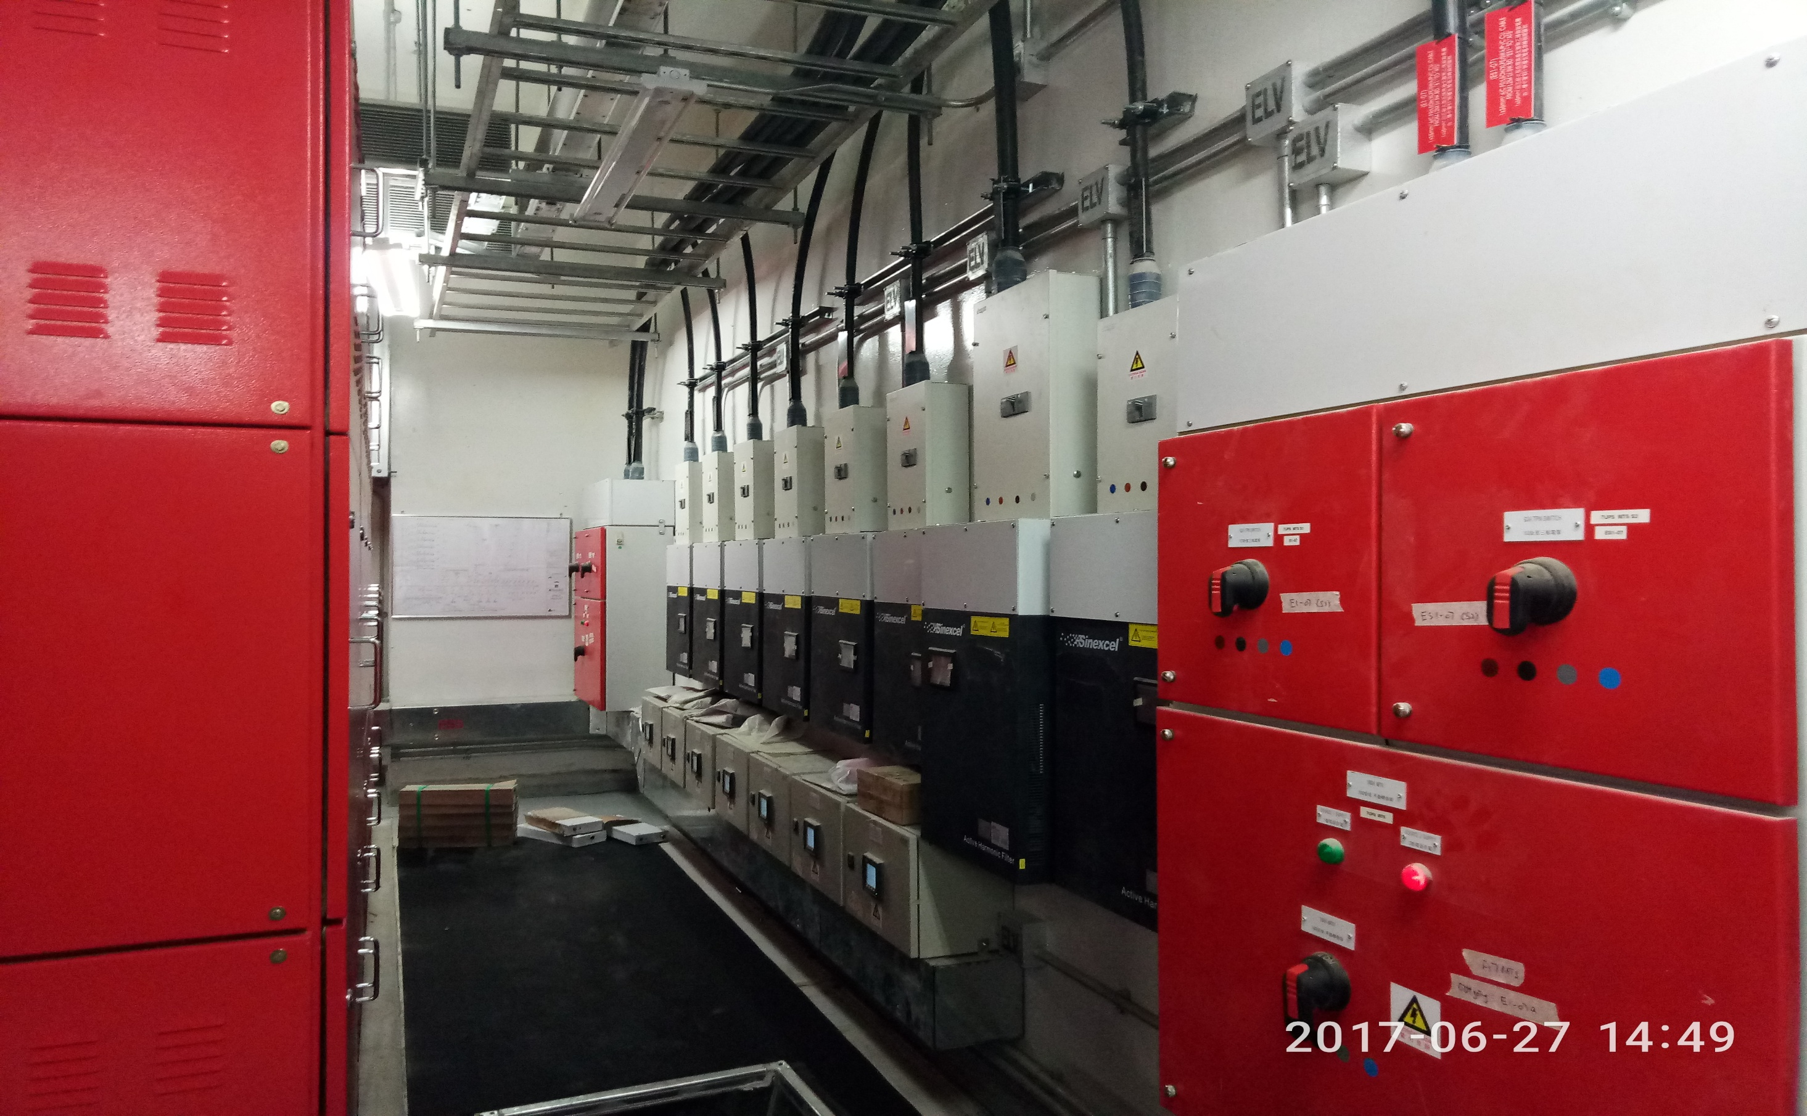
Flexible Engineering-Wall Mount Compact Installation

Slide 14
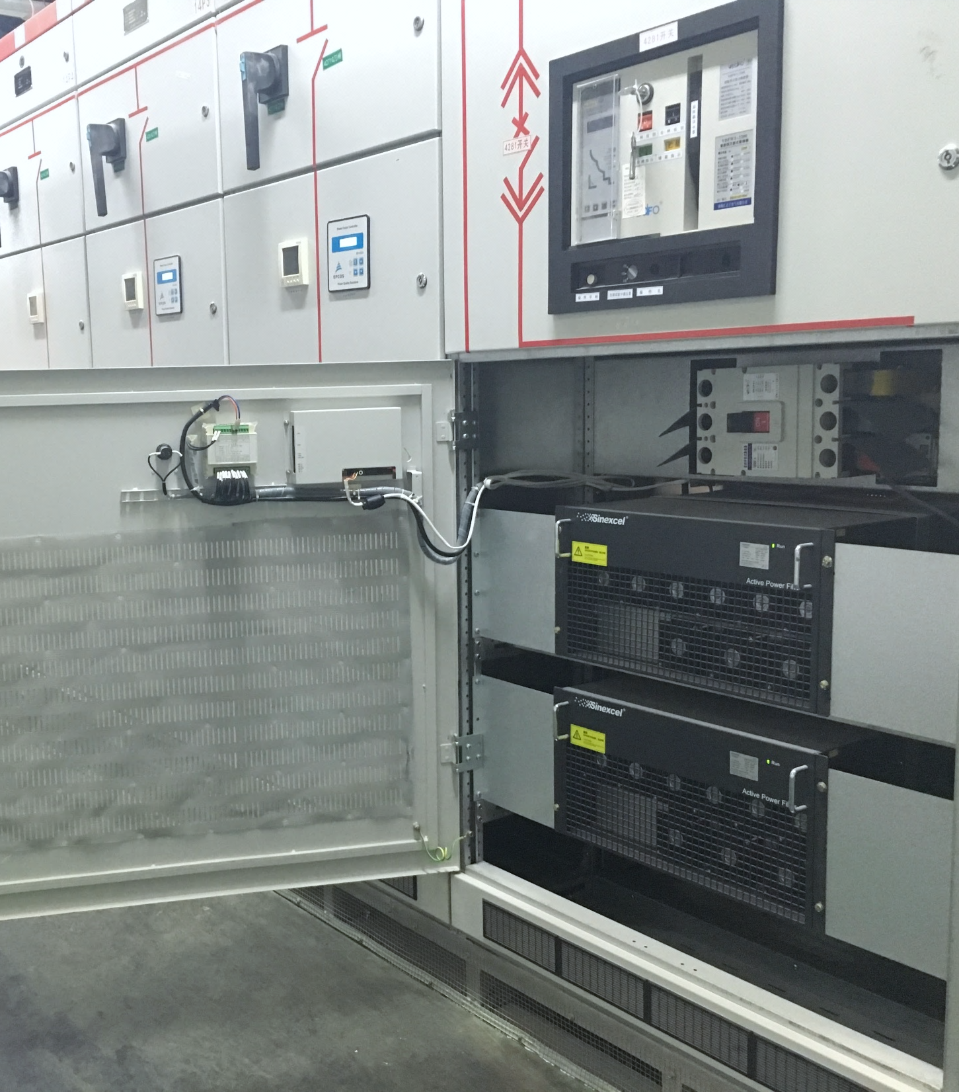
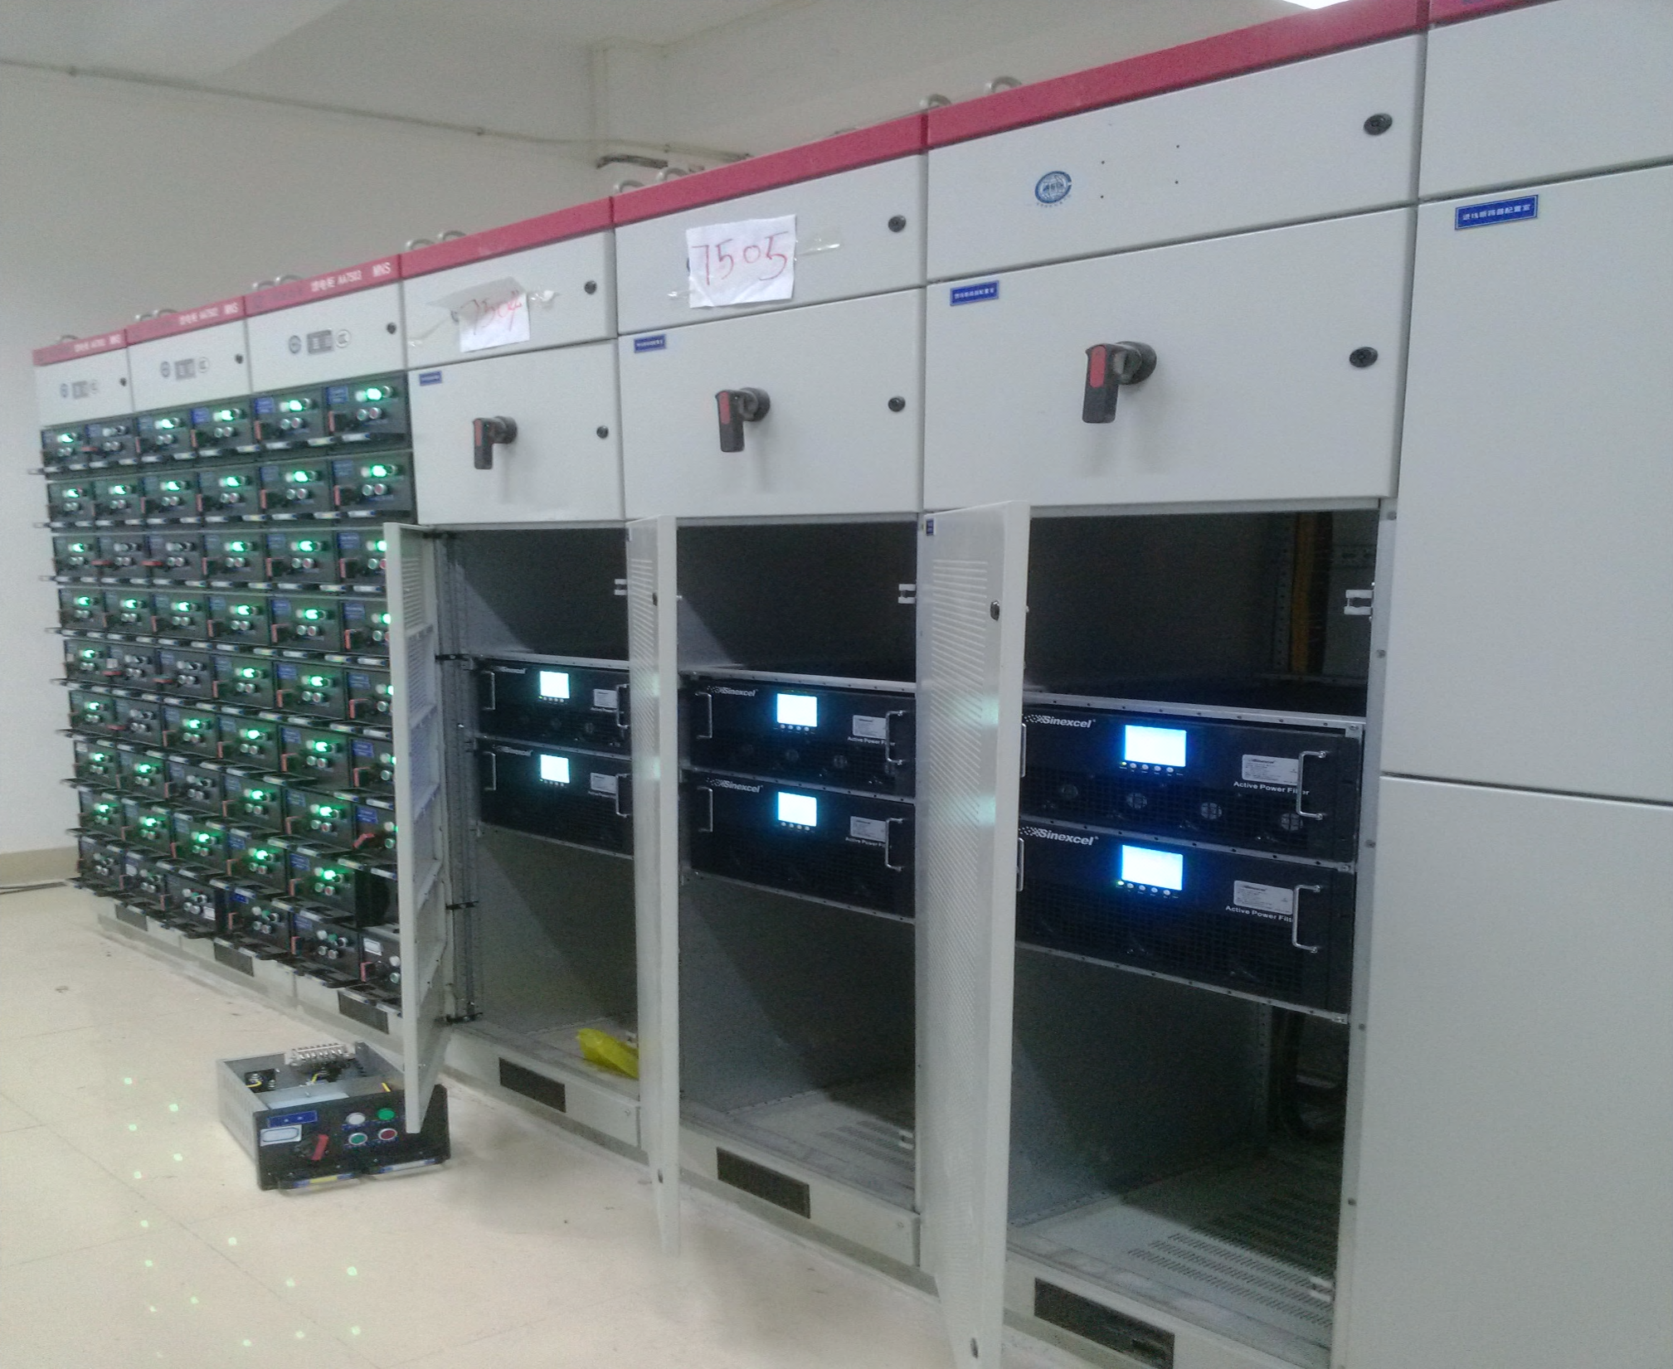
Flexible Engineering-Integrated into Switchgear

Slide 15
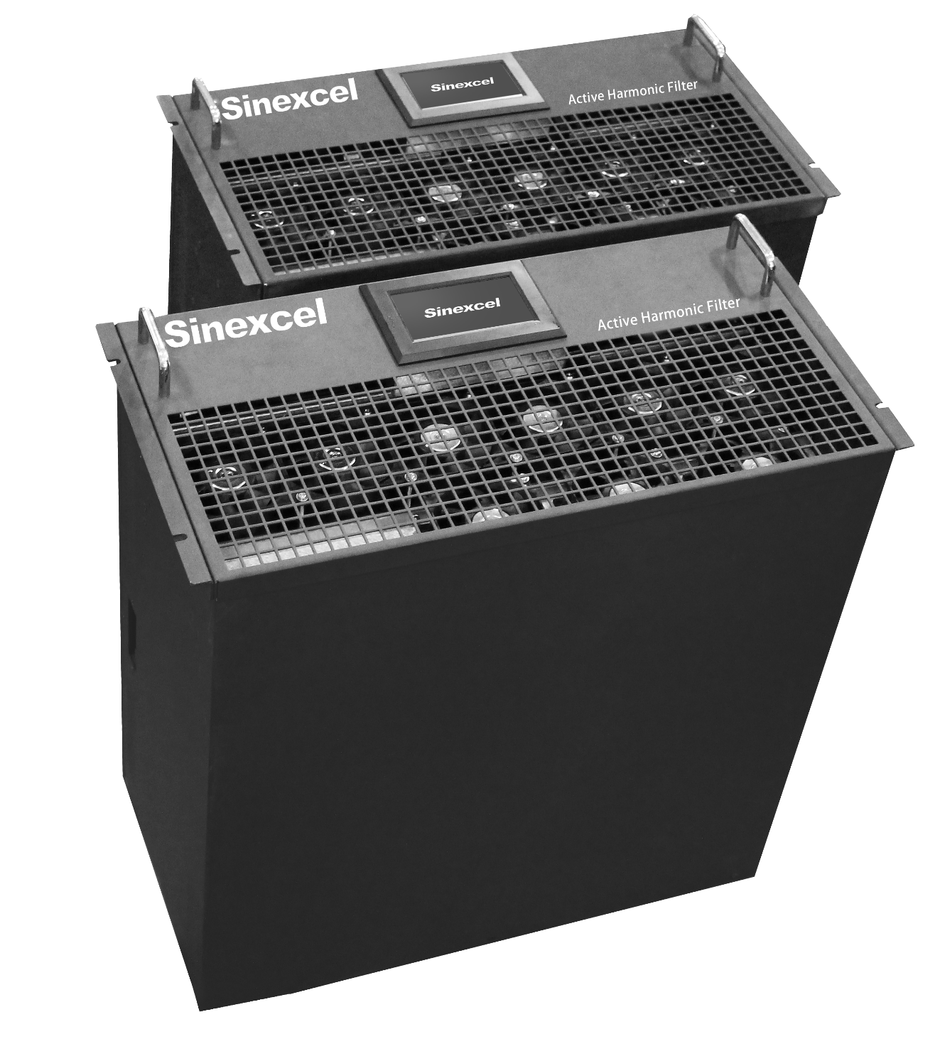
Unique
Modular Design
Modular redundancy
High reliability
Fastest and easiest engineering

Slide 16
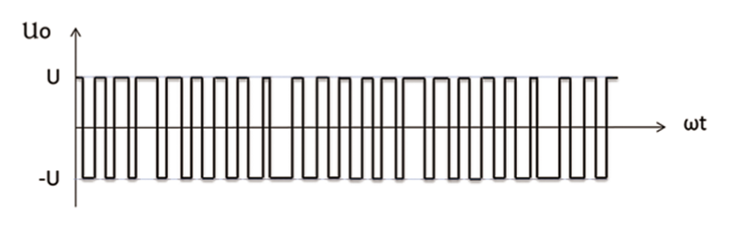
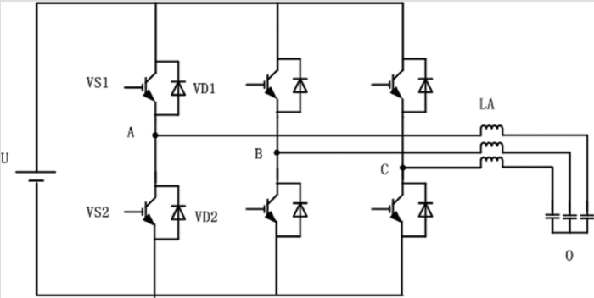
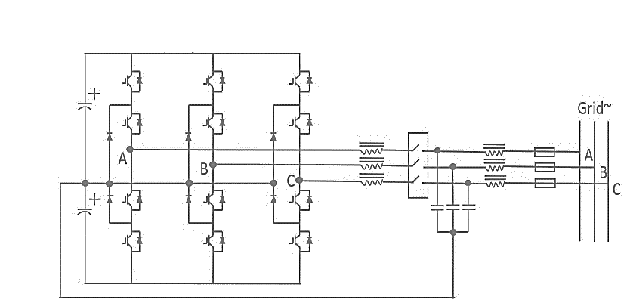
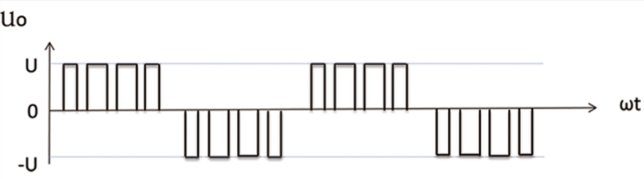
I
Ripple current
VS1
VD1
LA
U
U
A
B
C
VS2
VD2
T
O
-U
Technical Upgraded
Higher switching frequency from up to 35kHz
100% more IGBT and more complicated program
One more level voltage, more PWM
Higher switching frequency of IGBT could filter more ripple current
I
Ripple current
U
0
T
-U
Unique
Modular design compact and flexible
Higher accuracy on harmonic performance
Higher reliable by program control
Close to sine wave
Customer Benefits
3 Level Topology

Slide 17
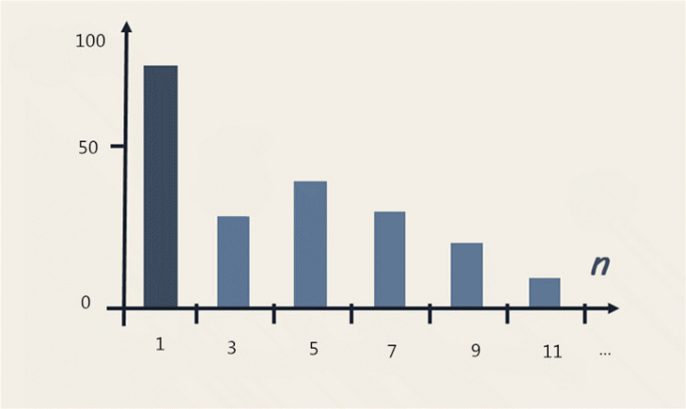
1
FFT-Fast Fourier Transform
It is the mode of program to identify RMS current to fundamental current, harmonic current of 150Hz/3rd , 250Hz/5th, 350Hz/7th,450Hz/9th...up to 2500Hz/50Hz
AHF output current as same frequency as individual harmonic order at the reverse direction.
3
5
…
n

Slide 18
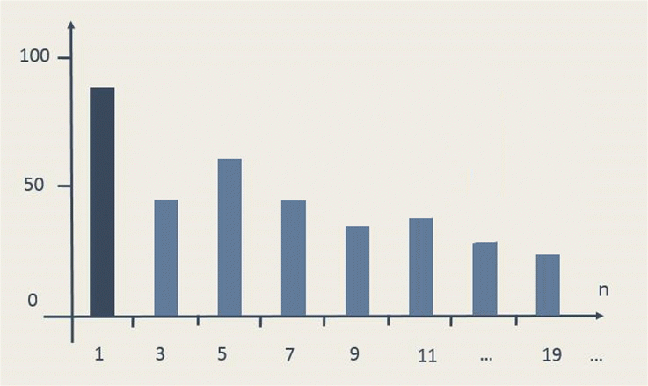
Self learn system impedance, identify feature of individual harmonic order
Unique
Intelligent FFT
Progress add compensation capacity
Base on FFT add intelligent program
Resonance?
Resonance real time monitor
NO
YES
If resonance change to the other harmonic order, go back to the begin process and self learn impedance and adjust program
Output all capacity system needed within 5 mins
Program detects some harmonic order has resonance, stop output at the order but continuous compensates the others
Cancel most of the harmonic meet requirement

Slide 19
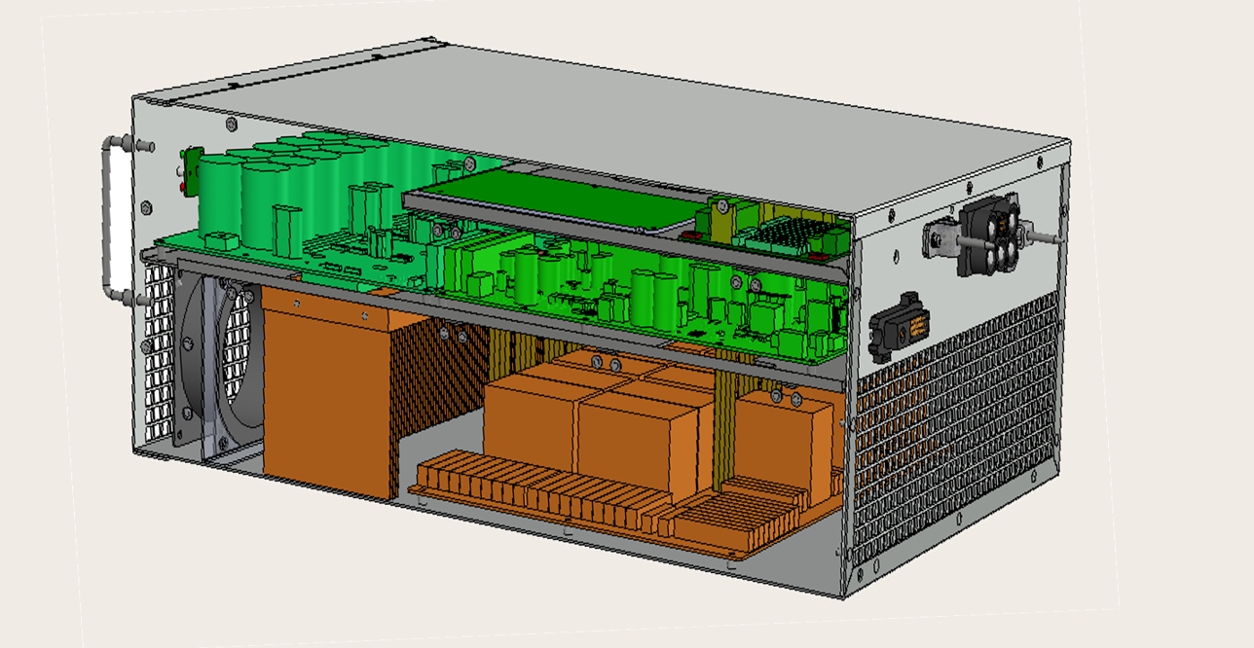
Unique
Heat Isolation
Air inlet
Air Outlet
Heat dissipation
Dust prevention

Slide 20
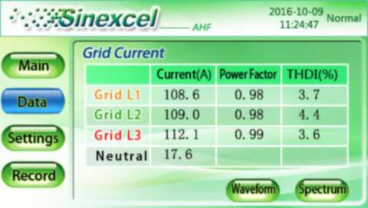

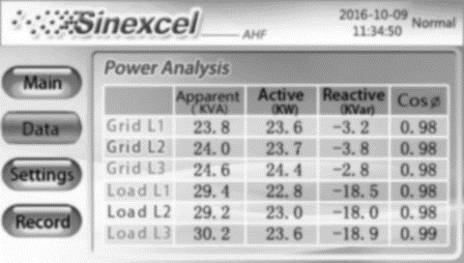
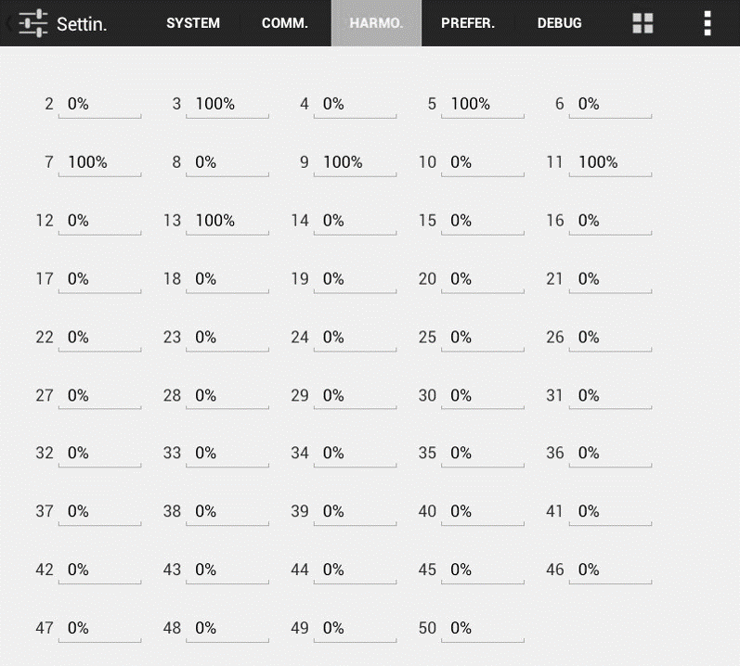

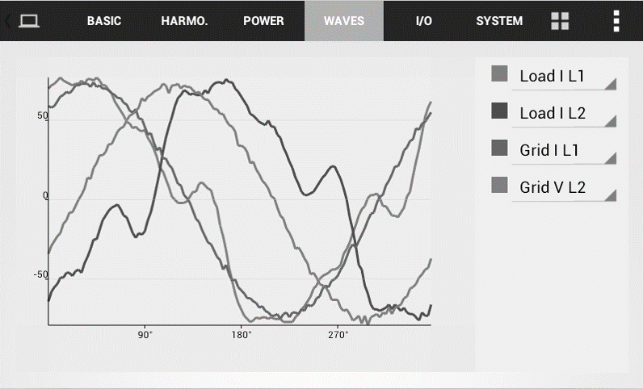
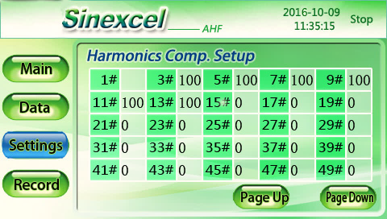
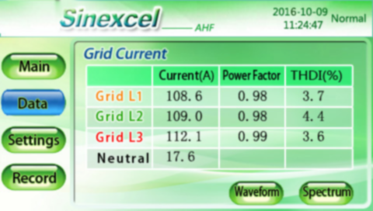

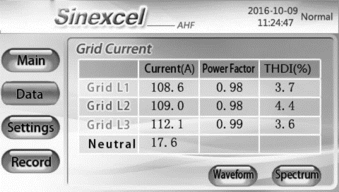
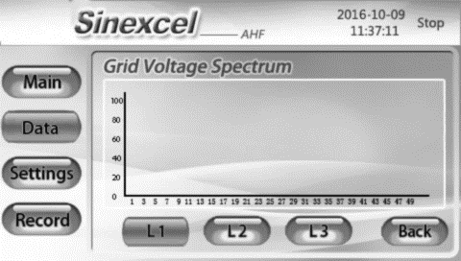
Unique
Friendly Interface

Slide 21
Items | 400V | 208V/480V | 600V | 690V
Rated Voltage | 228~456V | 384~552V | 420~690V | 483v~793V
Rated Capacity | 15/25/35/50/60/75/ 100/150/300A | 25/35/50/60/75/90/100A
Compensation | Harmonic Compensation, Reactive power compensation, unbalance Compensation
Power Grid Structure | 3P4W, 3P3W
Filter Range | 2~50th order
Response Time | <5ms
Efficiency | >97%
Cooling air requirement | 44/75/151/300/405L/Sec | 359L/Sec
Dimensions (W x D x H) (mm³) | 440*470*150、440*590*190、440*600*230、500*510*270 | 544*640*250(Rack-mounted)/504*253*640(Wall-mounted)
Module display interface | 4.3-inch HMI(module), 7-inch HMI(central monitor),LED | 4.3-inch HMI(wall-mounted), 7-inch HMI(rack mounted)
Communications ports | RS485,and Ether net port(RJ45)
Communications protocols | Modbus (RTU)
Standards Compliance | UL /ETL（UL508）/ DNV/ RINA/ BV/ IEEE519, ER G5/4

Slide 22




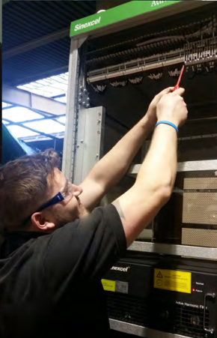
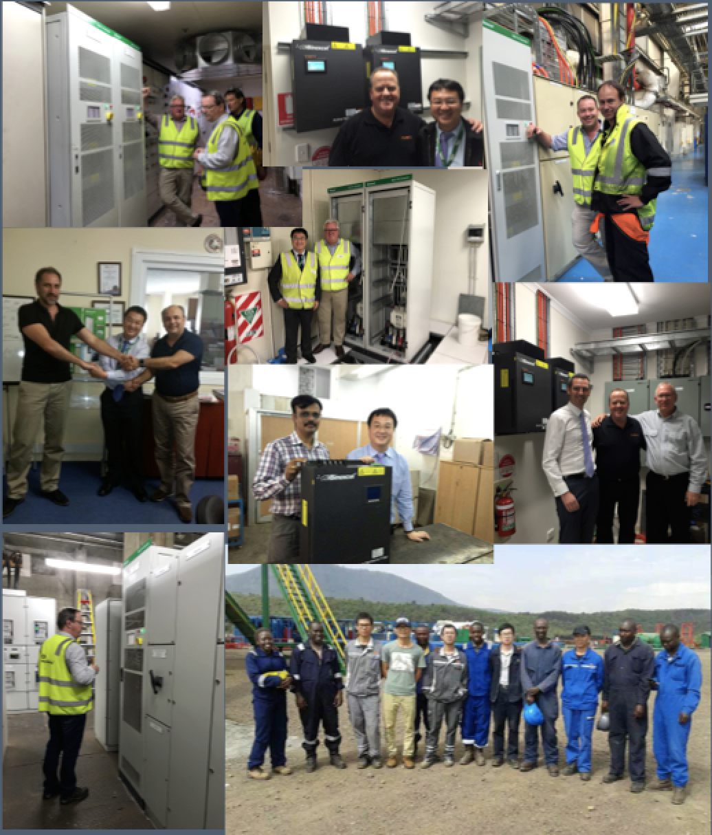







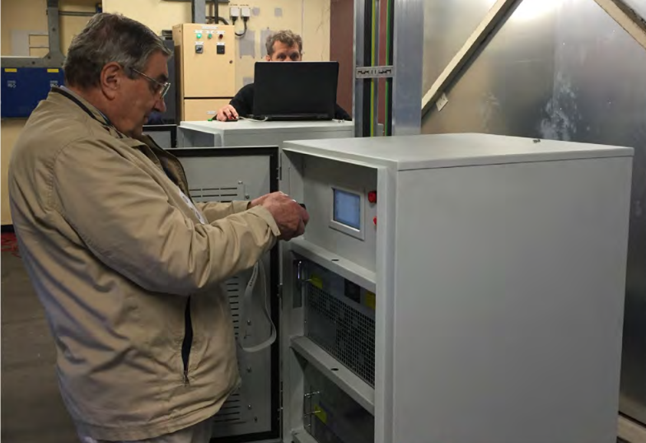
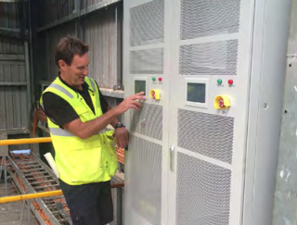




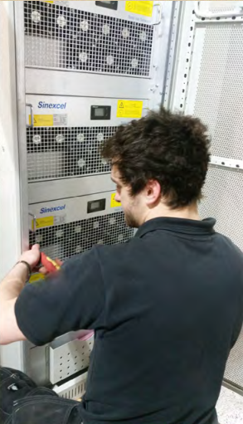



LEADING
IN INDUSTRY
2.0 Million Installation Global
The biggest quantity installation reference
Widest Application
Reference in non-linear loads
Reference in industries
Reference in environment
Unique Engineering Innovation
Modular Design
3 Level topology

Slide 23
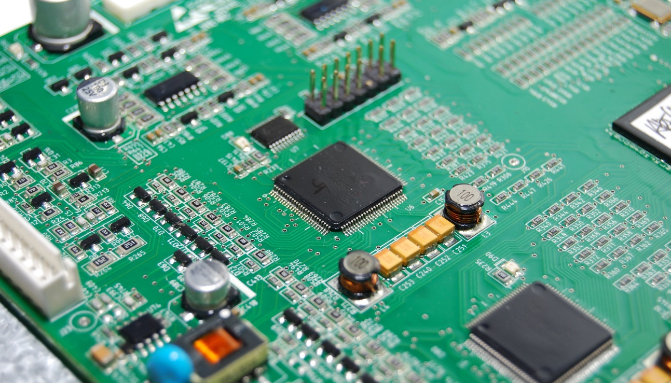
Inverter PQ focus company
100% Power Electronic company high focus on PQ Tech
Stock listed on CEM stock code 300693

Slide 24
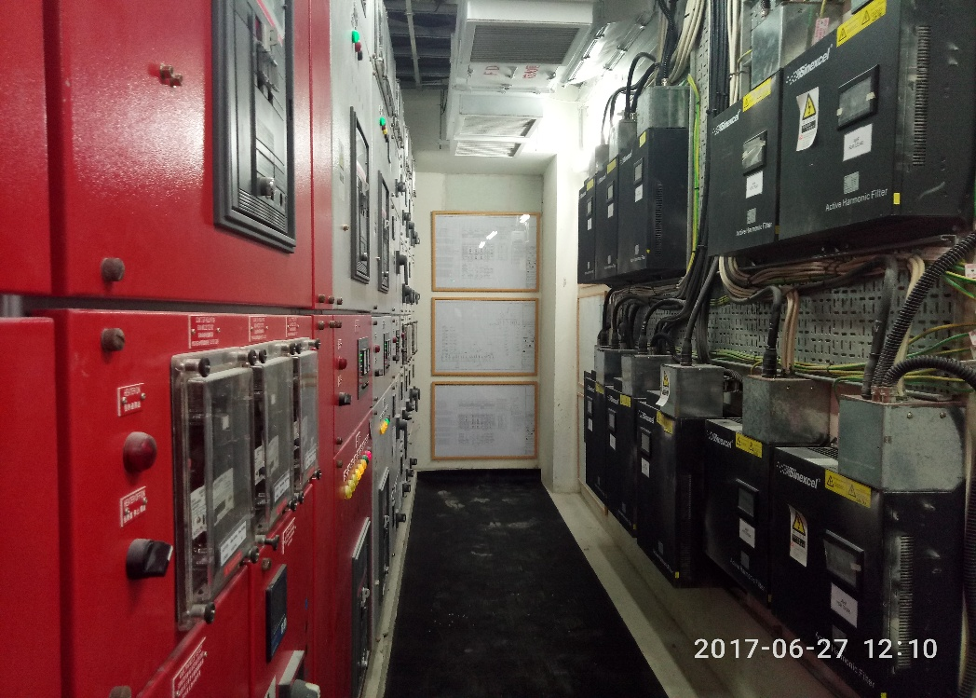
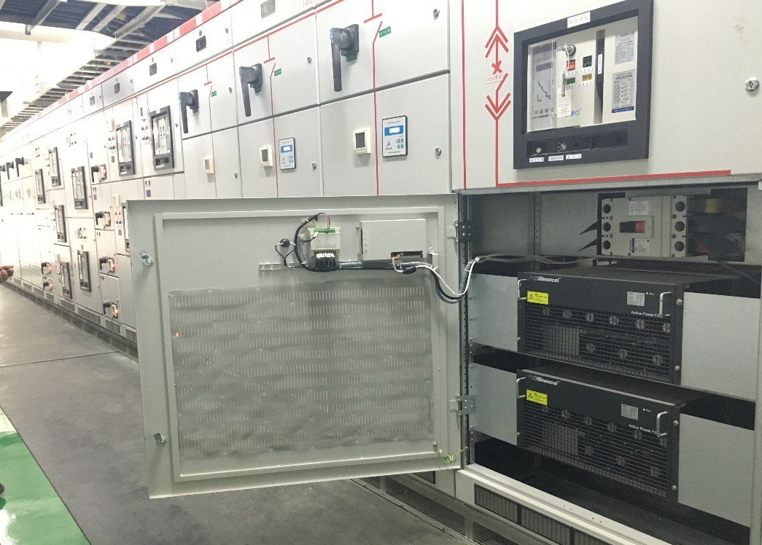
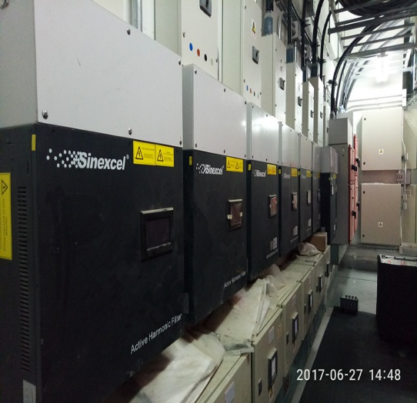
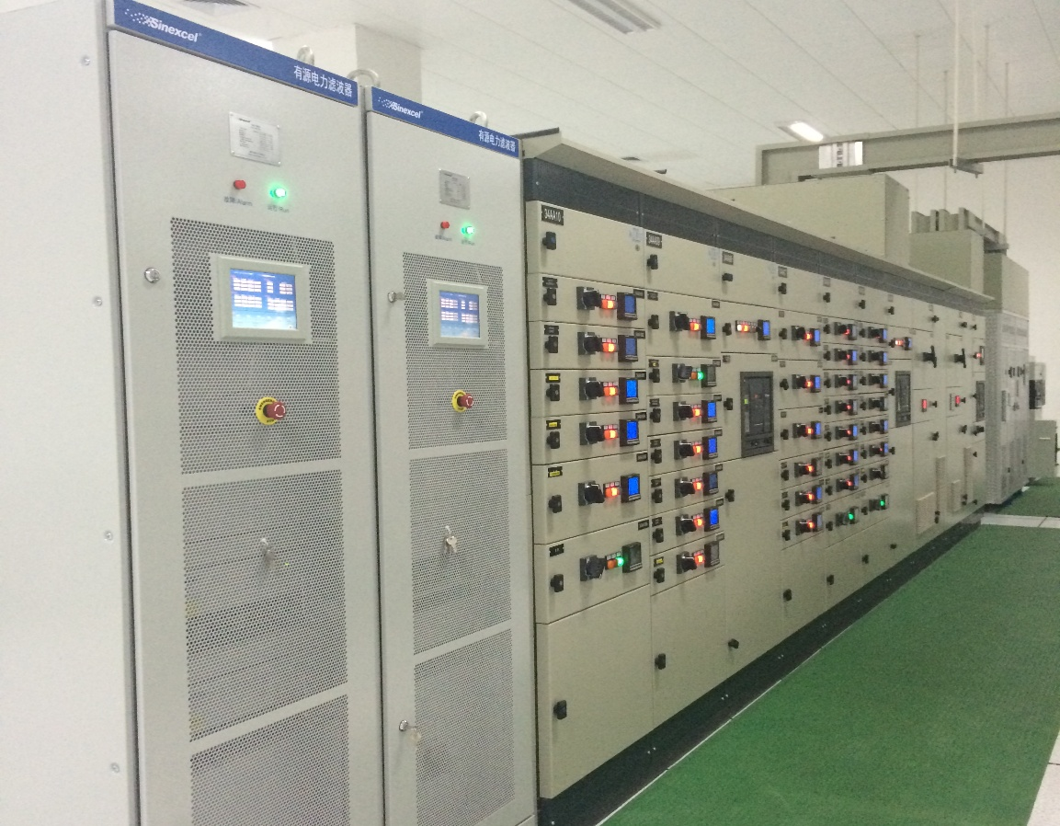
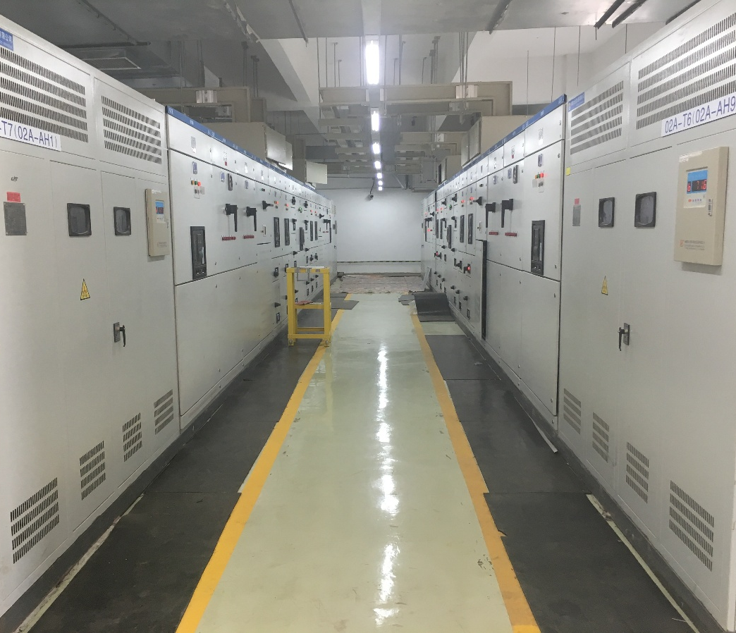
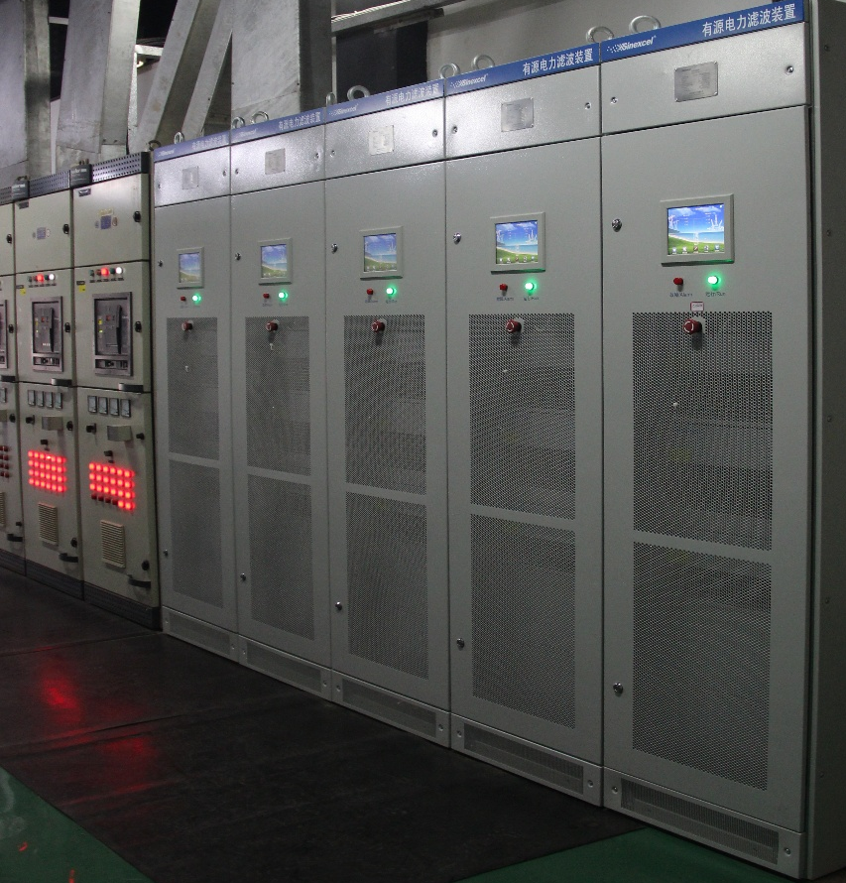
Reference in Global, Industries, Non-linear Loads

Slide 25


Australia, Sydney Opera house, 200A

Slide 26


New Zealand, Irrigation, Central Plains Water, VFD,1340A

Slide 27


Hong Kong International Airport, one of the busiest, most developed airport in the world, 520A

Slide 28
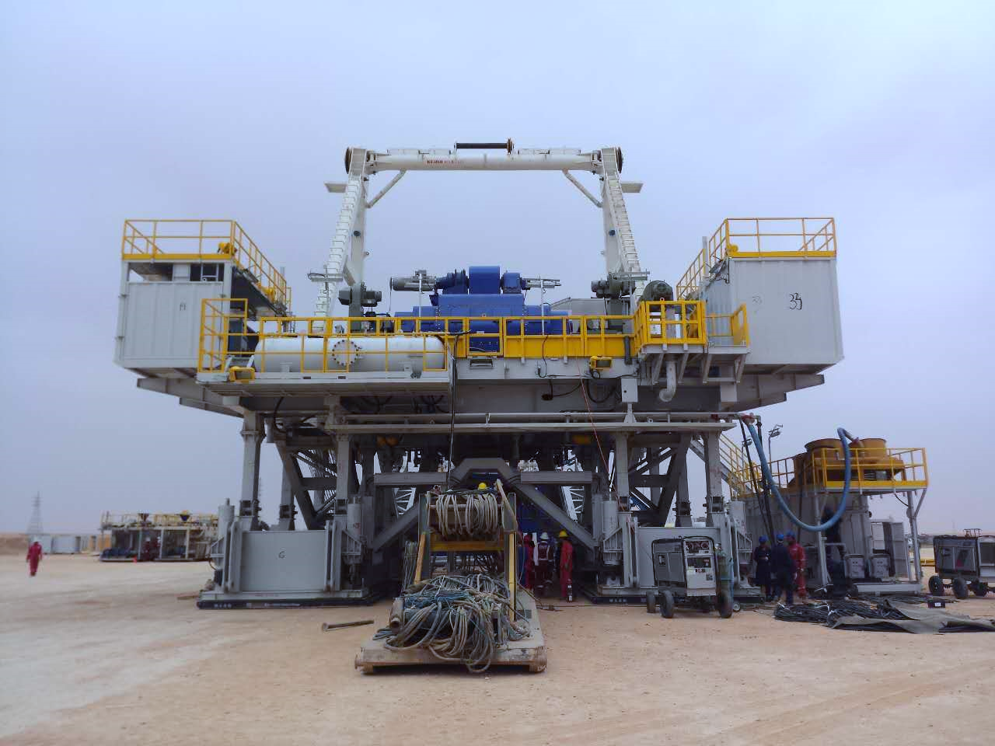

Saudi Arabia, oil drilling, off grid diesel system, high impendence, high THDu, 450A

Slide 29

Changlong Ocean World, Theme Park, Hotel, Shopping mall , 12000A

Slide 30
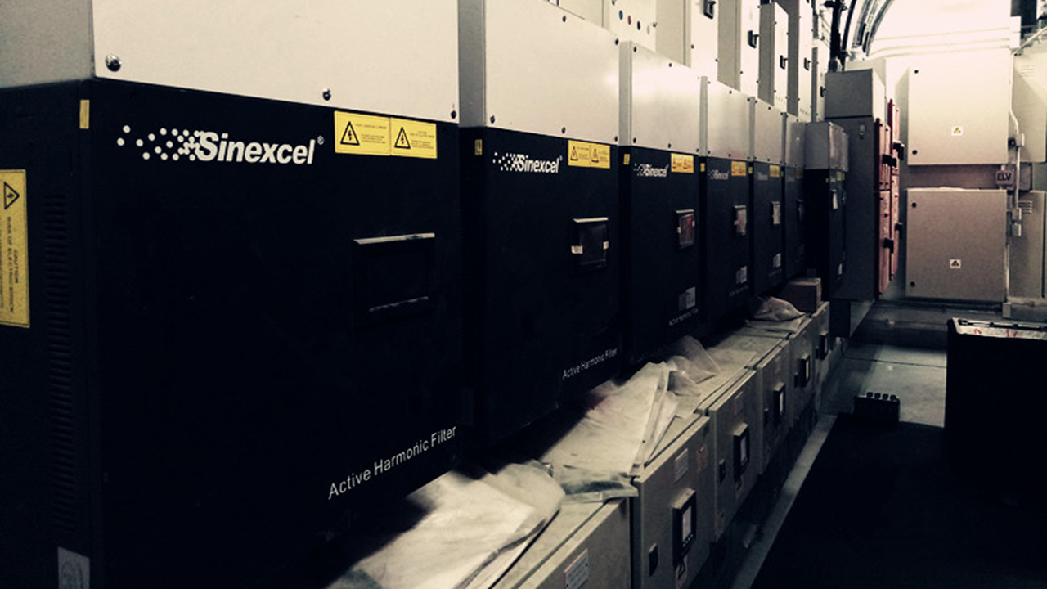

Slide 31


Turkey, Ministry of Health of Turkey, UPS, sensitive medical equipment, 1015A

Slide 32
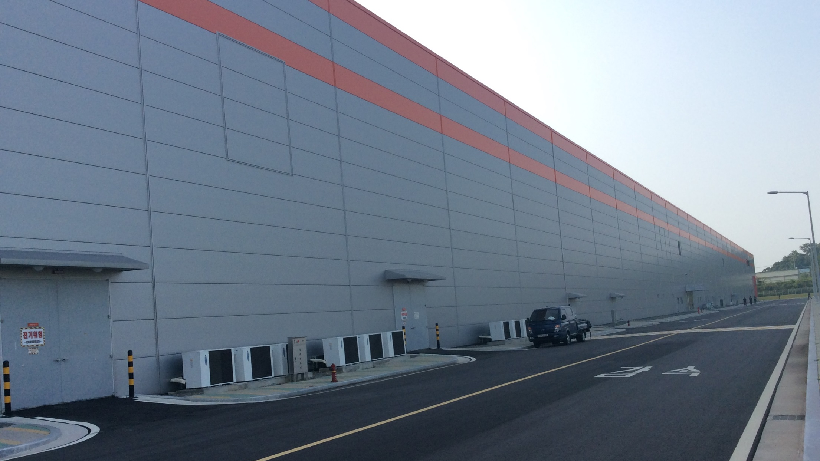

Korea, Hanwha Solar Factory. Furnace, 600A

Slide 33


Canada, Food Product Factory , Hylife Food, 1440A

Slide 34


Singapore, CBD Skyscraper Applications, Marina Bay Financial Center Tower, Asia Square Tower, Ocean Financial Center, Keepel Bay Tower, South Beach Tower, Metropolis Tower, Guoco Tower, Duo Tower for the top companies of the world PWC International, Hewlett Packard, Oracle, ABN AMRO Bank, Google, Boeing, lighting, UPS, VFD, harmonic of commercial building, 5000A+

Slide 35


Malaysia, Prime Minister's Department Complex, , 125A

Slide 36
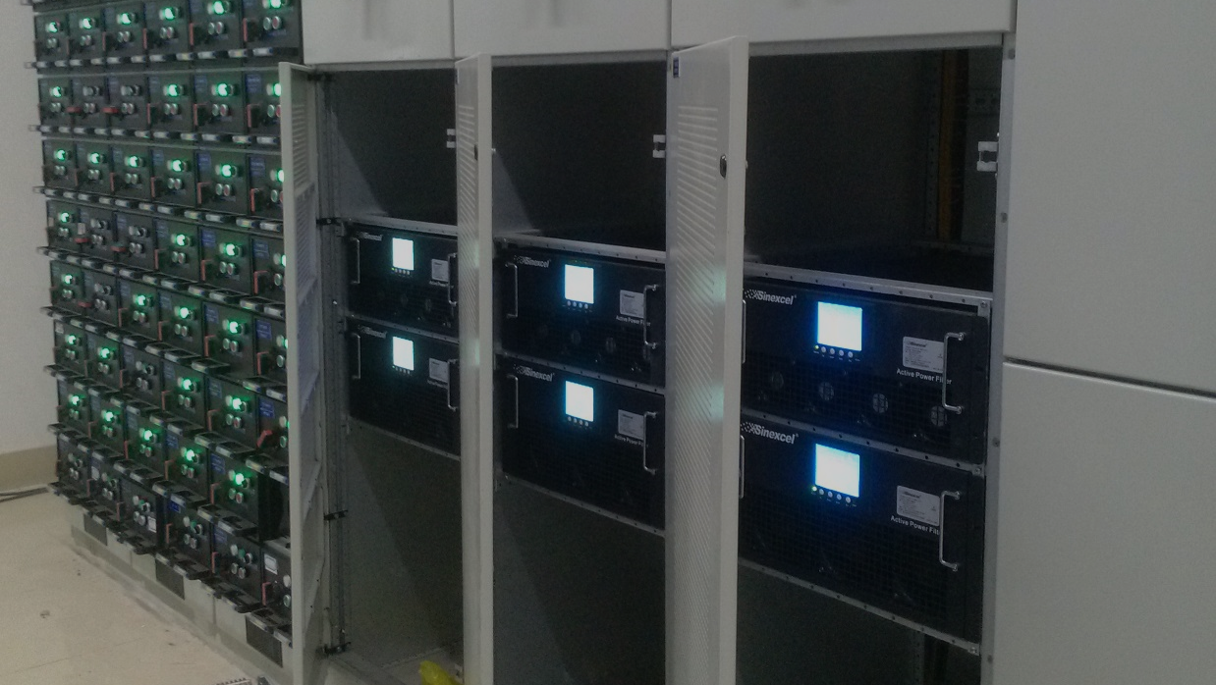
`

Slide 37


Chile, Food Product Factory, Cecinas Llanquihue, 200A

Slide 38
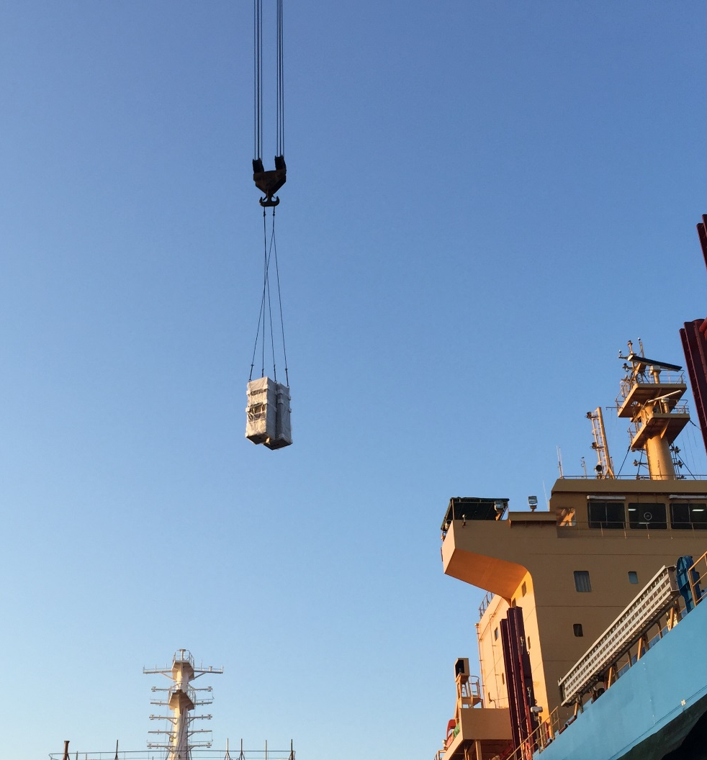


Germany, Transportation, AHF, Summit Bulk Carrier, VFD, isolated grid, high THDu, Ship Certification approval AHF, 300A

Slide 39

Tibet, copper industry , AHF 9900A , SVG 1000kvar

Slide 40


The UK, Glabina cheese, VFD, 350A

Slide 41
Thank You

