Slide 1
AHF/SVG Application in Oil and Gas Industry

Slide 2
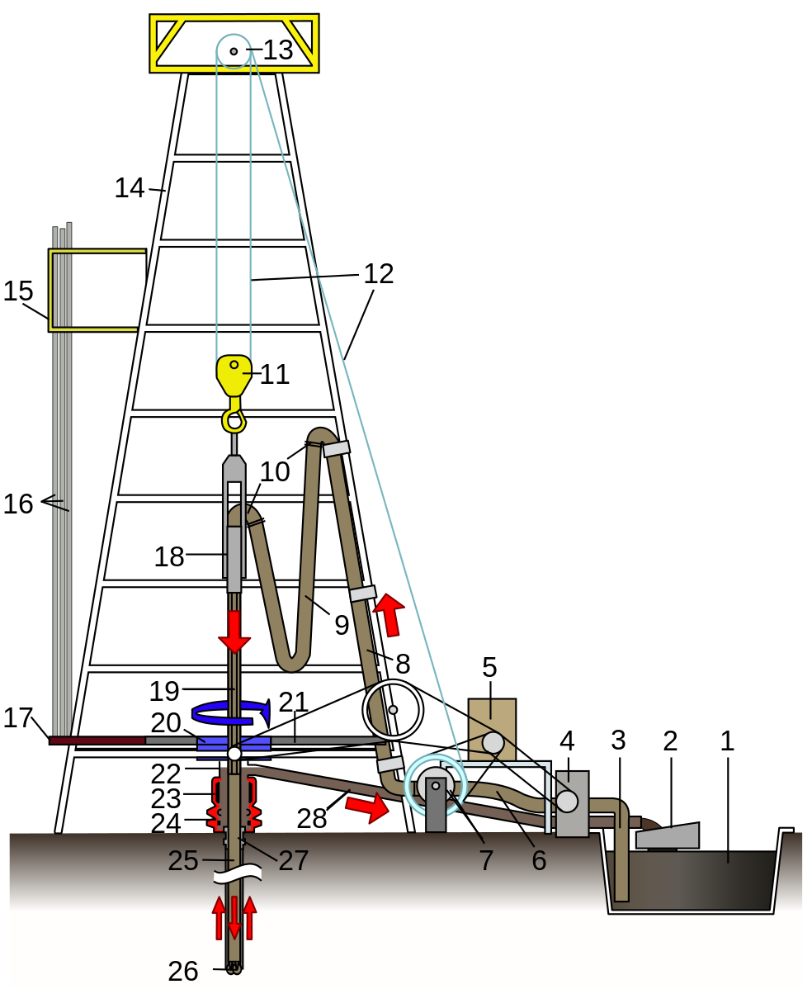
Drilling Rig Sketch
1.Mud tank
2.Shale shakers
3.Suction line
4.Mud pump
5.Power source
6.Vibrating hose
7.Draw-works
8.Standpipe
9.Kelly hose
10.Goose-neck
11.Traveling block
12.Drill line
13. Crown block
14.Derrick
15.Monkey board
16.Stand
17.Pipe rack
18.Swivel
19.Kelly drive
20.Rotary table
21.Drill floor
22.Bell nipple
23.Blowout preventer
24.Blowout preventers
25.Drill string
26.Drill bit
27.Casing head
28.Flow line

Slide 3
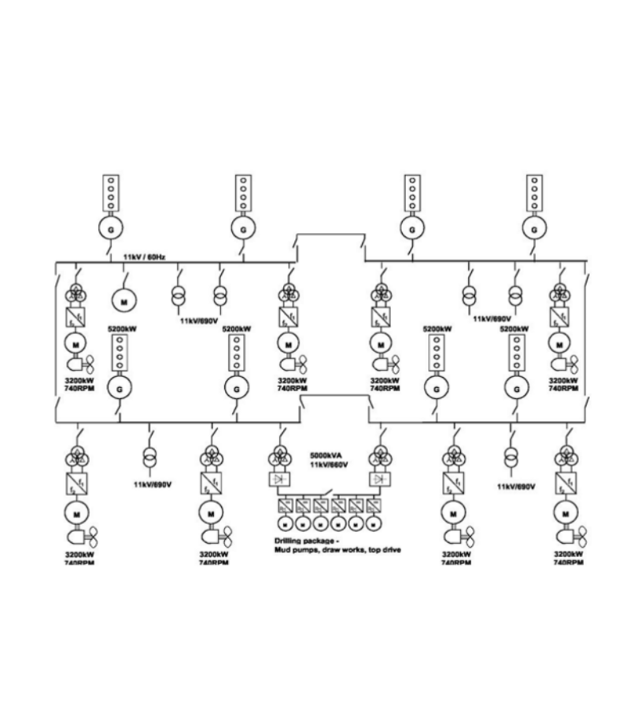
Single Line Diagram
Main loads:
Mud pumps
Draw works
Top drive
Motors

Slide 4
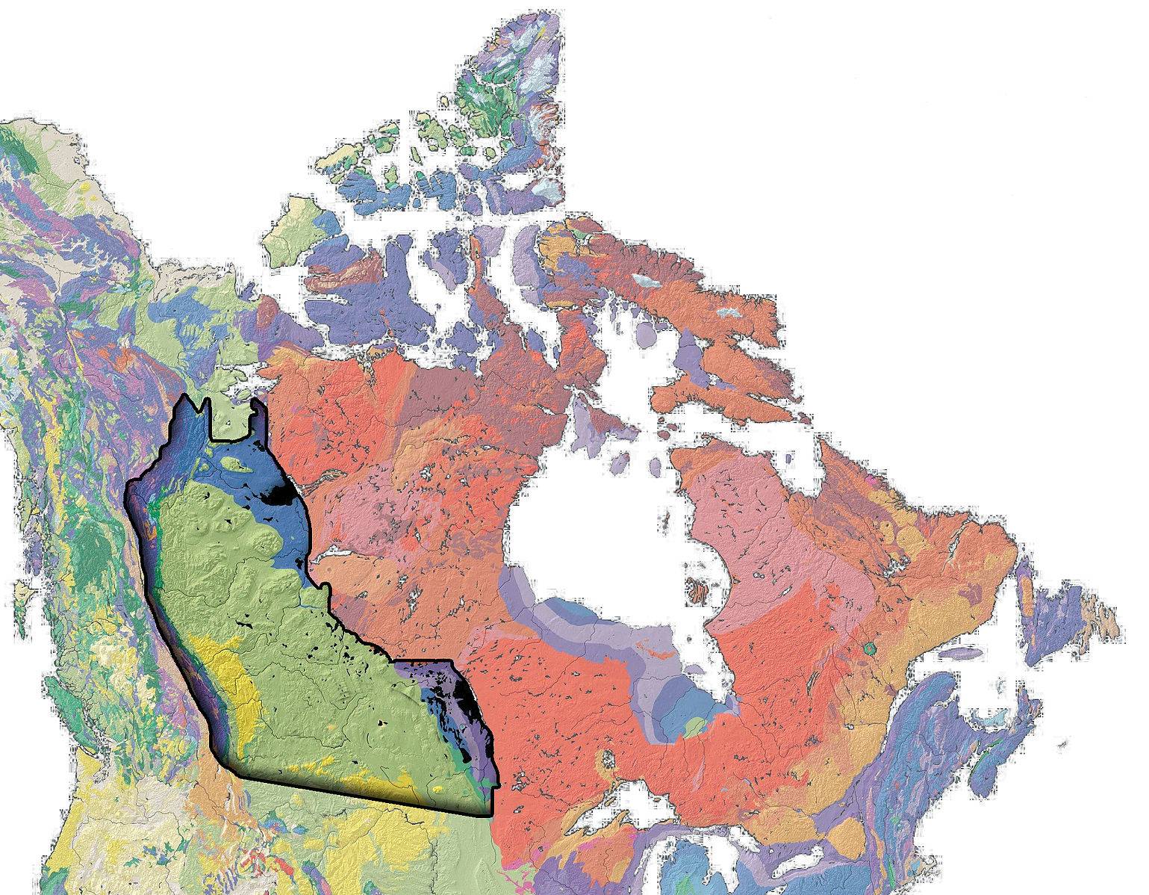
Oil and Gas in Canada
On Land：
Western Canadian Sedimentary Basin
Offshore：
Newfoundland and Labrador

Slide 5
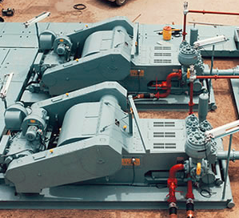
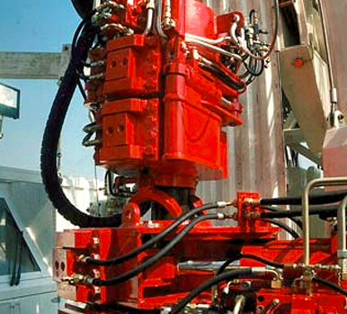
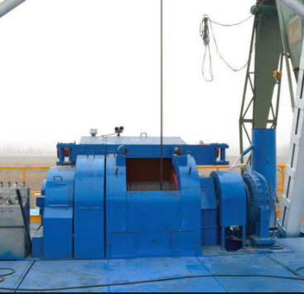
Loads at Site
Mud Pump
Top Drive
Draw Works

Slide 6
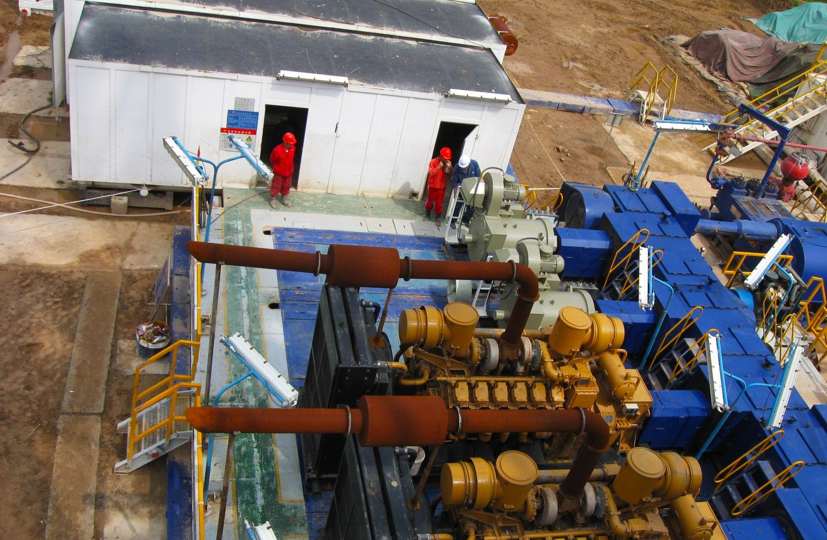
Unhealthy Power Quality Brings Hazard
High cost

Slide 7
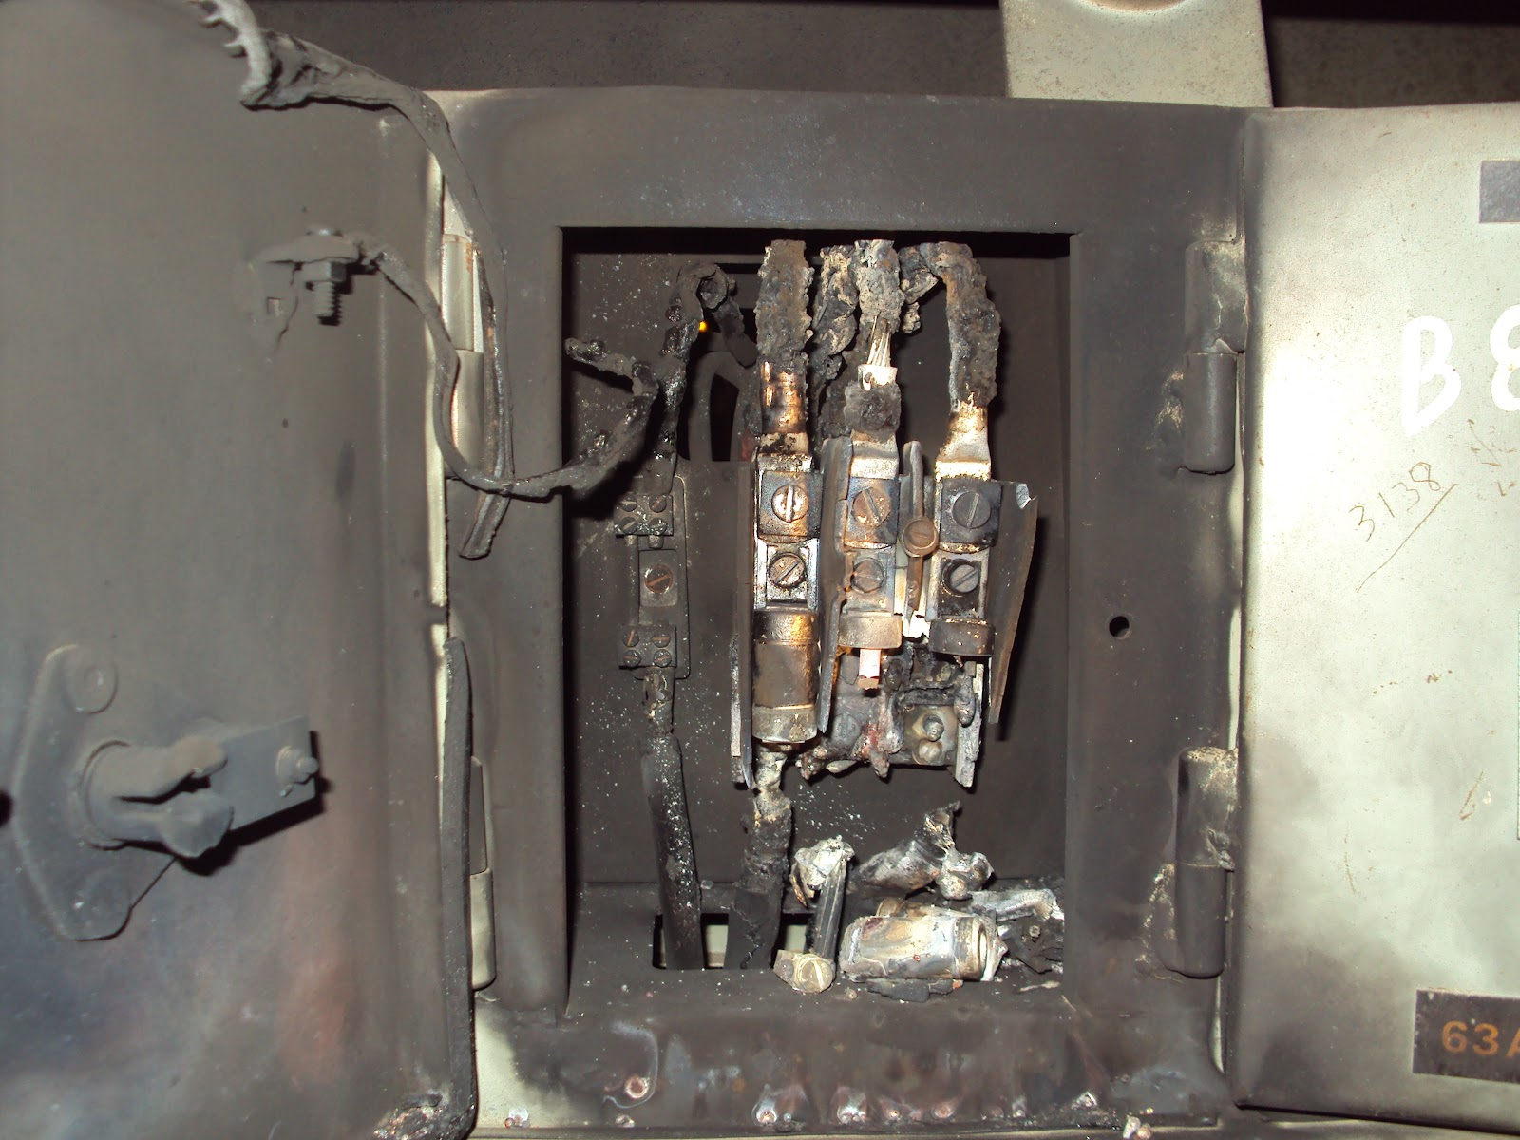
Unhealthy Power Quality Brings Hazard
Equipment damage

Slide 8
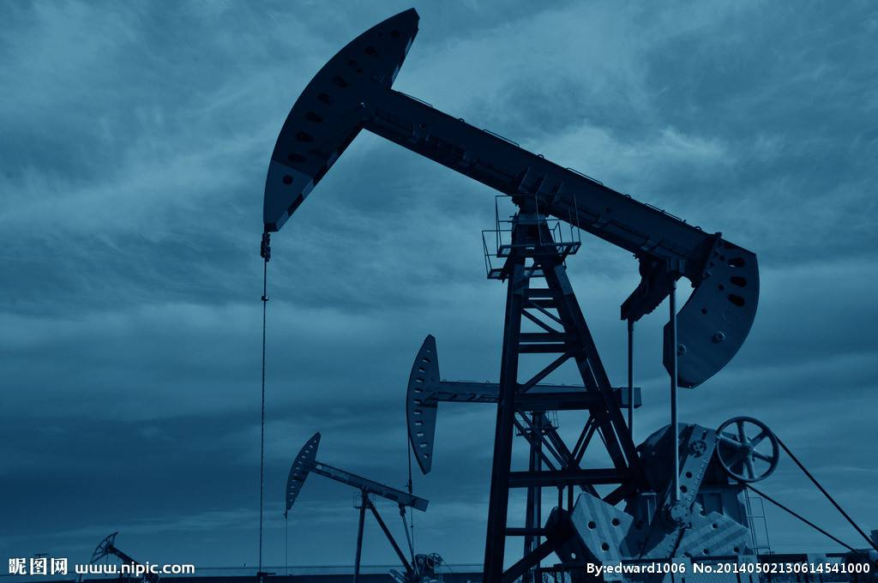
Unhealthy Power Quality Brings Hazard
Delayed schedule

Slide 9
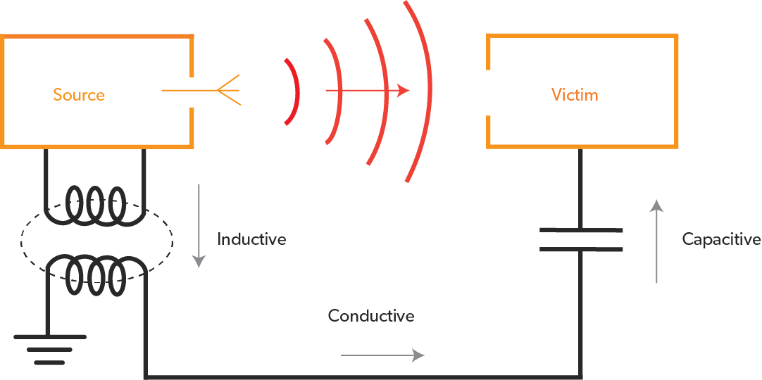
Unhealthy Power Quality Brings Hazard
Communication interference

Slide 10
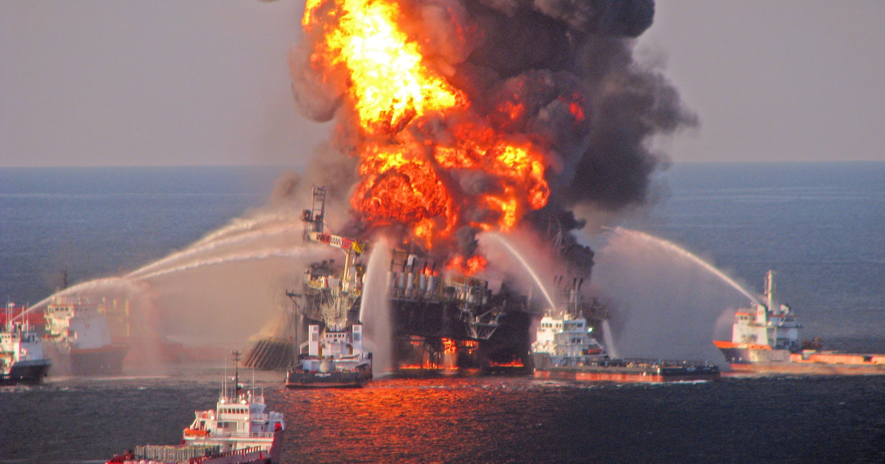
Unhealthy Power Quality Brings Hazard
Fire disaster

Slide 11
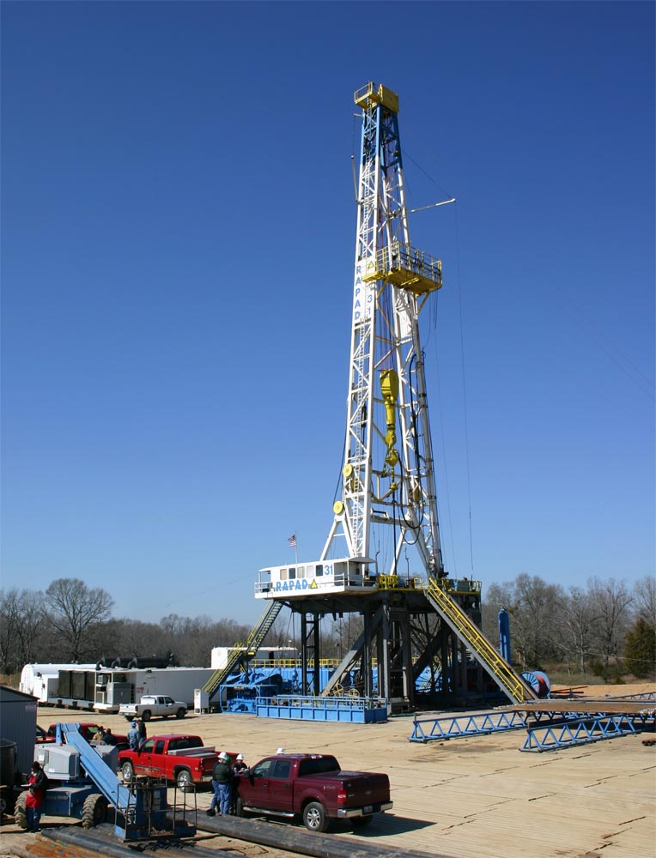
On Land Rigs
IEEE 519-2014
IEC 6000-2-2
IEC 6000-2-4

Slide 12
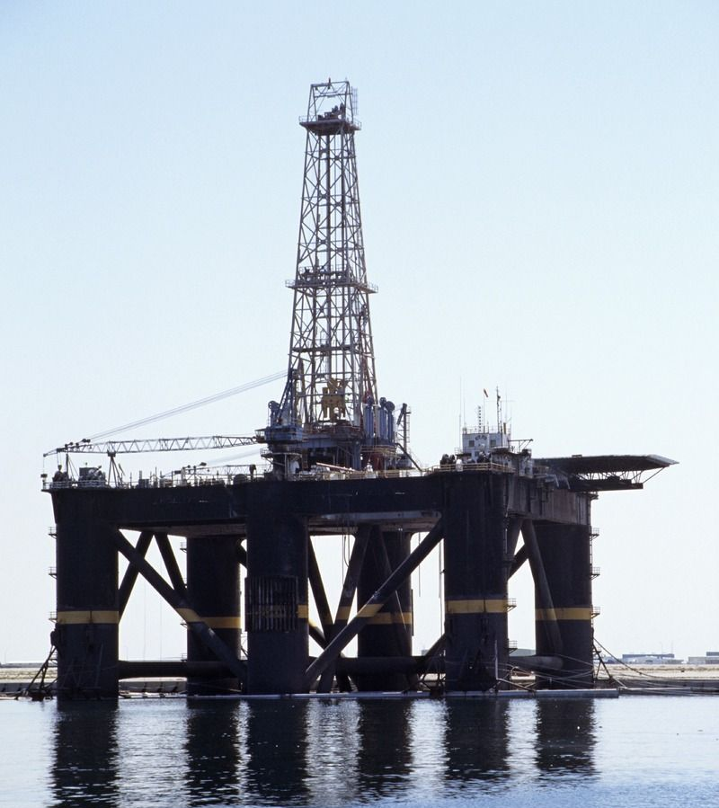
Offshore Drillings
Marine Classification Society | Total harmonic distortion | Single Harmonic
ABS | 8% | 5%
DNV | 8% | 5%
LR | 8% | 1.5%, order >25th

Slide 13
Living examples that support validity of AHF/SVG

Slide 14
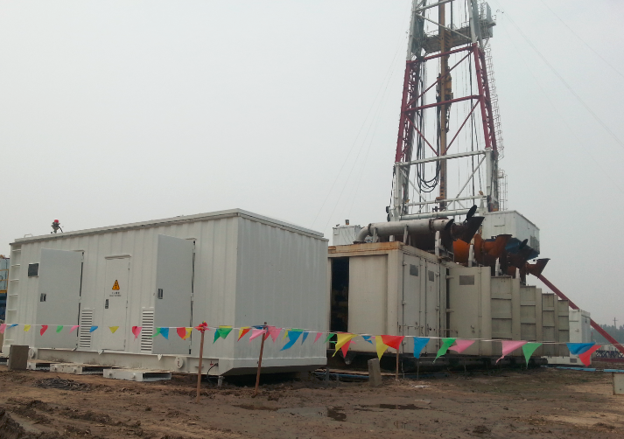
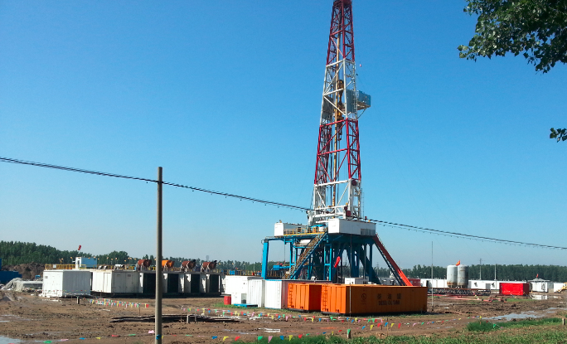
Honghua Oil Drilling

Slide 15
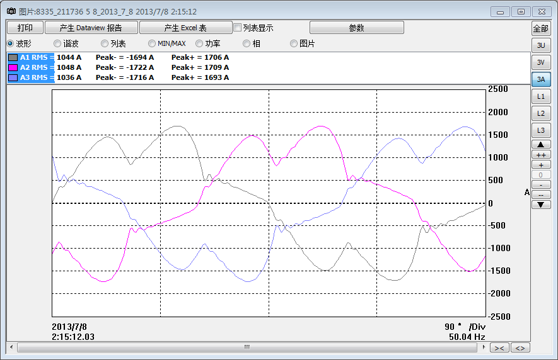
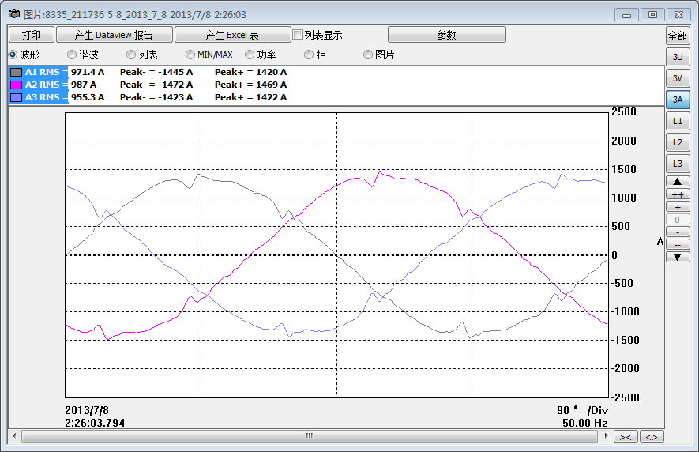
Honghua Oil Drilling
Current waveform before compensation
Current waveform after compensation

Slide 16
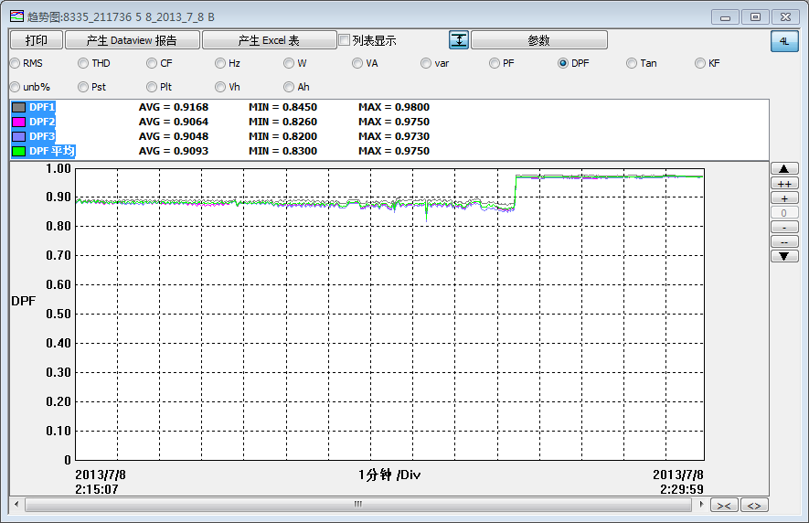
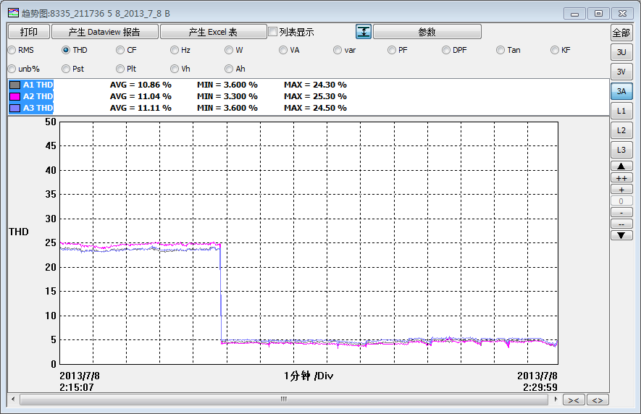
Honghua Oil Drilling
Power factor
THDi
AHF ON
AHF OFF
AHF OFF
AHF ON

Slide 17
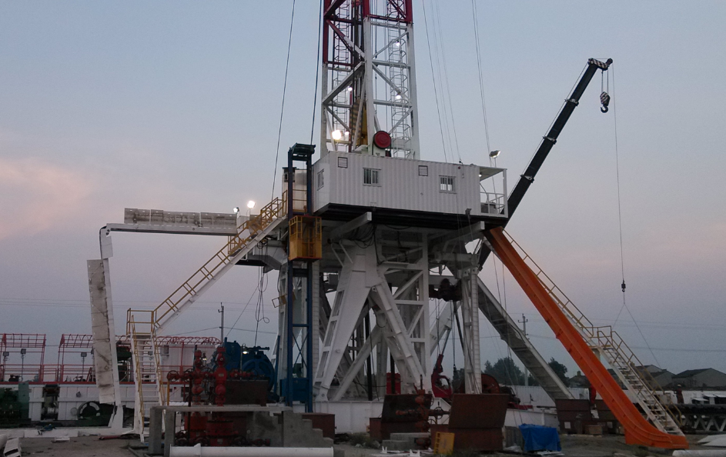
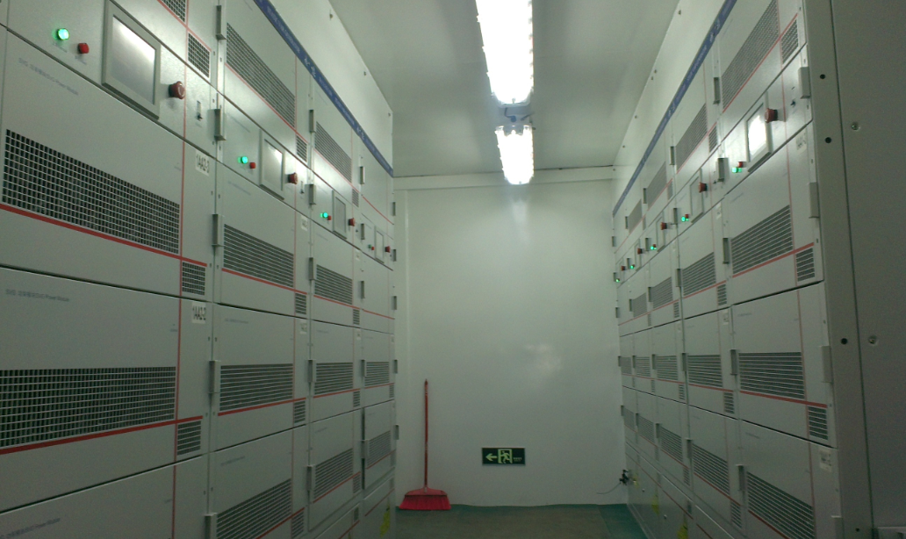
Southwest Bureau Of Sinopec

Slide 18
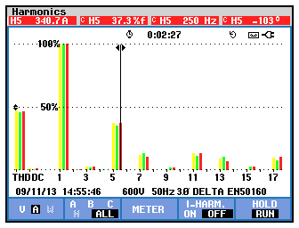
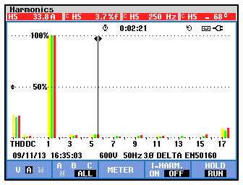
Southwest Bureau Of Sinopec
5th harmonic before compensation
5th harmonic after compensation

Slide 19
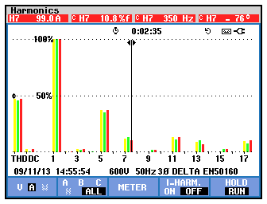
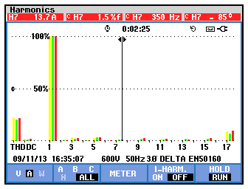
Southwest Bureau Of Sinopec
7th harmonic before compensation
7th harmonic after compensation

Slide 20
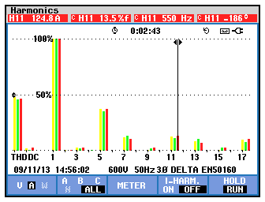
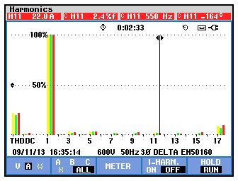
Southwest Bureau Of Sinopec
11th harmonic before compensation
11th harmonic after compensation

