Slide 1
Sales Partner Internal Use Document
Marketing Version will release later

Slide 2
Sinexcel SVG Pro
50kvar&100kvar
SVG is a breakthrough to PFC, Sinexcel Pro SVG, it is a breakthrough to Sinexcel SVG, breakthrough*breakthrough, it is a big technology revolution at PFC to end users, it is a great business expansion opportunity to current PFC business for sales partners.

Slide 3
Significant Innovations

Slide 4
CT Connection at Grid Side
It does not matter for accuracy of performance CT at source side or grid side, it does matter the habit of electric system CT at grid side.
Sinexcel SVG is always compatible with CT installation on both sides,
for now SVG Pro can realize multiple unit s with one set of CT on grid side.

Slide 5
Big breakthrough peak efficiency 98.5%
Power electronics, every 0.5% increase in efficiency, a great technology improvement.
This time, on the basis of the three-level topology which has lead the industry for 12 years, Sinexcel has once again made major technology innovations in circuit design and algorithm.
Sinexcel SVG Pro 3*0.5% efficiency breakthrough.

Slide 6
50% energy consumption reduced
100% capacity of Power Factor Correction
50kVar&100kVar are high-power equipment, supporting a large facility to
operate multiple modules in parallel, 24*365 working hours and SVG's own energy consumption are important indicators for users to operate efficiently.
Pro SVG peak efficiency up to 98.5%, compare to industry standard 97%,
energy consume saving: 12,972KWH per year

Slide 7
Inverters say please run at 80% load, Sinexcel SVG Pro says go ahead for 100% full load 24hours*365days
Only for SVG Pro 100kvar, important, only for SVG Pro 100kvar
Heat is the biggest challenge for lifetime of components, reliable of inverter.
Sinexcel SVG Pro use high quality components and innovative design at circuit board and programming, 100% full load 24hours*365days is no problem (SVG Pro 100kVar).
Reduce capacity at PFC capacity sizing, and cost of cabling, installation.

Slide 8
33% heat reduction, stable*stable
Heat dissipation is the most important technical index of SVG reliability, Sinexcel SVG has a convincing record of stability, Pro SVG 33% heat reduce, this is stable*stable, double safty insurance for customers
Innovative design of Circuit Board, air duct and algorithm to greatly optimize heat dissipation.
Less heat generation enables SVG to adapt to various working conditions all over the world, such as power distribution rooms without air conditioning and hot tropical areas.

Slide 9
36%~53% Ventilation need reduced
Less air conduct, lower noise
Less heat generation, longer lifespan
Less ventilation need, more easy to be contained in the Electrical Panel
Pro 50kvar
360CFM
SVG 50kvar
481CFM
Pro 100kvar
390CFM
SVG 100kvar
825CFM
Pro SVG
SVG

Slide 10
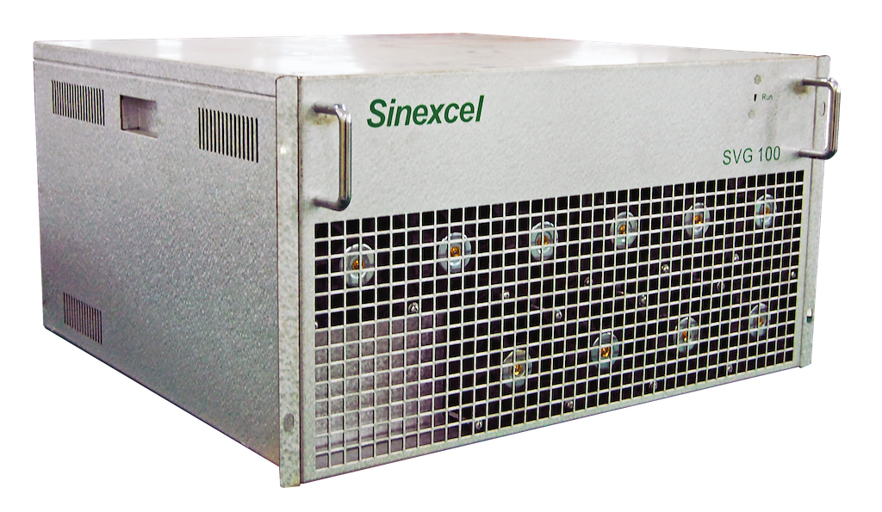
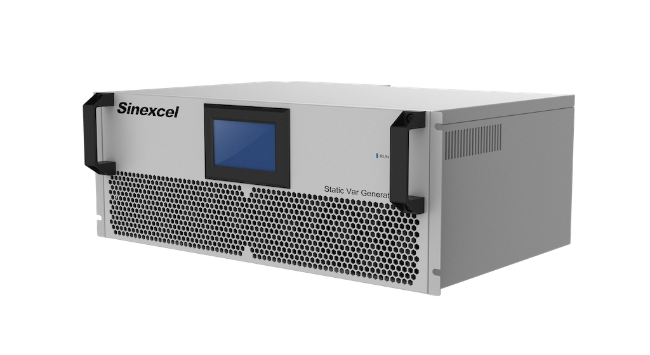
Get customer’s impressive recognition by 20% mechanical size and weight to competitor with same function, and the module looks delicately, great potential at marketing
40% reduce mechanical size
Weight drop from 48kg to 35kg
SVG 100kvar_48kg
Pro SVG 100kvar_35kg
269mm
190mm
520mm
500mm
495mm
500mm

Slide 11
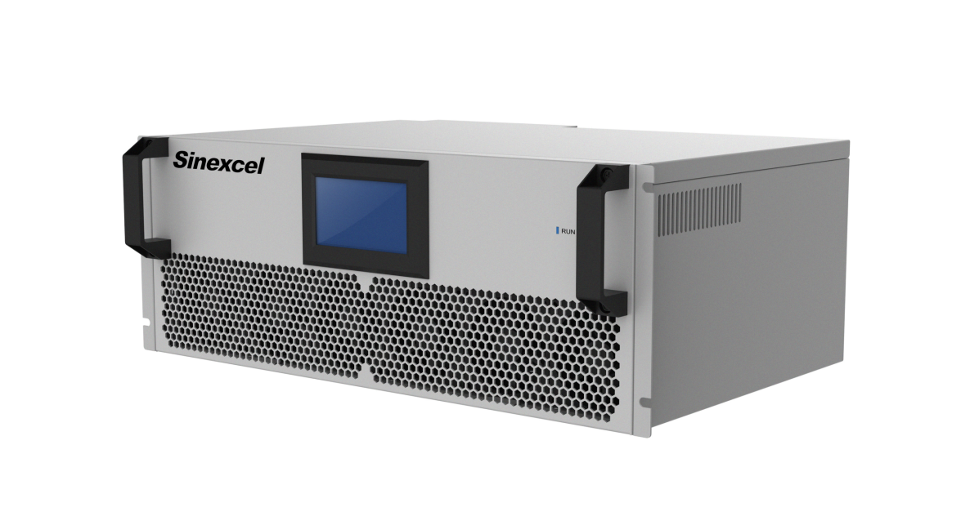
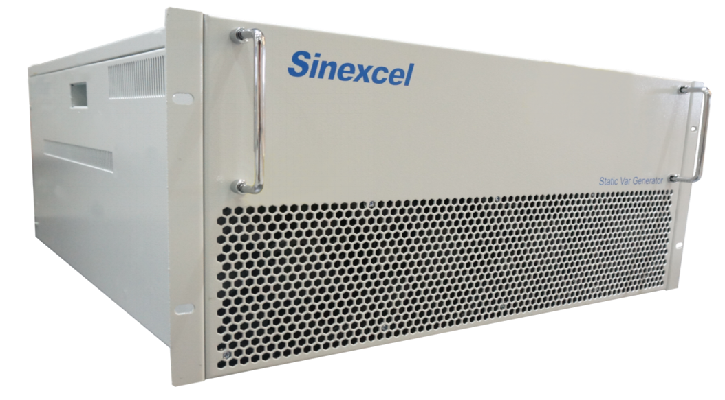
50kvar, 25kg, 300mm height
applaud for this innovation, incredible
SVG 50kvar_36kg
Pro SVG 50kvar_25kg
370mm
190mm
690mm
500mm
300mm
500mm

Slide 12
Sinexcel would like to ask a
product idea discussion?
Cap bank has a bank, can SVG Pro no bank, all modules mount at wall to save cost at cabinet and installation.
We are urge to discuss this topic, pls feedback to us.

Slide 13
Innovations improve user experience

Slide 14
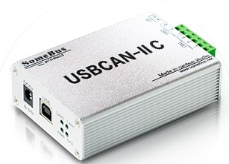
On-line software updating
Flashupdate software can realize the on-line upgrading, no need to disassemble and replace the circuit board.

Slide 15
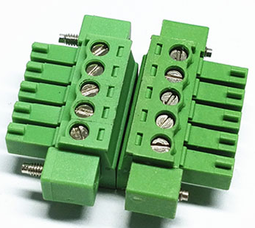
Fixed secondary CT terminal
Upgraded CT terminal can be fixed on the unit, fastened terminals to avoid falling off during mechanical vibration.

Slide 16
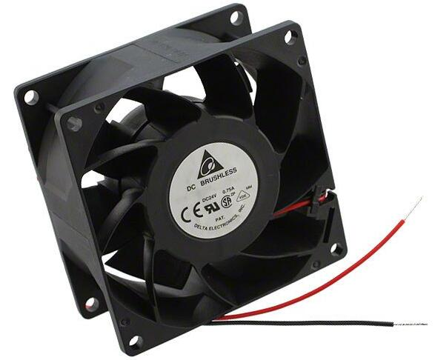
Fan fault point detection
PRO models equipped with fan alarm function to accurately record and feedback fault points. Together with over-temperature alarm function, increase units reliability.

Slide 17
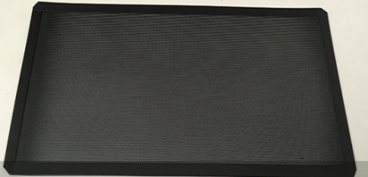
Dustproof Cover
Reserved connector for vents, compatible with the dustproof cover snap-in installation design, easy to disassemble and clean

Slide 18
2020.05.01
Available to Market (CE about at 2020.09.01.)

