Slide 2
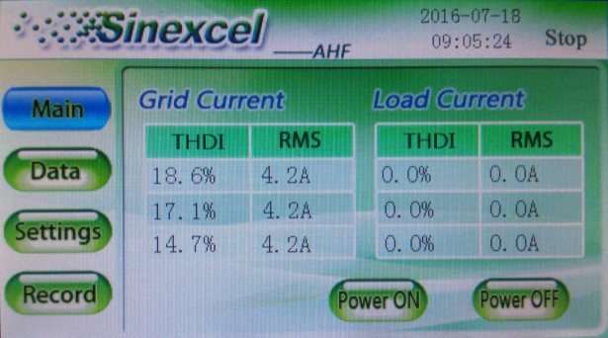
“Main Interface”
“Alarm”: system status (It includes the following three states).
“Stop”: stand by mode
“Alarm”: abnormal working condition
“Normal”: abnormal working condition
“Main”:
Grid Current: after compensating
Load Current: before compensating
PF： power factor
RMS： root mean square
Power On： starting up
Power Off： shutdown

Slide 3
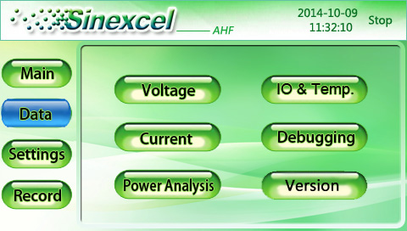
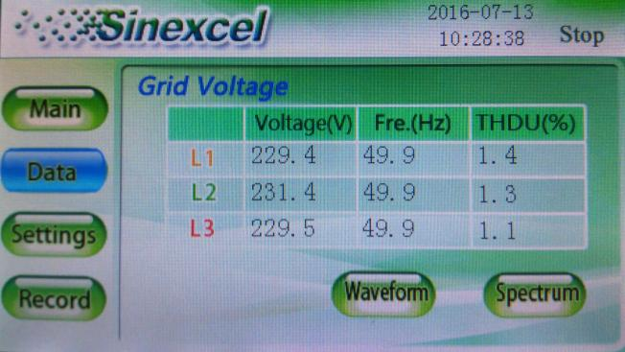
“Data Interface”
This interface is about voltage/ frequency/THDu of AHF power access point, check 3-phase voltage waveform by clicking “waveform” , check each order of harmonic voltage distribution by clicking “Spectrum”
L1 corresponding to the A phase
L2 corresponding to the B phase
L3 corresponding to the C phase

Slide 4
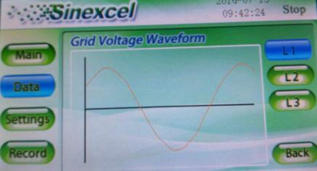
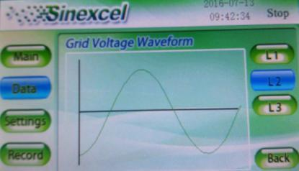
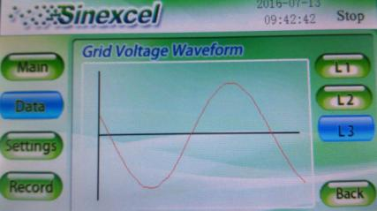
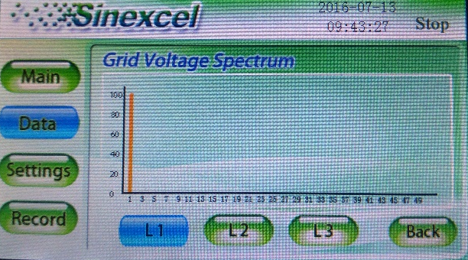
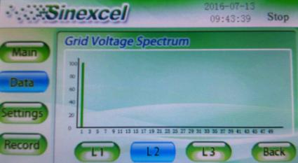
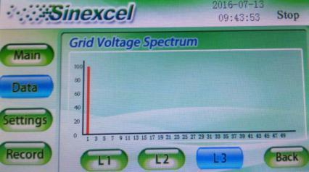
“Waveform and Spectrum”
Voltage Waveform（L1/L2/L3）
Voltage Spectrum （L1/L2/L3）

Slide 5
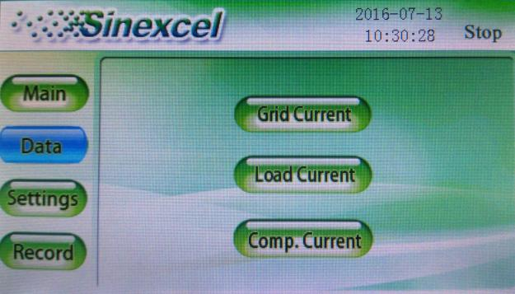
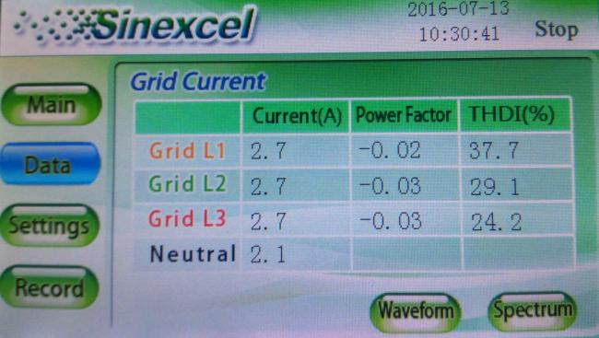
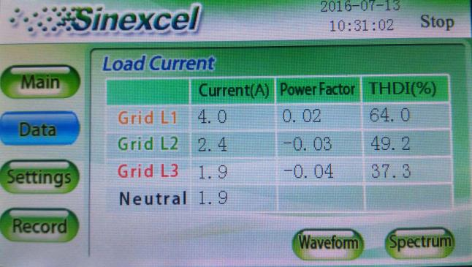
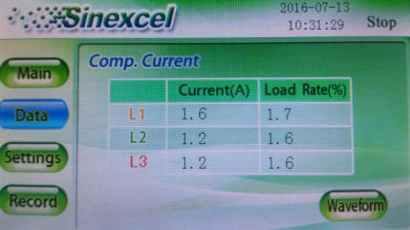
“current”
Grid current ：the current after compensation
load current ： the current before compensation
Comp current ：the current outputted from AHF.
Check 3-phase current waveform by clicking “waveform” , check each order of harmonic current distribution by clicking “Spectrum”

Slide 6
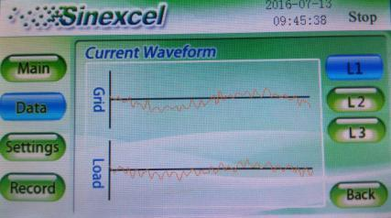
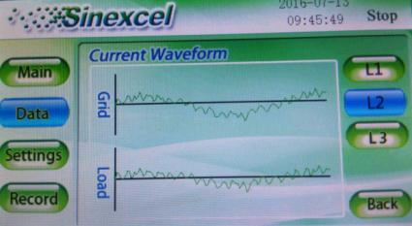
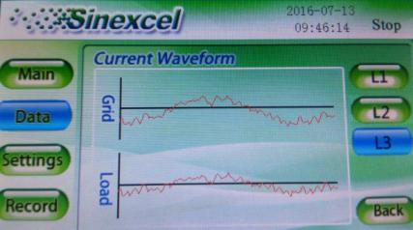
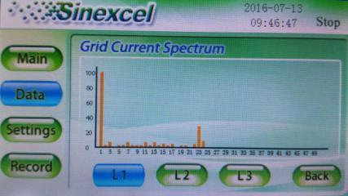
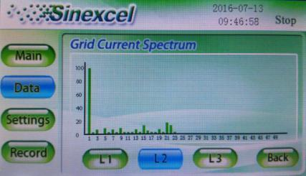
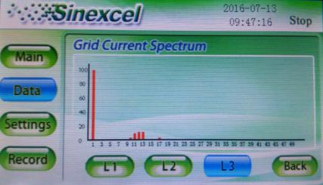
Waveform and Spectrum
Grid current Waveform（L1/L2/L3）
Grid current Spectrum（L1/L2/L3）

Slide 7
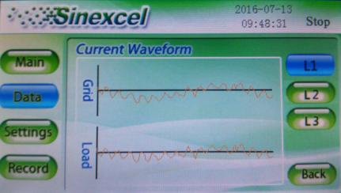
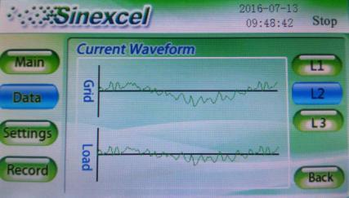
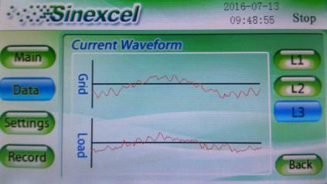
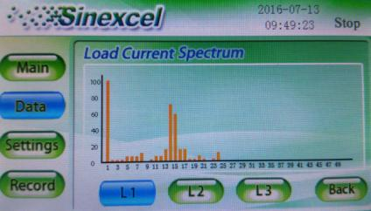
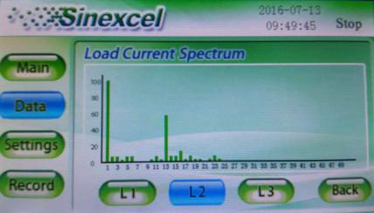
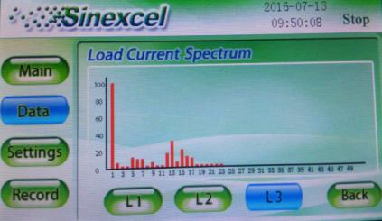
Waveform and Spectrum
Load current Waveform（L1/L2/L3）
Load current Spectrum（L1/L2/L3）

Slide 8
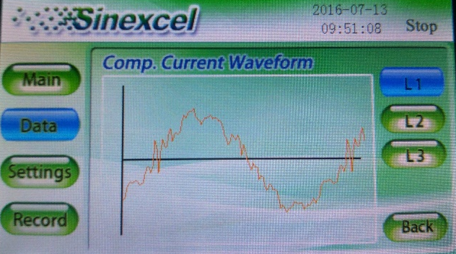
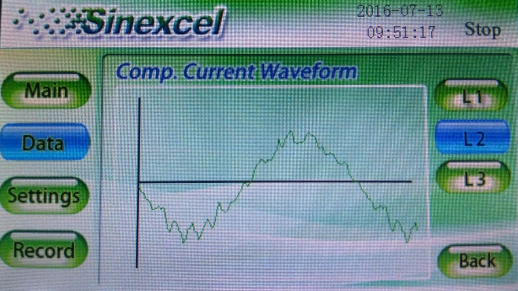
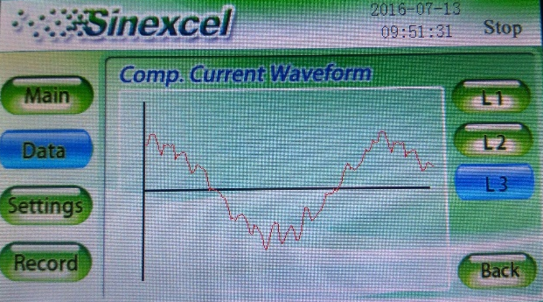
Compensation current Waveform（L1/L2/L3）
Compensation current Spectrum（L1/L2/L3）

Slide 9
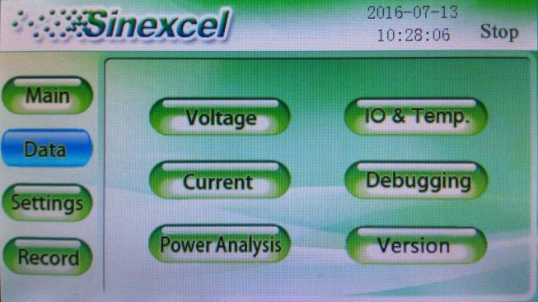
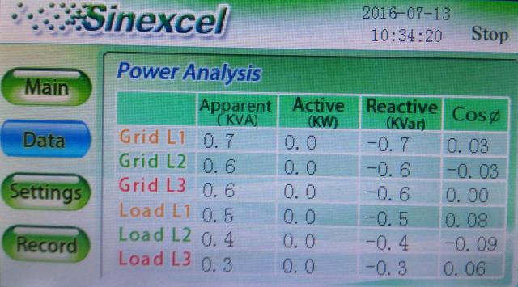
Debugging & Power Analysis
“Debugging”
Different setting values correspond to different internal variables of DSP. And it is forbidden to change from users.
“Power Analysis”
Grid side / Load side (L1/L2/L3)
Apparent power,
Active power ,
Reactive power
cosΦ.
(Grid side means after compensation, Load side means before compensation.)

Slide 10
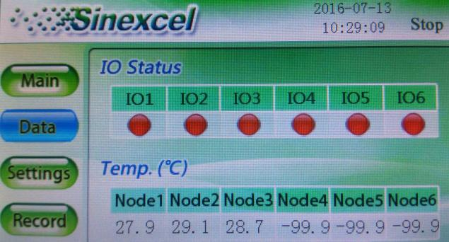
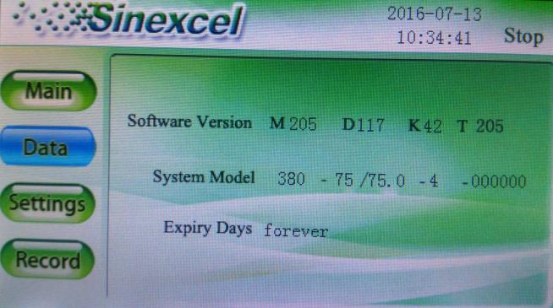
“ IO & Temperature”
Node1-3 are invalid,
It respectively AHF inner L1/L2/L3 the highest temperature. .
“ Version”
Software Version
Mxxx said monitoring software version information,
Dxxx of DSP software version information

Slide 11
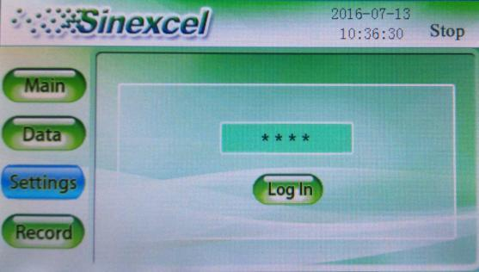
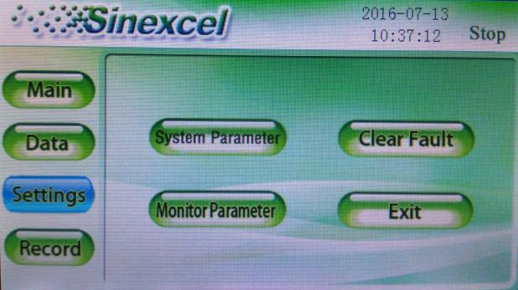
“Setting”
password : 080808
More parameters settings under the advanced password
System Parameter
(Basic parameters of the DSP control system)
Clear Fault
(After the AHF appeared some fault alarm, it need to click the "Clear fault" to restore normal work)
Monitor Parameter
(The basic parameters for monitor display)
Exit
(drop out From the parameter settings interface)

Slide 12
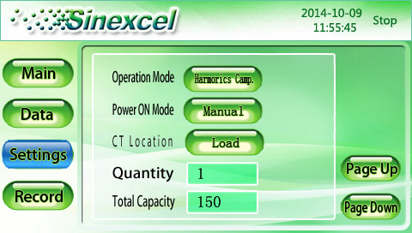
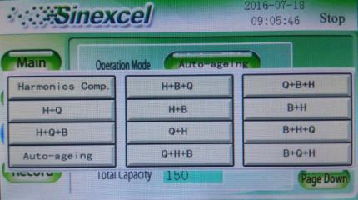
System Parameter : Operation Mode:
Operation mode:
H（harmonic）: Harmonic compensation
Q (Reactive）: Reactive power compensation
B (Balancing) : unbalance compensation
Auto-ageing:
Manufacturer internal testing work mode, client shall be forbidden to use.
There have 12 kinds of operation modes
H H+B+Q Q+B+H
H+Q H+B B+H
H+Q+B Q+H B+H+Q
Auto-ageing Q+H+B B+Q+H
H+B+Q means harmonic compensation first, then compensating 3-phase unbalanced, finally compensating reactive power

Slide 13
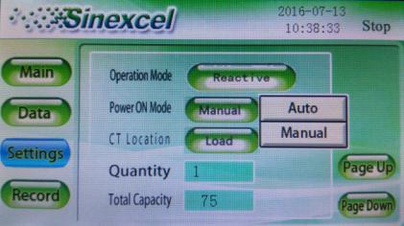
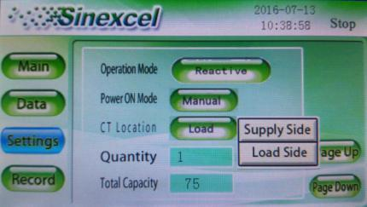
Power ON Mode and CT Location
Power ON Mode:
Auto : AHF can automatically start working when AHF power on
Manual: AHF will work when user clicking power on
CT Location:
Supply Side
for single AHF system , supply side is mean the CT installed between Grid and AHF
Load Side
load side is mean the CT installed between AHF and loads, user can chose supply or load according to where is the CT installation point , for multiple AHFs system , use can only chose load side no matter CT installed on grid side or load side

Slide 14
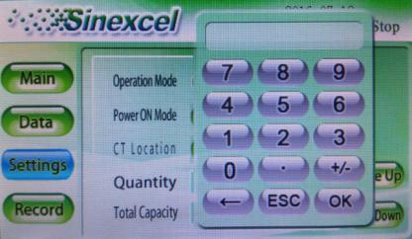
Quantity & Total Capacity:
Quantity:
Parameter a default value is 1, can not be changed
Total Capacity:
for single AHF system ，total capacity =AHF rate capacity , for multiple AHFs parallel system, total capacity=combining each single AHF rated capacity.
For example :
If AHF system capacity= 200A, AHF total capacity should be set as 200 for each 100A AHF

Slide 15
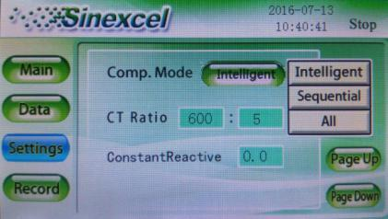
Compensation mode & CT ratio
Compensation mode:
Choose "Intelligent compensation" mode first. "sequential compensation" and "All compensation" are suitable for harmonic system that changes rapidly, and they are less stable than "Intelligent compensation".
CT ratio:
The setting value need to correspond to the actual changes of external CT. The setting range: 150~30000. (500 means 500:5 .)
Constant Reactive:
Before setting this parameter need to consult the manufacturer engineers

Slide 16
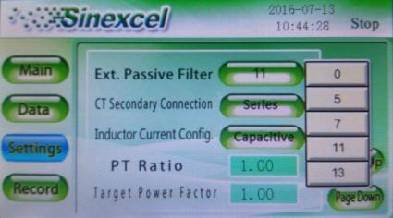
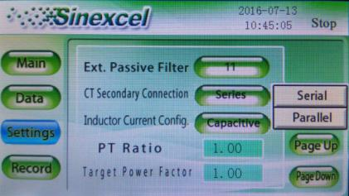
Click “Page Down”
Ext. Passive Filter:
Reserved.
CT Secondary Connect:
it is can only be set as series
Inductor Current Configuration
In the auto-aging mode , choose inductance current or capacitive current output. And it is forbidden to change from users port.

Slide 17
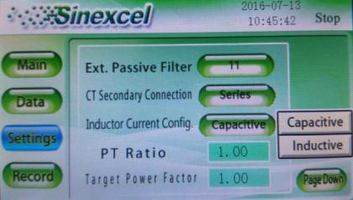
Click “Page Down”
(go to next page)
PT Ratio:
Equipment when being used get access to the grid through the transformer. And it is used to set the external transformer ratio. The default is 1.0 meaning 1∶1，ranging 0.1~25.
(Before the change must consult the Engineer)
Target Power Factor:
Adjusting the grid side power factor. (range: -1~1)

Slide 18
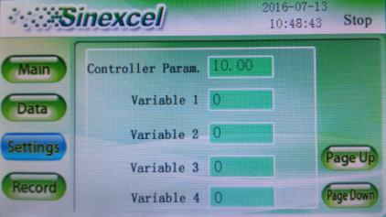
“Page Down”
Controller Parameter I
Voltage loop control parameters, the larger parameters of the controller I is , the more stable voltage loop is . And it is forbidden to change from users.
Variable 1~6
Different setting values correspond to different internal variables of DSP . And it is forbidden to change by users.

Slide 19
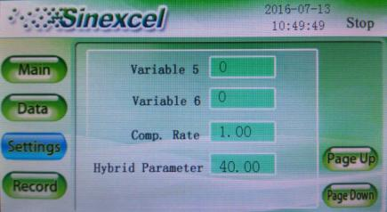
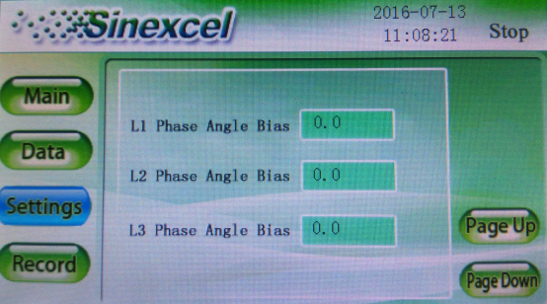
“Page Down”
Compensation Rate
Set the compensation ratio of compensation current measured by AHF. The setting range is 0~1, 1 on behalf of 100%.
Hybrid Parameters
Reserved (it is forbidden to change by users)
L1/ L2/ L3 Phase Angle Bias
Reserved. and can be changed by users

Slide 20
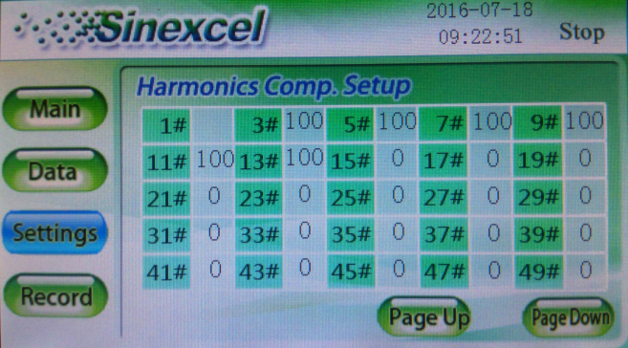
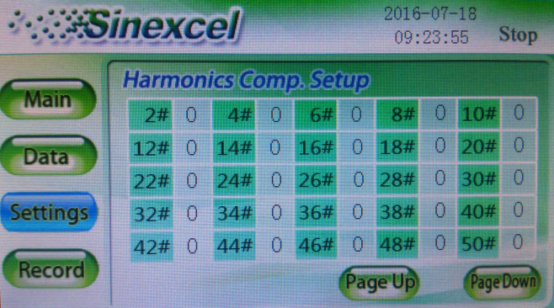
Harmonic Comp. Setup
Harmonic Comp. Setup interface
it is allow to adjust compensation rate of every order harmonics. The setting range: 0%~110%

Slide 21
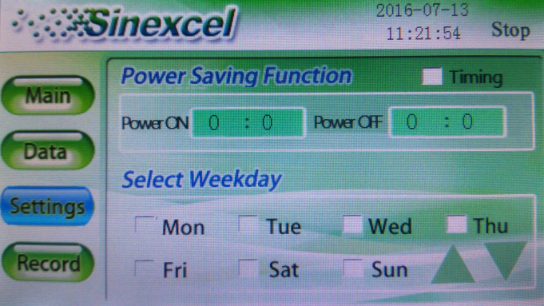
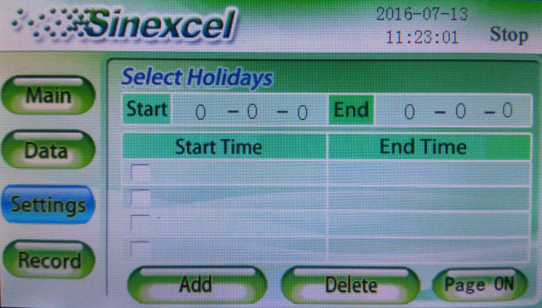
Power Saving Function
Power Saving Function
Setting the time of power on and power off to achieve saving power.
Select Weekday
Setting the working days of the machine.
Select Holidays
Setting the time of start and end.

Slide 22
“Monitor Parameter”
Local Address
Setting monitoring address
Baud Rate
Setting the times of carriers that change in per unit time.
Language
Choose monitor display language.
Time
Set current time.

Slide 23
“Alarm”
Active
Displays the current alarm information.
History
Display previous alarm information.
A total of 500 pieces of information can be recorded.
Download
Download recorded information by USB access

Slide 24
“Operations”
View the machine's operation record.

