Slide 1

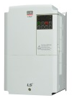
S100 INV PM Motor Control
INDEX
1. Introduction
2. Background Information
3. S100 PM Sensorless
4. S100 S/L Mode Parameter Comparison
5. Sensorless Vector Control Troubleshooting Guide
6. PM Sensorless Test References

Slide 2
1. Introduction
▶ S100 Permanent magnet synchronous sensorless vector control technology
A. Development Background
- Minimum Energy Performance Standards (MEPS) & Sensorless Control
: Since the regulation of the motor’s minimum efficiency is strengthened, there has been the growing trend in driving
conventional induction motor with inverter or changing the induction motor to permanent magnet motor
or synchronous reluctance motor. Thus, the development for PM or SynRM Sensorless control algorithm has became essential.
B. Comparison
 | LSIS | Competitors
 | Improved Tech. | Y Company | M Company
Starting Torque | 100% | 100% | -
Speed control Range | 1:20 | 1:20 | 1:15

Slide 3
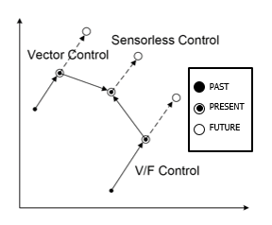
2. Background Information
▶ R&D Trend for Motor Control
- Sensorless Control?
: Control method of motor that estimates the rotor position by calculating without speed or position sensor

Slide 4
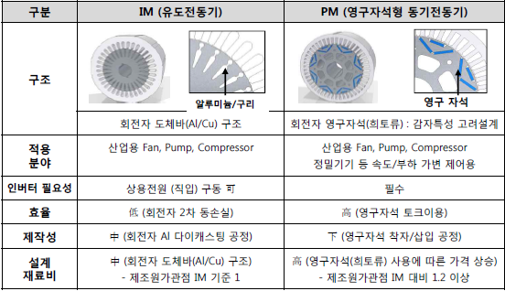
2. Background Information
▶ Difference by types of motors
 | IM (INDUCTION MOTOR) | PM (PERMANENT MAGNET MOTOR)
Structure
 | Rotor Conductor Bar Structure | Rotor Permanent Magnet(Rare Earth Metal)
Application | Industrial Fan, Pump, Compressor, etc. | Industrial Fan, Pump, Compressor Precision Machinery, etc.
Necessity for inverter | Possible to use commercial power (direct connection) | Must use inverter
Efficiency | Low | High
Production Difficulty | Moderate (Rotor AI diecast) | Low (Permanent magnet insertion)
Material Cost | Moderate | High (at least 20% more expensive than IM motor)
Aluminium / Copper
Permanent Magnet

Slide 5
3. S100 PM Sensorless
1-1. Basic Parameters
Code No. | Display | Description
DRV-01 | Cmd Frequency | Command Frequency
DRV-09 | Control Mode | Control Mode(6: PM Sensorless)
DRV-18 | Base Freq | PM motor rated frequency setting
DRV-14 | Motor Capacity | Motor capacity setting
BAS-11 | Pole Number | Number of PM motor’s magnetic pole
BAS-13 | Rated Curr | PM motor’s rated current
BAS-15 | Rated Volt | PM motor’s rated voltage
BAS-16 | Efficiency | Motor efficiency
BAS-20 | Auto Tuning | Motor constant Auto-Tuning
BAS-21 | Rs | stator’s resistance of PM motor
BAS-28 | Ld (PM) | d-axis inductance of PM motor
BAS-29 | Lq (PM) | q-axis inductance of PM motor
BAS-30 | PM Flux Ref | Magnetic flux of PM motor (Counter electromotive force constant)
- Input the motor information and basic operating values.
- All motor information must be properly inputted(DRV-18, BAS-11, BAS-15, etc), before Auto Tuning(BAS-20) is conducted.

Slide 6
3. S100 PM Sensorless
1-2. Performance related Parameter A
Code No. | Display | Description
CON-04 | Carrier Freq | Carrier Frequency
CON-12 | ASR P Gain 1 | Speed controller Proportional gain 1
CON-13* | ASR I Gain 1 | Speed controller Integral gain 1
CON-15* | ASR P Gain 2 | Speed controller Proportional gain 2
CON-16* | ASR I Gain 2 | Speed controller Integral gain 2
CON-33* | PM EdGain Perc | PM d-axis counter electromotive force gain percentage
CON-34* | PM EqGain Perc | PM q-axis counter electromotive force gain percentage
CON-39* | PMdeadBand Per | PM dead time compensation band
CON-40* | PMdeadVolt Per | PM dead time compensation voltage
CON-41* | PM SpdEst Kp | Speed estimator proportional gain
CON-42* | PM SpdEst Ki | Speed estimator integral gain
CON-43* | PM SpdEst Kp 2 | Speed estimator proportional gain 2
CON-44* | PM SpdEst Ki 2 | Speed estimator integral gain 2
CON-48* | ACR P-Gain | Voltage controller proportional gain
CON-49* | ACR I-Gain | Voltage controller integral gain
CON-54 | FWD +Trq Limit | Forward (+) torque limit
CON-55 | FWD –Trq Limit | Forward (-) torque limit
CON-56 | REV +Trq Limit | Reverse (+) torque limit
CON-57 | REV –Trq Limit | Reverse (-) torque limit
* DRV-09 PM Sensorless Selection can be set through Keypad

Slide 7
3. S100 PM Sensorless
1-3. Initial angular estimation related parameter
Code No. | Display | Description
CON-35 | PD Repeat Num | Number of trial for estimation of magnetic pole’s initial angle
CON-36 | Pulse Interval | Current application time for estimation of magnetic pole’s initial angle
CON-37 | Pulse Curr % | Current magnitude for estimation of magnetic pole’s initial angle
CON-38 | Pulse Volt % | Voltage for estimation of magnetic pole’s initial angle
CON-46 | Init Angle Sel | Estimation Option for magnetic pole’s initial angle
1-4. Field-weakening control related parameter
Code No. | Display | Description
CON-50 | V Con HR | Voltage controller standard
CON-51 | V Con Ki | Voltage controller gain(Ki)

Slide 8
4. S100 S/L Mode Parameter Comparison
A. IM motor sensorless control mode parameter
 | Code No. | Title | Description
C. Performance Related Parameter | CON-04 | Carrier Freq | Carrier Frequency [kHz]
 | CON-09 | PreEX Time | Pre-excite Time
 | CON-10 | Flux Force | Pre-excite Flux Force
 | CON-20 | SL2 G View Sel | Sensorless 2nd gain view setting
 | CON-21 | ASR-SL P Gain1 | Sensorless Speed controller Proportional Gain1
 | CON-22 | ASR-SL I Gain1 | Sensorless Speed controller Integral Gain1
 | CON-23 | ASR-SL P Gain2 | Sensorless Speed controller Proportional Gain2
 | CON-24 | ASR-SL I Gain2 | Sensorless Speed controller Integral Gain2
 | CON-26 | Flux P Gain | Magnetic Flux Estimator Proportional Gain
 | CON-27 | Flux I Gain | Magnetic Flux Estimator Integral Gain
 | CON-28 | S-Est P Gain1 | Speed Estimator Proportional Gain1
 | CON-29 | S-Est I Gain1 | Speed Estimator Integral Gain1
 | CON-30 | S-Est I Gain2 | Speed Estimator Integral Gain2
 | CON-31 | ACR SL P Gain | Sensorless Current Controller Proportional Gain
 | CON-32 | ACR SL I Gain | Sensorless Current Controller Integral Gain
 | CON-52 | Torque Out LPF | Torque Controller Output Filter
 | CON-53 | Torque Lmt Src | Source Setting Option for Torque Limit
 | CON-54 | FWD + Trq Lmt | Forward (+) Torque Limit
 | CON-55 | FWD - Trq Lmt | Forward (-) Torque Limit
 | CON-56 | REV + Trq Lmt | Reverse (+) Torque Limit
 | CON-57 | REV - Trq Lmt | Reverse (-) Torque Limit
 | CON-91 | SL Volt Comp1 | Sensorless Voltage Compensation1
 | CON-92 | SL Volt Comp2 | Sensorless Voltage Compensation2
 | CON-93 | SL Volt Comp3 | Sensorless Voltage Compensation3
 | Code No. | Title | Description
A. Parameter Settings based on Motor Name plate | DRV-14 | Motor Capacity | Motor Capacity
 | DRV-18 | Bas Freq | Base Frequency
 | DRV-20 | Max Freq | Max Frequency
 | BAS-11 | Pole Number | Number of Poles
 | BAS-12 | Rated Slip | Rated Slip
 | BAS-13 | Rated Curr | Motor's Rated Current
 | BAS-14 | Motor No load Curr | No load Current
 | BAS-15 | Rated Volt | Motor's Rated Voltage
 | BAS-16 | Efficiency | Motor's Efficiency
 | BAS-19 | AC Input Volt | AC Input Voltage
B. Parameter Settings based on PM Motor Tuning | BAS-21 | Rs | Motor Stator Resistance (Ohm)
 | BAS-22 | Lsigma | Leakage Inductance
 | BAS-23 | Ls | Stator Inductance
 | BAS-24 | Tr | Rotor Time Constant
 | BAS-25 | Ls Scale | Stator Inductance Scale
 | BAS-26 | Tr Scale | Rotor Time Constant Scale
 | BAS-31 | Ls Regen Scale | Regeneration Inductance Scale

Slide 9
4. S100 S/L Mode Parameter Comparison
B. Synchronous motor sensorless control mode parameter
 | Code No. | Title | Description
A. Parameter Settings based on Motor Name plate | DRV-14 | Motor Capacity | Motor Capacity
 | DRV-18 | Bas Freq | Base Frequency
 | DRV-20 | Max Freq | Max Frequency
 | BAS-11 | Pole Number | Number of Poles
 | BAS-13 | Rated Curr | Motor's Rated Current
 | BAS-15 | Rated Volt | Motor's Rated Voltage
 | BAS-16 | Efficiency | Motor's Efficiency
 | BAS-19 | AC Input Volt | AC Input Voltage
B. Parameter Settings based on PM Motor Tuning | BAS-21 | Rs | Motor Stator Resistance (Ohm)
 | BAS-28 | Ld (PM) | PM d axis Inductace(mH)
 | BAS-29 | Lq (PM) | PM q axis Inductace(mH)
 | BAS-30 | PM Flux Ref | PM Counter Electromotive Force Constant(WB)
C. Performance Related Parameter | CON-04 | Carrier Freq | Carrier Frequency [kHz]
 | CON-12 | ASR P Gain1 | PM S/L Speed Controller Proportional Gain1
 | CON-13 | ASR I Gain1 | PM S/L Speed Controller Integral Gain1
 | CON-15 | ASR P Gain2 | PM S/L Speed Controller Proportional Gain2
 | CON-16 | ASR I Gain2 | PM S/L Speed Controller Integral Gain2
 | CON-33 | PM EdGain Perc | PM d axis Counter Electromotive Force %
 | CON-34 | PM EqGain Perc | PM q axis Counter Electromotive Force %
 | CON-39 | PM Dead Band Per | PM dead time compensation band
 | CON-40 | PM Dead Volt Per | PM dead time compensation voltage
 | CON-41 | PM SpdEst Kp | Speed estimator proportional gain
 | CON-42 | PM SpdEst Ki | Speed estimator integral gain
 | CON-43 | PM SpdEst Kp2 | Speed estimator proportional gain 2
 | CON-44 | PM SpdEst Ki2 | Speed estimator integral gain 2
 | CON-45 | PM Flux FF % | PM S/L speed estimator feed forward
 | CON-46 | Init Angle Sel | Estimation Option for magnetic pole’s initial angle
 | CON-48 | ACR P-Gain | Voltage controller proportional gain
 | CON-49 | ACR I-Gain | Voltage controller integral gain
 | CON-50 | V Con HR | Voltage controller standard
 | CON-51 | V Con Ki | Voltage controller gain(Ki)

Slide 10
1. S100 PM S/L
4. S100 S/L Mode Parameter Comparison
C. PM Sensorless related Parameter setting
 | Code No. | Title | Description | PM Motor 1 | PM Motor 2 | PM Motor 3 | Parameter Change
A. Parameter Settings based on Motor Name plate | DRV-14 | Motor Capacity | Motor Capacity | 3.7kW-2 | 3.7kW-4 | 7.5kW-4 | O
 | DRV-18 | Bas Freq | Base Frequency | 72.5Hz | 87.5Hz | 150Hz | O
 | DRV-20 | Max Freq | Max Frequency | 87Hz | 105Hz | 180Hz | O
 | BAS-11 | Pole Number | Number of Poles | 6 | 6 | 10 | O
 | BAS-13 | Rated Curr | Motor's Rated Current | 13.6A | 7.2A | 11.7A | O
 | BAS-15 | Rated Volt | Motor's Rated Voltage | 185V | 368V | 460V | O
 | BAS-16 | Efficiency | Motor's Efficiency | 94% | 90% | 94% | O
 | BAS-19 | AC Input Volt | AC Input Voltage | 220V | 380V | 469V | O
B. Parameter Settings based on PM Motor Tuning | BAS-21 | Rs | Motor Stator Resistance (Ohm) | 0.47 | 1.2 | 0.48 | O
 | BAS-28 | Ld (PM) | PM d axis Inductace(mH) | 6.2 | 16.8 | 9.3 | O
 | BAS-29 | Lq (PM) | PM q axis Inductace(mH) | 11.6 | 29.8 | 11.1 | O
 | BAS-30 | PM Flux Ref | PM Counter Electromotive Force Constant(WB) | 0.331 | 0.546 | 0.398 | O
C. Performance Related Parameter | CON-04 | Carrier Freq | Carrier Frequency [kHz] | 5 | 5 | 5
 | CON-12 | ASR P Gain1 | PM S/L Speed Controller Proportional Gain1 | 150 | 140 | 140 | O
 | CON-13 | ASR I Gain1 | PM S/L Speed Controller Integral Gain1 | 200 | 260 | 260 | O
 | CON-15 | ASR P Gain2 | PM S/L Speed Controller Proportional Gain2 | 150 | 150 | 125 | O
 | CON-16 | ASR I Gain2 | PM S/L Speed Controller Integral Gain2 | 200 | 200 | 260 | O
 | CON-33 | PM EdGain Perc | PM d axis Counter Electromotive Force % | 100% | 100% | 100%
 | CON-34 | PM EqGain Perc | PM q axis Counter Electromotive Force % | 100% | 100% | 100%
 | CON-41 | PM SpdEst Kp | Speed estimator proportional gain | 100 | 100 | 100
 | CON-42 | PM SpdEst Ki | Speed estimator integral gain | 10 | 10 | 10
 | CON-43 | PM SpdEst Kp2 | Speed estimator proportional gain 2 | 300 | 300 | 300
 | CON-44 | PM SpdEst Ki2 | Speed estimator integral gain 2 | 30 | 30 | 30
 | CON-45 | PM Flux FF % | PM S/L speed estimator feed forward | 300% | 300% | 600% | O
 | CON-46 | Init Angle Sel | Estimation Option for magnetic pole’s initial angle | 0 | 0 | 0
 | CON-48 | ACR P-Gain | Voltage controller proportional gain | 1200 | 1200 | 1200
 | CON-49 | ACR I-Gain | Voltage controller integral gain | 120 | 120 | 120
 | CON-50 | V Con HR | Voltage controller standard | 14% | 0.14 | 0.14
 | CON-51 | V Con Ki | Voltage controller gain(Ki) | 20 | 20 | 20

Slide 11
1. S100 PM S/L
5. Sensorless Vector Control Troubleshooting Guide
Problem | Related Parameter | Solution
Starting torque is insufficient | CON-48 : ACR P-Gain | If “OCT” triggers at start, gradually lower the CON-48 by 10
Output current is oscillation or torque is insufficient at low speed below 10Hz | CON-04 : Carrier Freq CON-12 : ASR P Gain 1 CON-13 : ASR I Gain 1 | - When output current is oscillates at low speed, gradually increase CON-13 value by 50msec, and if the output current does not oscillates gradually increase CON-12 value by 10% to find optimum condition When there are oscillation in output current and insufficient torque at 5~10Hz, gradually lower CON-04 by 1kHz. (when set above 3kHz)
“OVT” at medium speed(above 30Hz) due to rapid acceleration / deceleration or abrupt load variation. ¹⁾ | CON-16 : ASR I Gain 2 | - Gradually lower CON-16 value by 5%
BAS-30 PM Flux Ref value changes to 0, after auto tuning via BAS-20 Auto Tuning “7: All (PM)” | BAS-15 : Rated Volt DRV-18 : Base Freq | Input BAS-15 : Rated Volt & DRV-18 : Base Freq in accordance with the motor plate information. Then, re-try BAS-20 Auto Tuning
Stationary auto tuning does not operate in accordance with parameter and triggers trip | BAS-21 : Rs BAS-28 : Ld (PM) BAS-29 : Lq (PM) BAS-30 : PM Flux Ref | If the stationary PM auto tuning is not performed correctly, the parameter inaccuracy may cause failure, so operate with the given information on motor name plate.
1) When DB resistor is not connected

Slide 12
1. S100 PM S/L
5. Sensorless Vector Control Troubleshooting Guide
Problem | Related Parameter | Solution
Speed fluctuates under overload condition in high speed operation | BAS-29 : Lq (PM) BAS-45 : PM Flux FF % CON-50 : V Con HR CON-51 : V Con Ki | - For rated speed, increase CON-50 gradually by 5%, and if the response is slow increase CON-51 gradually by 5% Gradually increase CON-45 by 100% (PM S/L speed estimator feed forward) - Gradually decrease BAS-29: Lq (PM) value by 5% - In case of rated speed, gradually increase CON-50 by 5%, and if the response is slow, gradually increase CON-51 by 5%
OC1 trip and/or oscillation occurs In high speed operation | CON-41 : PM SpdEst Kp CON-42 : PM SpdEst Ki | Gradually increase CON-41 value by 10 and CON-42 by 1. Caution should be taken, for too high value in the CON-41 or/and CON-42 may cause trip at start-up.
Speed oscillation occurs in low speed operation | CON-13 : ASR I Gain 1 | - Increase the value of the integral controller gain CON-13 in the low-speed zone speed controller to reduce oscillation.
Rattling sound right after starting-up or after decelerating to stop. | CON-12 : ASR P Gain 1 CON-13 : ASR I Gain 1 | - Increase CON-12 and CON-13 by 10%
Current speed is below the target speed at a speed higher than the rated speed, or if the speed response is slow | CON-50 : V Con HR CON-51 : V Con Ki | - If the target speed is not met, increase CON-50 1% by 1%. - If the speed response is slow, increase CON-51 : V Con Ki by 10% gradually
OC1 trip triggers after a sudden regenerated load(above 100%) at low speed is applied and exit | CON-12 : ASR P Gain 1 CON-13 : ASR I Gain 1 | - Decrease CON-12, CON-13 by 10%
Oscillation occurs while accelerating | BAS-30 : PM Flux Ref CON-42 : PM SpdEst Ki | - Increase CON-30 value 10% by 10% or increase CON-42 integral gain 5 by 5 to reduce influence from speed estimator feed forward by counter electromotive force constant

Slide 13
1. S100 PM S/L
5. Sensorless Vector Control Troubleshooting Guide
Problem | Related Parameter | Solution
Stop along with large current flow at the beginning stage of 20:1 speed start-up | CON-13 : ASR I Gain 1 | Gradually increase CON-13 by 10%
Oscillation occurs when sudden load is applied at low speed zone | CON-41 : PM SpdEst Kp CON-42 : PM SpdEst Ki | Gradually increase CON-41, CON-42 by 10%
OC1 triggers at start-up above rated speed under overload on the load side | BAS-28 : Ld (PM) BAS-29 : Lq (PM) | If BAS-28, BAS-29 value is higher than those of motor name plate, decrease BAS-28, BAS-29 value 1 by 1.

Slide 14
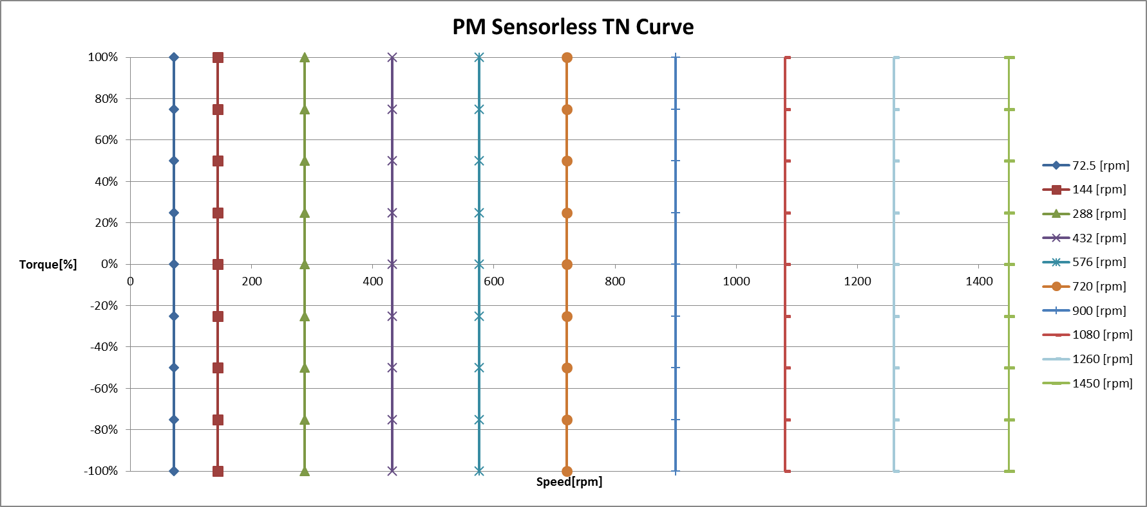
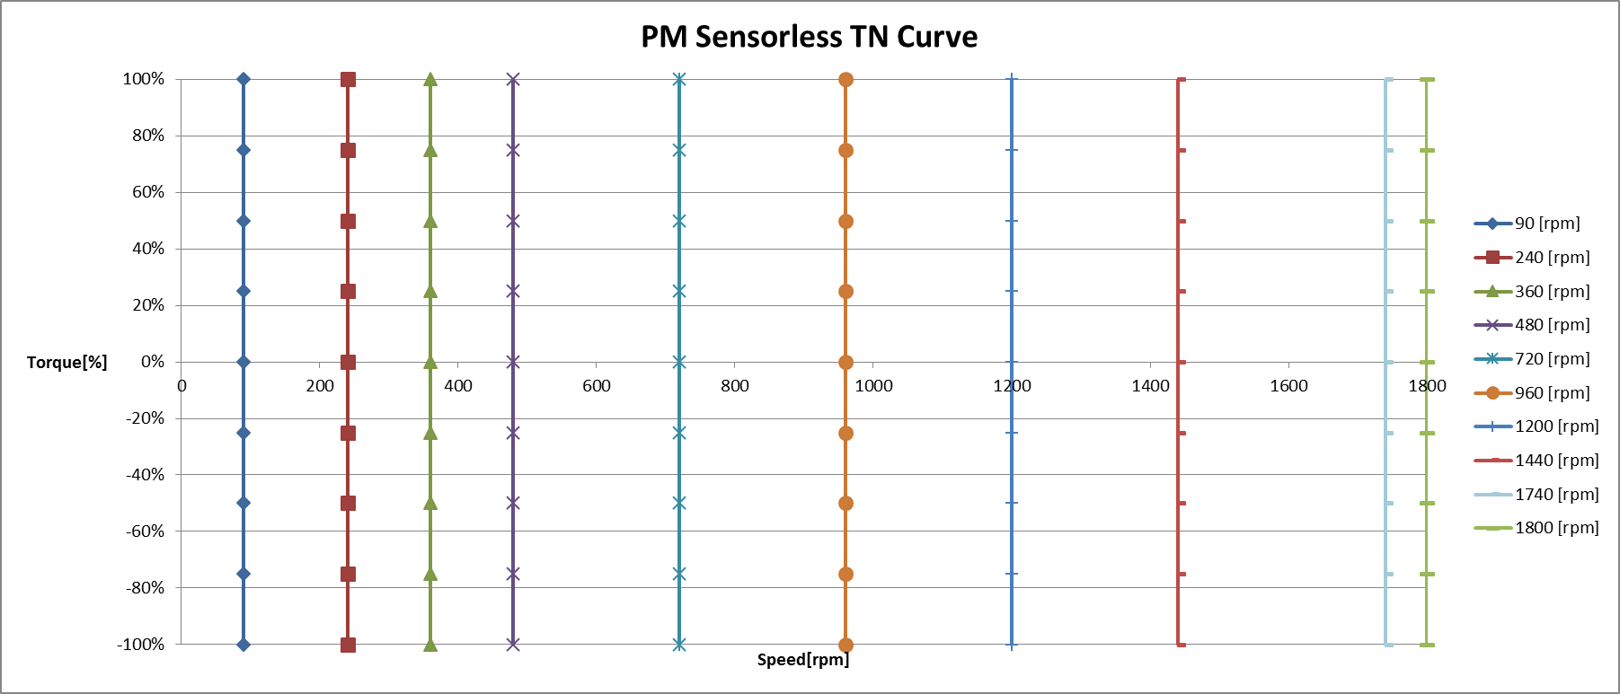
1. S100 PM S/L
6. PM Sensorless Test Reference
[ Y company Motor Test]
0.75kW-4 no load OK
3.7kW-2 OK
3.7kW-4 OK
[ M company Motor Test]
3.7kW-2 OK
3.7kW-4 OK
7.5kW-2 OK
7.5kW-4 OK
[ M company Motor Test]
2.2kW-4 OK
7.5kW-4 OK
22kW-4 OK
[Yaskawa 3.7kW-2 TN Curve]
[Marathon 7.5kW-4 TN Curve]

Slide 15
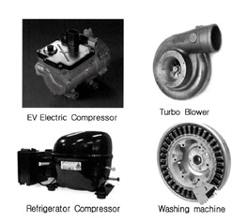
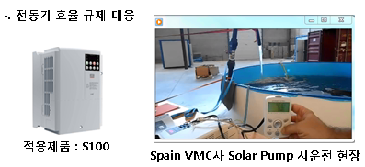
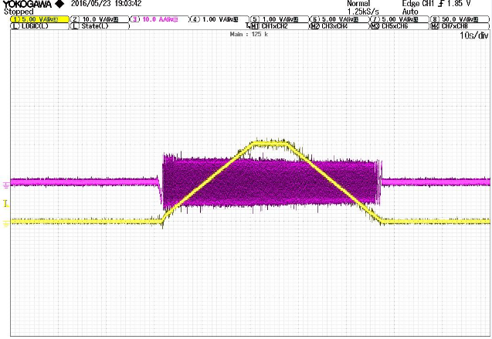
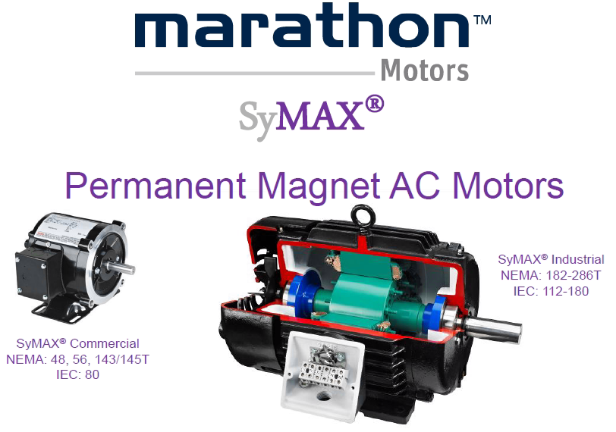
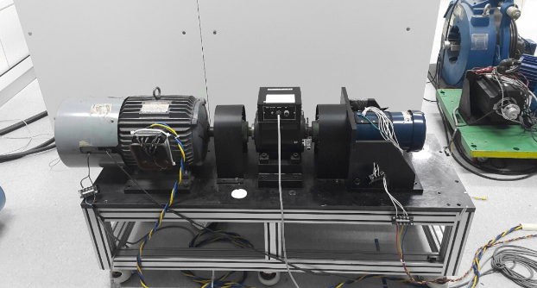
1. S100 PM S/L
6. PM Sensorless Test Reference
[Spain VMC company Pump Test]
[PM S/L reference]
Applied Product
Filed Test at Solar Pump in Spain (VMC)
[ North America, Motor 2.2kW, 7.5kW, 22kW Test with 100% load] → S100 Benshaw BL
Ch1 | Out Freq | 45 [Hz/div]
Ch3 | Out Current | 10 [A/div]
[Marathon 2.2kW-4 MG Set]
[Marathon 2.2kW 100% Load 기동 Test]

