Slide 1
Siemens S7 PLC – LS iS7 Profibus Set up Guide
2013. 11. 29
LSIS Global Support Team

Slide 2
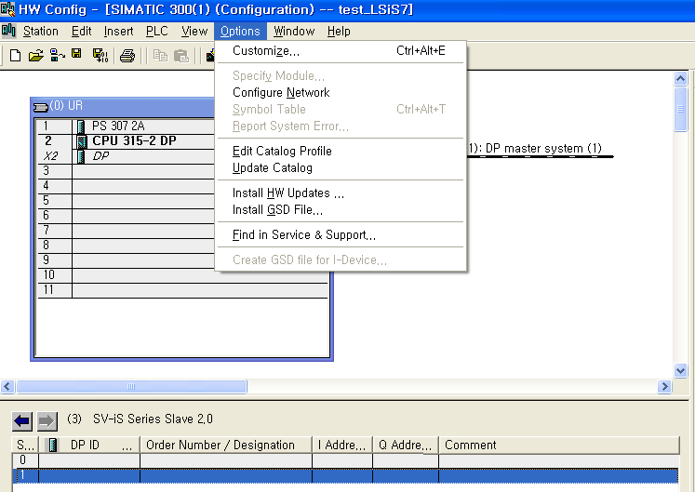
Siemens S7 Hardware Configuration ( ex. Send 8 Word – Receive 8 Word )
1) LS iS7 drive GSD file update to Install GSD file

Slide 3
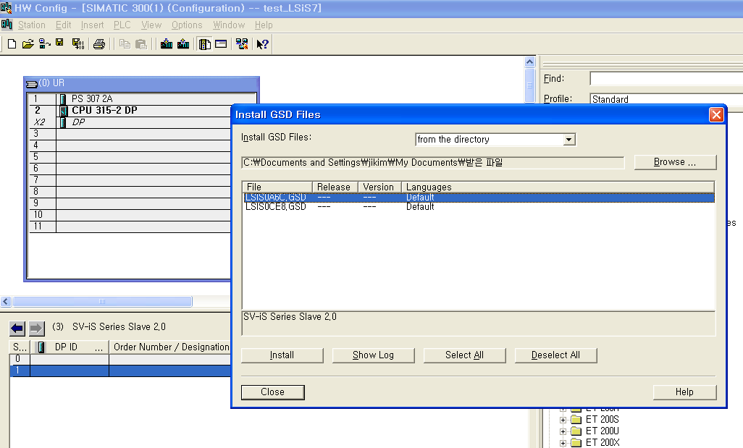
Siemens S7 Hardware Configuration ( ex. Send 8 Word – Receive 8 Word )
1) LS iS7 drive GSD file update to Install GSD file
1.
2.

Slide 4
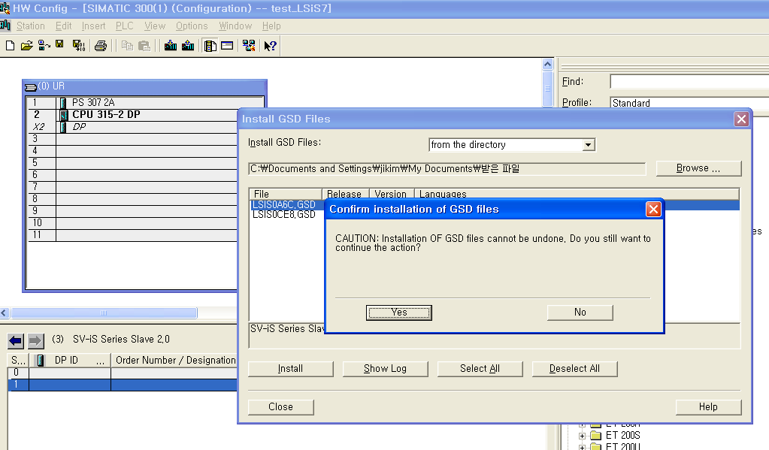
Siemens S7 Hardware Configuration ( ex. Send 8 Word – Receive 8 Word )
1) LS iS7 drive GSD file update to Install GSD file
1.

Slide 5
Siemens S7 Hardware Configuration ( ex. Send 8 Word – Receive 8 Word )
1) LS iS7 drive GSD file update to Install GSD file
1.

Slide 6
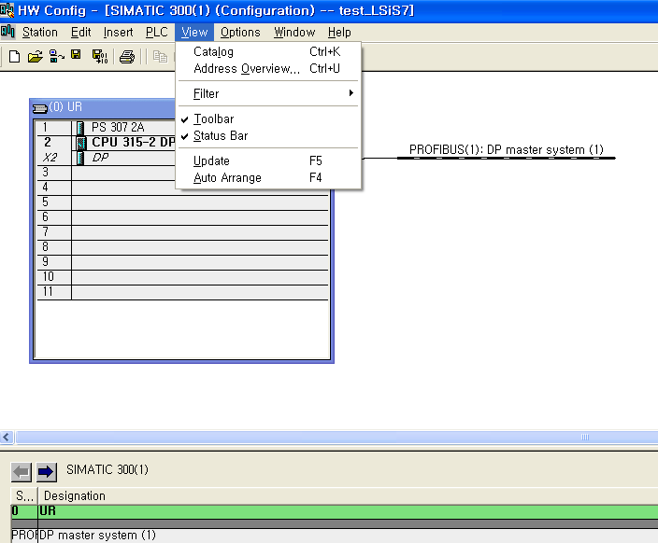
Siemens S7 Hardware Configuration ( ex. Send 8 Word – Receive 8 Word )
1) LS iS7 drive GSD file update to Install GSD file
1. [Menu] -> [View] -> [Catalog]

Slide 7
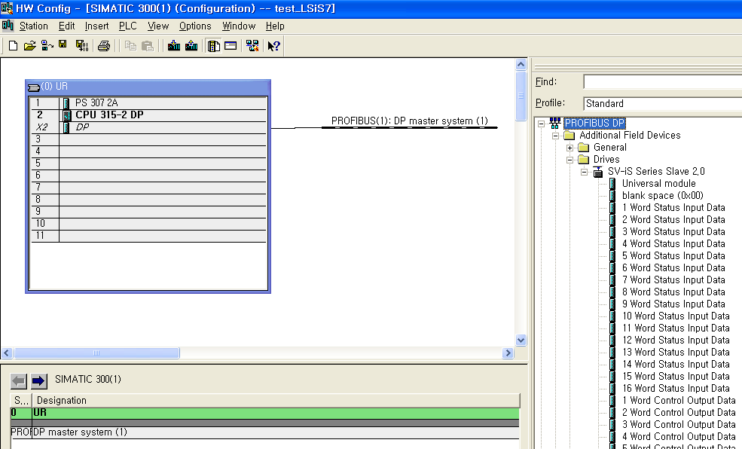
Siemens S7 Hardware Configuration ( ex. Send 8 Word – Receive 8 Word )
1) LS iS7 drive GSD file update to Install GSD file
PROFIBUS DP – Additional Field Devices
Drives
SV-IS Series Slave 2.0

Slide 8
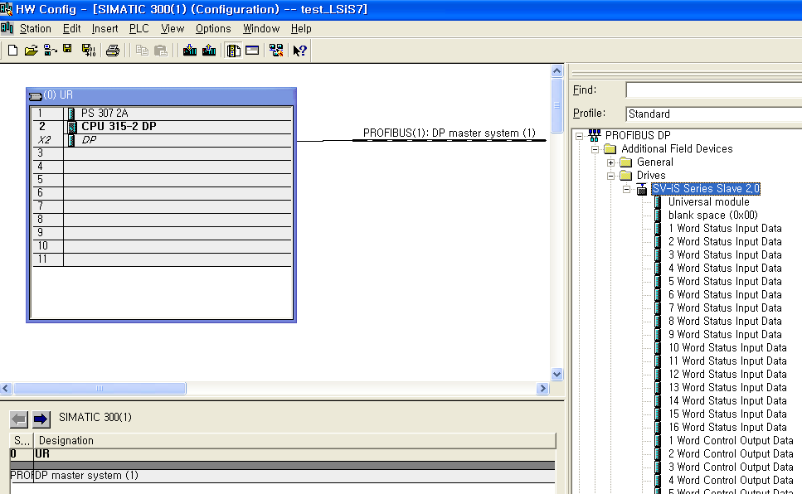
Siemens S7 Hardware Configuration ( ex. Send 8 Word – Receive 8 Word )
2) LS iS7 Hardware configuration & Address mapping
Drag to PROFIBUS(1) : DP Master system(1)

Slide 9
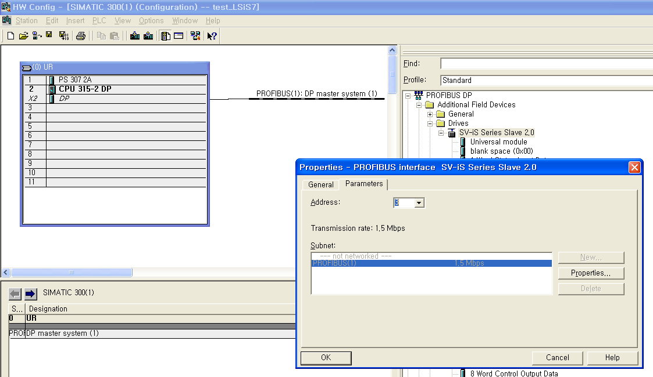
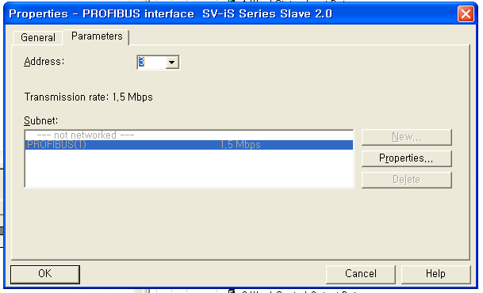
Siemens S7 Hardware Configuration ( ex. Send 8 Word – Receive 8 Word )
2) LS iS7 Hardware configuration & Address mapping
Address matches iS7 station No.

Slide 10
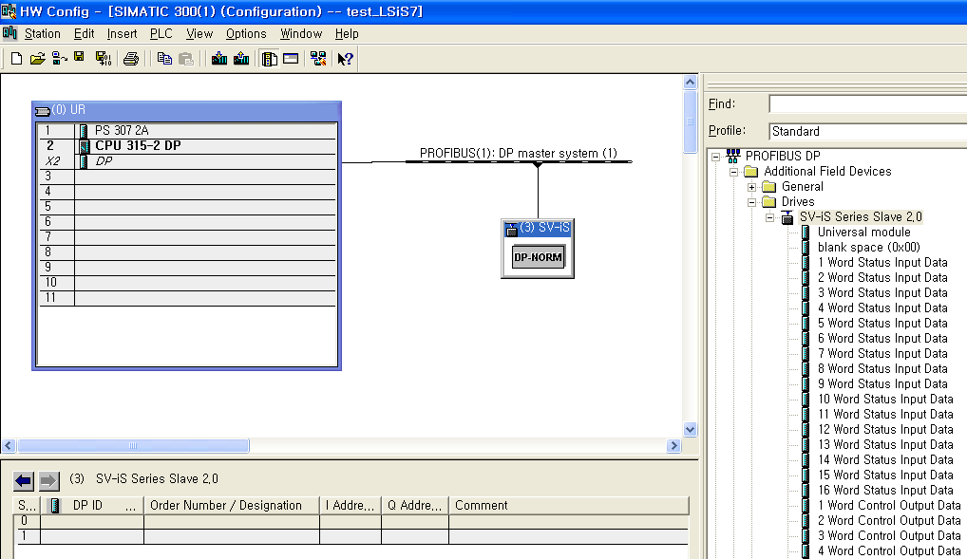
Siemens S7 Hardware Configuration ( ex. Send 8 Word – Receive 8 Word )
2) LS iS7 Hardware configuration & Address mapping

Slide 11
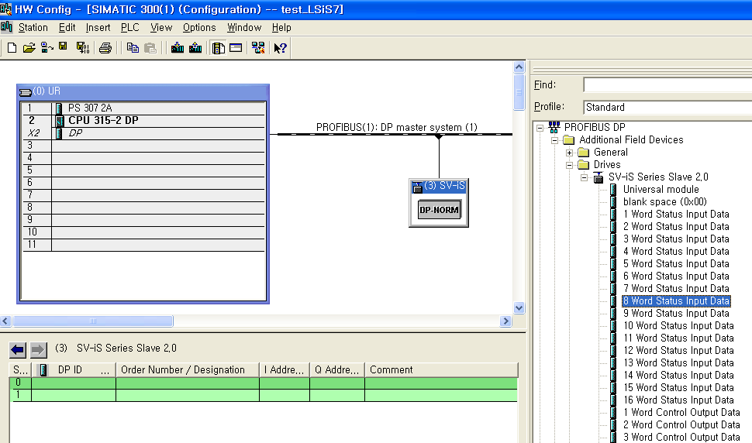
Siemens S7 Hardware Configuration ( ex. Send 8 Word – Receive 8 Word )
2) LS iS7 Hardware configuration & Address mapping
1.Double click
2.

Slide 12
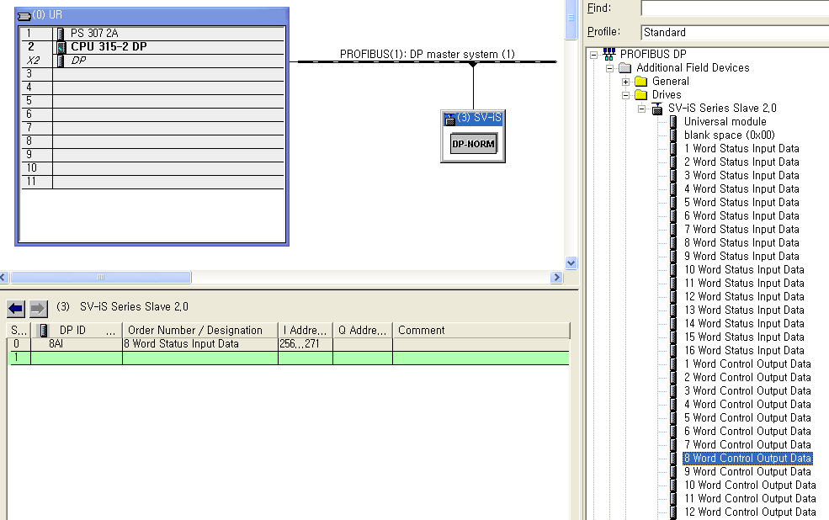
Siemens S7 Hardware Configuration ( ex. Send 8 Word – Receive 8 Word )
2) LS iS7 Hardware configuration & Address mapping
3. 256...271 means 16 byte = 8 word
2. I / Q Address mapping
1. Double Click

Slide 13
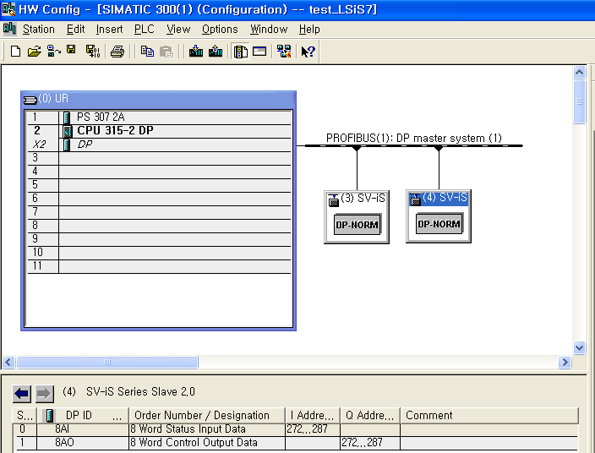
Siemens S7 Hardware Configuration ( ex. Send 8 Word – Receive 8 Word )
2) LS iS7 Hardware configuration & Address mapping
1. The way of the setting for the additional drive will be same.

Slide 14
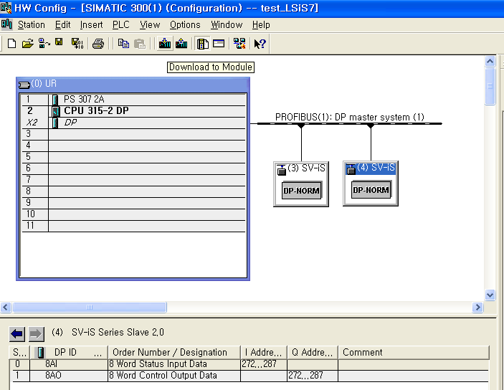
Siemens S7 Hardware Configuration ( ex. Send 8 Word – Receive 8 Word )
2) LS iS7 Hardware configuration & Address mapping
1. Configuration finished then Download to Module execute.

Slide 15
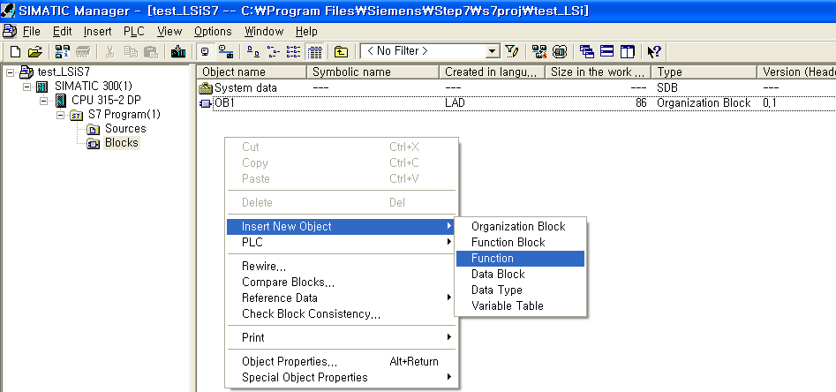
Siemens S7 Hardware Configuration ( ex. Send 8 Word – Receive 8 Word )
3) Siemens S7 to LS iS7 Communication example program
Select Insert New Object
Addition Function

Slide 16
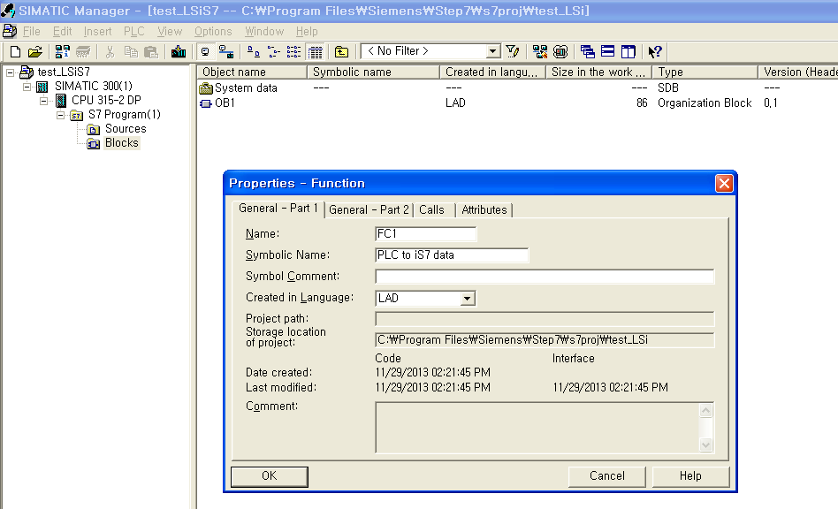
Siemens S7 Hardware Configuration ( ex. Send 8 Word – Receive 8 Word )
3) Siemens S7 to LS iS7 Communication example program

Slide 17
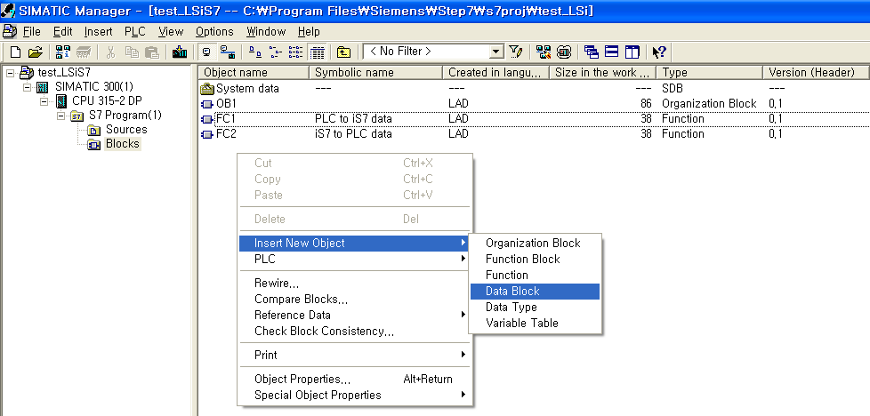
Siemens S7 Hardware Configuration ( ex. Send 8 Word – Receive 8 Word )
3) Siemens S7 to LS iS7 Communication example program
Also make a Data Block

Slide 18
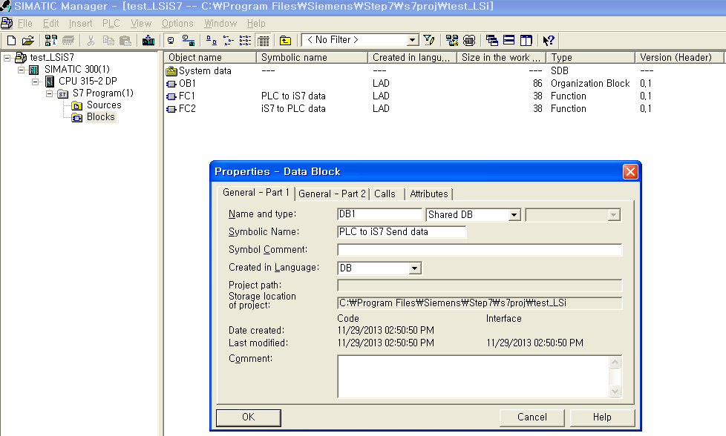
Siemens S7 Hardware Configuration ( ex. Send 8 Word – Receive 8 Word )
3) Siemens S7 to LS iS7 Communication example program

Slide 19
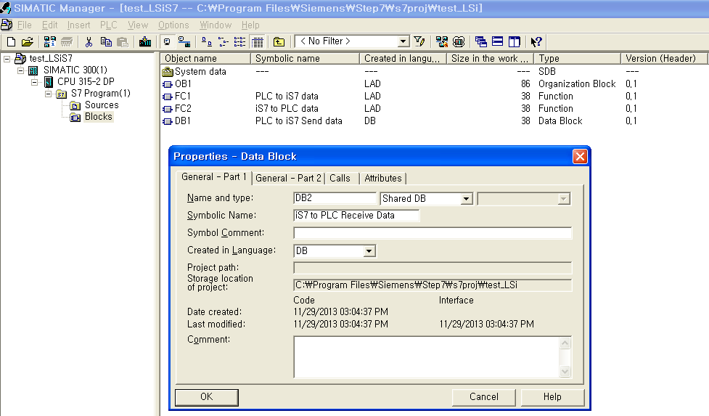
Siemens S7 Hardware Configuration ( ex. Send 8 Word – Receive 8 Word )
3) Siemens S7 to LS iS7 Communication example program

Slide 20
Siemens S7 Hardware Configuration ( ex. Send 8 Word – Receive 8 Word )
3) Siemens S7 to LS iS7 Communication example program

Slide 21
Siemens S7 Hardware Configuration ( ex. Send 8 Word – Receive 8 Word )
3) Siemens S7 to LS iS7 Communication example program
1. OB1 Double click

Slide 22
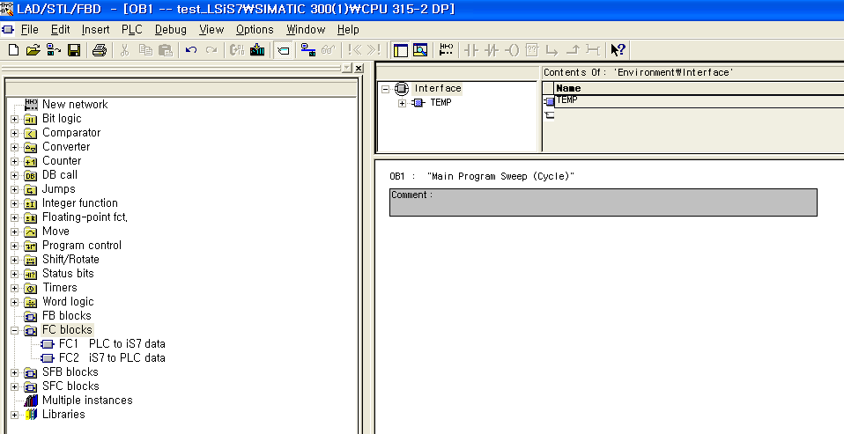
Siemens S7 Hardware Configuration ( ex. Send 8 Word – Receive 8 Word )
3) Siemens S7 to LS iS7 Communication example program
Click FC blocks menu

Slide 23
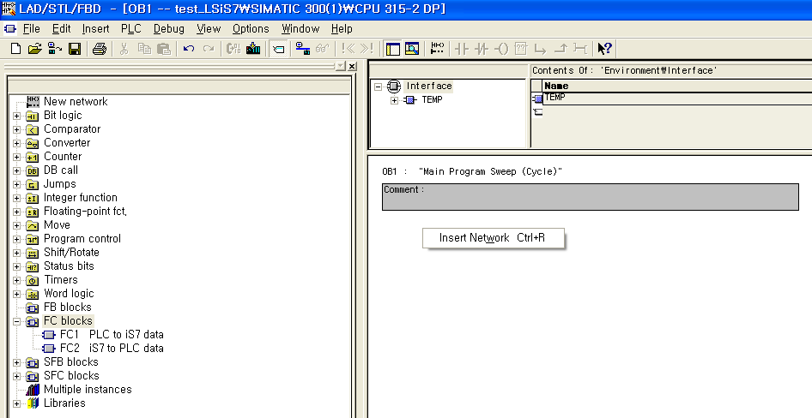
Siemens S7 Hardware Configuration ( ex. Send 8 Word – Receive 8 Word )
3) Siemens S7 to LS iS7 Communication example program
Right mouse point Click -> Insert Network Ctrl+R

Slide 24
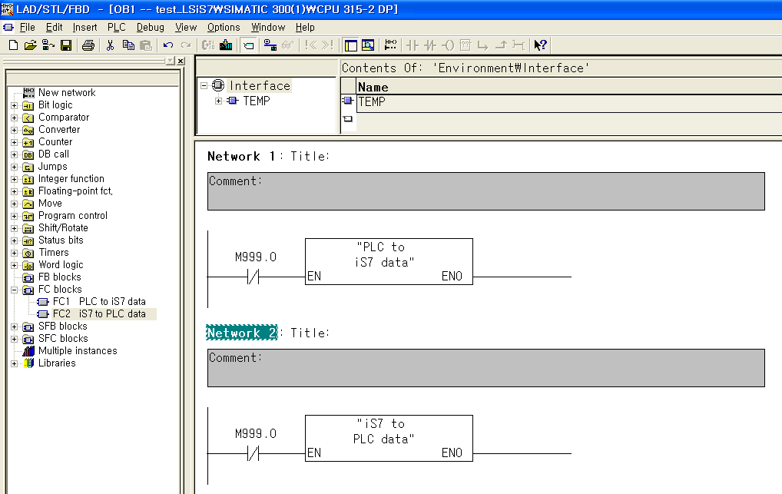
Siemens S7 Hardware Configuration ( ex. Send 8 Word – Receive 8 Word )
3) Siemens S7 to LS iS7 Communication example program
Drag to FC block
Drag to FC block
OB1 Program finished.

Slide 25
Siemens S7 Hardware Configuration ( ex. Send 8 Word – Receive 8 Word )
3) Siemens S7 to LS iS7 Communication example program
FC1 Function Open

Slide 26
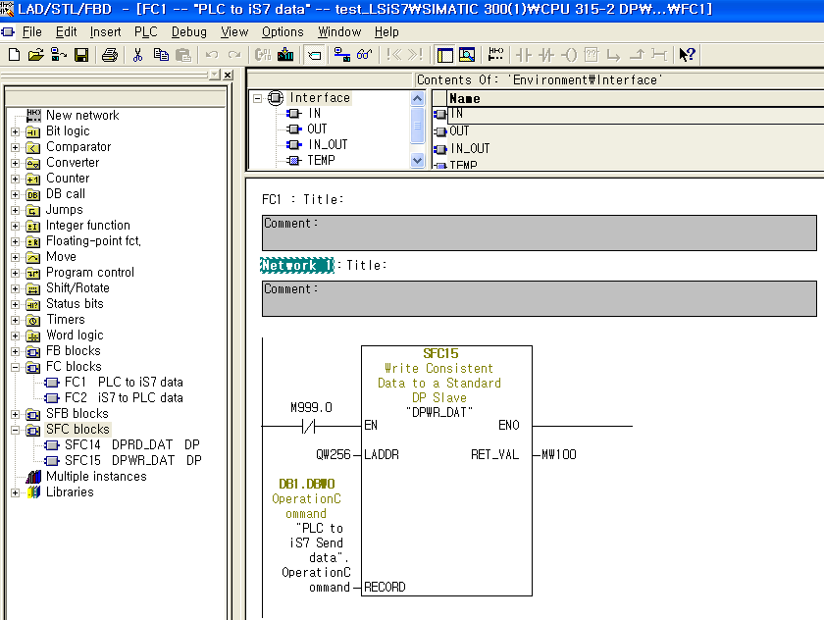
Siemens S7 Hardware Configuration ( ex. Send 8 Word – Receive 8 Word )
3) Siemens S7 to LS iS7 Communication example program
This Address Hardware configuration first address

Slide 27
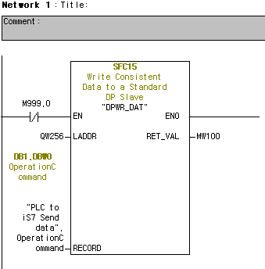
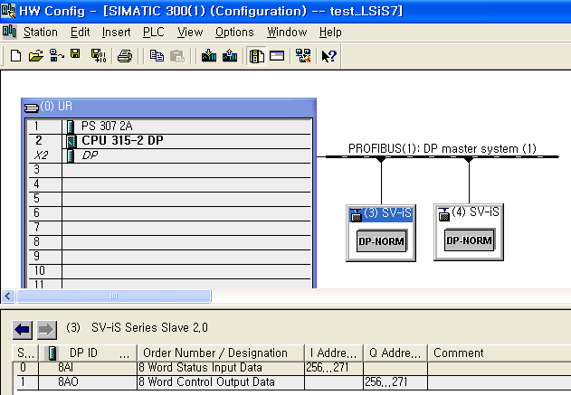
Siemens S7 Hardware Configuration ( ex. Send 8 Word – Receive 8 Word )
3) Siemens S7 to LS iS7 Communication example program

Slide 28
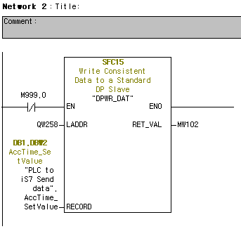
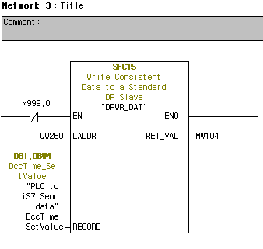
Siemens S7 Hardware Configuration ( ex. Send 8 Word – Receive 8 Word )
3) Siemens S7 to LS iS7 Communication example program
1. PLC S7 – iS7 Control word is 8Word so you make 8ea of SFC15 function
2. You need to make a DB ( Data block ) below ;

Slide 29
Siemens S7 Hardware Configuration ( ex. Send 8 Word – Receive 8 Word )
3) Siemens S7 to LS iS7 Communication example program
Double click
Change Name & comment

Slide 30
Siemens S7 Hardware Configuration ( ex. Send 8 Word – Receive 8 Word )
3) Siemens S7 to LS iS7 Communication example program
Double click
Change Name, comment & Data type

Slide 31
Siemens S7 Hardware Configuration ( ex. Send 8 Word – Receive 8 Word )
3) Siemens S7 to LS iS7 Communication example program
FC2 Function Open

Slide 32
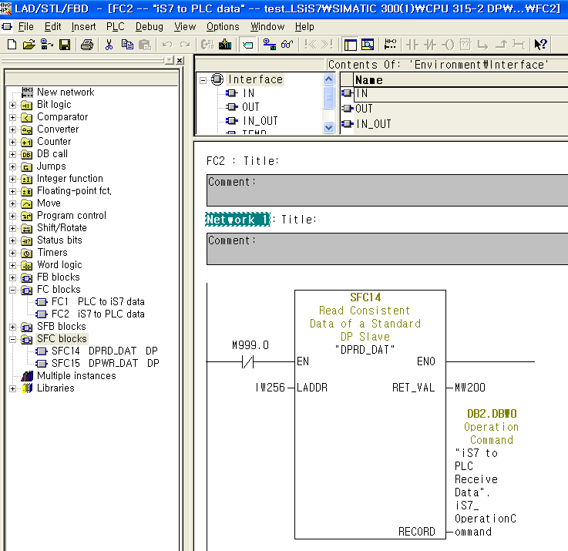
Siemens S7 Hardware Configuration ( ex. Send 8 Word – Receive 8 Word )
3) Siemens S7 to LS iS7 Communication example program
This Address Hardware configuration first address
iS7 status data ( Current, status bit data...etc.

Slide 33
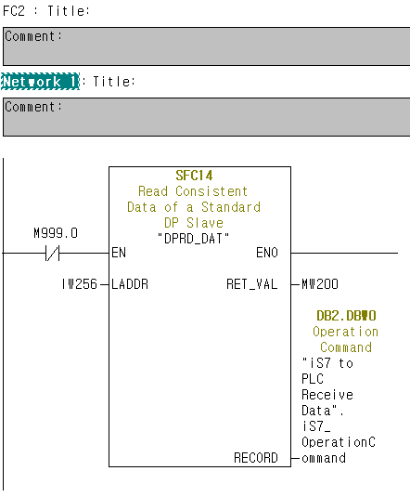
Siemens S7 Hardware Configuration ( ex. Send 8 Word – Receive 8 Word )
3) Siemens S7 to LS iS7 Communication example program
Record means use iS7 Status data for your program

Slide 34
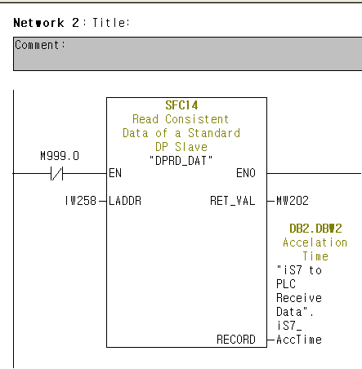
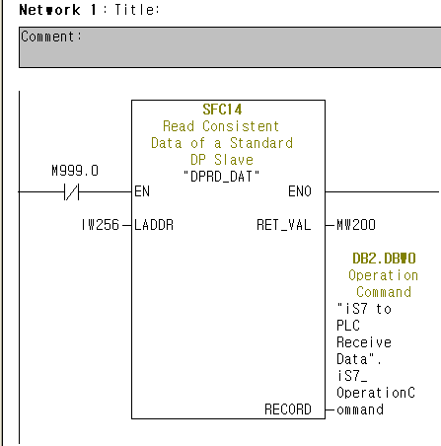
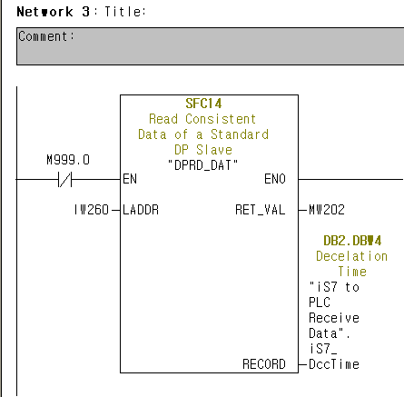
Siemens S7 Hardware Configuration ( ex. Send 8 Word – Receive 8 Word )
3) Siemens S7 to LS iS7 Communication example program
1. iS7 Status word is 8Word so you make 8ea of SFC14 function
Cause : SFC14, 15 Function block RET_VAL must different value

Slide 35
Siemens S7 Hardware Configuration ( ex. Send 8 Word – Receive 8 Word )
3) Siemens S7 to LS iS7 Communication example program
Double click
Change Name, comment & Data type

Slide 36
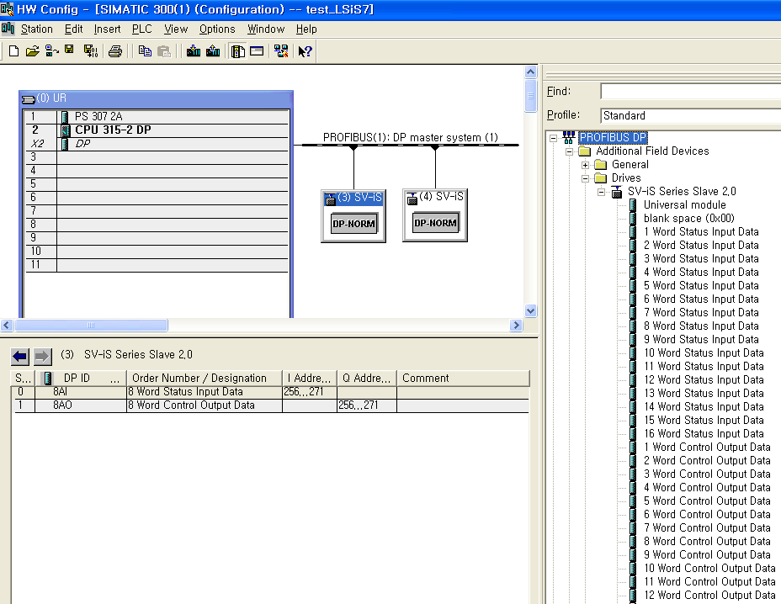
Siemens S7 Hardware Configuration ( ex. Send 8 Word – Receive 8 Word )
4) Siemens S7 to LS iS7 Communication Caution
Change Profibus word data length then Hardware configuration download
Also, iS7 Profibus com update function execute then also PLC configuration download

Slide 37
Siemens S7 Hardware Configuration ( ex. Send 8 Word – Receive 8 Word )
4) Siemens S7 to LS iS7 Communication Caution
Change Profibus word data length then FC1, FC2 function block change
Change Profibus word data length then Must all program & system data write.

Slide 38
Siemens S7 Hardware Configuration ( ex. Send 8 Word – Receive 8 Word )
Thank you !!!
If you have question, send the mail below address.
jikim@lsis.biz

